Slide 1
SKIN PREP

Slide 2
Purpose
Reduce the number of “transient” microbes to the least possible number on the intended operative site (same reason we perform surgical hand scrub)
Rids site of dirt
Rids site of oils
Minimizes microbes to least possible number “irreducible minimum”
Notes:
Skin can’t be sterilized

Slide 3
When to Prep?
Invasive surgical procedures
Traumatic wound care

Slide 4
Goal
Prevent SSI
SSI -an infection of the tissue in or around a surgical wound. To be considered a surgical site infection, the infection must occur within 30 days after surgery.

Slide 5
Action
Mechanical
friction - the rubbing of one object or surface against another
Chemical
antiseptic solution - an antiseptic is a substance which inhibits the growth and development of microorganisms.
Anti = prefix meaning against
septic = containing or resulting from disease-causing organisms

Slide 6
Types of Antiseptics
Alcohol -rapid reduction of microbial count
May use after iodine to provide better adhesion of bio-drape (Ioban)
If on field at start color or clearly label to avoid confusion with other clear medications that may be on the field
Avoid splashing as this is a re-capped solution
FLAMMABLE! Avoid pooling.
Iodine - rapid reduction of microbial count
Remove after 2-3 minutes to avoid skin irritation (dry/blot with sterile towel)
Iodophors - less irritating to skin/no need to remove
Chlorohexidine (Hibiclens)- less rapid reduction of microbial count
Residual effect 4-6 hours
Hexachlorophene (G-11)-can use several days prior to surgery as builds up a lasting or cumulative effect

Slide 7
Prep Sets
Assemble you own: Antiseptic, sponge sticks, sponges, sterile gloves, sterile towels
Prep packs: may or may not contain antiseptics
Single-use applicators: Gel-Preps
Circulator or ST circulator assistant performs betadine scrub prep and may do betadine paint
Surgeon or ST may perform betadine paint after circulator does scrub
Surgeon may just use paint and no scrub

Slide 8
Considerations
Should be “broad spectrum antiseptic”
Should provide “residual or lasting” effect
Patient specific (sensitivities/allergies)
Procedure specific
Surgeon preference
Prevent pooling
Avoid splashing
Avoid eyes, ears, nose

Slide 9
Contaminated Areas
Normally “harbor body fluids or microorganisms”
Broken skin
Avoid mucous membranes:
Sinuses
Mouth
Nose
Vagina
Anus
Stomas (openings: colostomy, etc.)

Slide 10
Contaminated Area: Rules of Thumb
Prep surrounding area first and contaminated area last
Use new sponge each time have passed over contaminated area

Slide 11
Where the Prep Falls in the Sequence of Pre-operative Preparation
Anesthesia administered
Urinary catheter placed
Patient positioned
All pre-operative procedures must occur before the “prep” to prevent contamination of the incision site
Skin prep
Draping of the patient
Intra-operative phase begins with incision or beginning of surgery

Slide 12
Prior to Procedure
Clean surgical site prior to prep prn of dirt, grease, etc.
May need to shave area: electric razor preferable as is less likely to create skin irritation which can open an area exposing to potential infection
Shave should occur as close to time of surgery as possible (surgeon preference if removed)
Remove all hair (use tape prn)
May need to change a draw sheet
Do not want hair floating around and getting in surgical site

Slide 13
Procedure
Basic handwash
Gather supplies:
Prep kit
Sterile gloves (open glove technique for circulator if doing pre-scrub)
Clock with second hand
Clean working surface
Lighting
Trash
Positioning aides prn
Final surgical position achieved prior to prep

Slide 14
Procedure
Area to be prepped exposed
Drip towels or prep pad is placed
Prepare sterile field
Don sterile gloves using open glove technique if you are not a sterile team member
Prep according to situation and area
AVOID grounding pad
May need to have CRNA move EKG electrodes if they are in the area needing to be prepped
Excess prep solution can cause chemical burns to patient’s skin and potentially cause a fire if near area of cautery (spark) or laser (beam)

Slide 15
Situations and Areas of Prep
Rules of thumb:
Prep surgical area beginning with incision site and moving outward in circular motion, include a large area surrounding the surgical incision site
Do not go back!
If axilla, thighs, or pubic areas are involved prep them last
If area is a contaminated area, prep surrounding area first, and contaminated area last

Slide 16
NOTE
Some services: orthopedic, neurosurgical, vascular, thoracic, may require timed scrubs of 5 minutes
ASK if not on preference card

Slide 17
Prep Area: Abdomen
Incision site to nipples and pubis, pubis last
May include upper thighs, still prep groin and pubis last

Slide 18
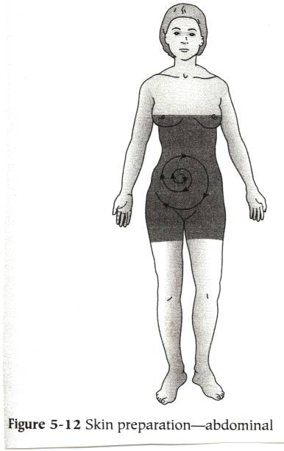

Slide 19
Prep Area: Chest & Breast
Incision site, around to bedline, includes shoulder and axilla
May include arm (rare)

Slide 20
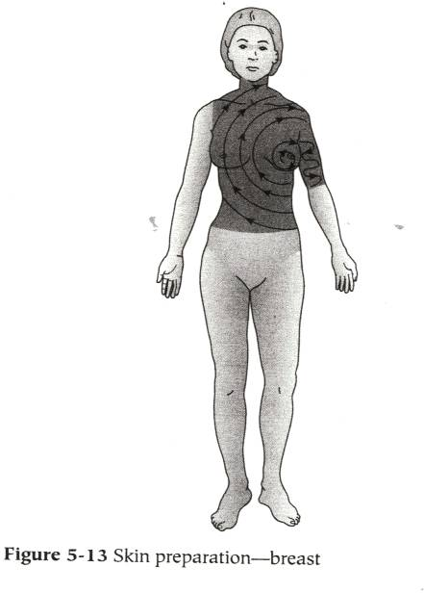

Slide 21
Prep Area: Extremities
Considerations:
Assistant with sterile gloves will grasp extremity after a prepped area has been washed and hold up for prepping
Begin at surgical incision site and move around circumference of extremity, prepping groin or axilla last
Feet or hands will be prepped separate or last if groin or axilla not involved

Slide 22
Prep Area: Extremitites
Leg & Hip
Foot & Ankle: foot and entire leg ankle to knee
Hip: hip, abdomen on affected side, entire leg and foot, buttocks to table line, groin, and pubis
Bilateral leg: both legs to toes or ankles to waist line or umbilicus, prepping groin and pubis last

Slide 23
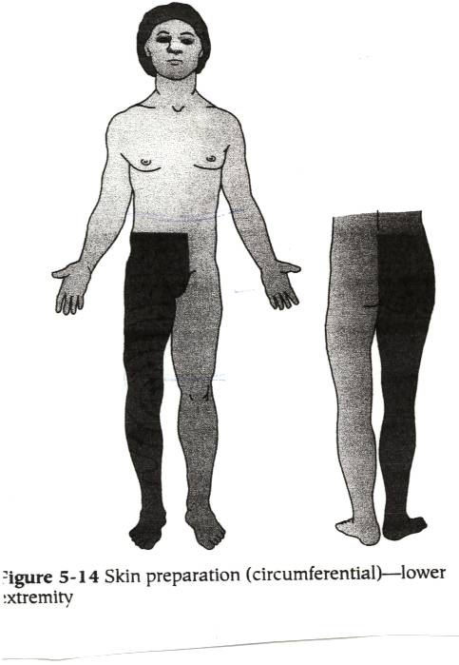

Slide 24
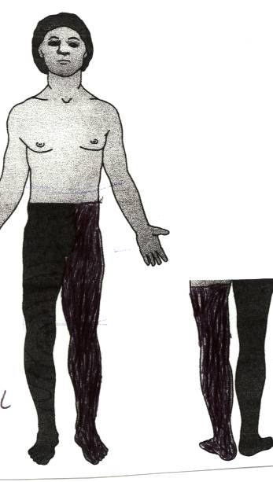

Slide 25
Prep Area: Extremities
Hand & Arm
Hand: hand & arm to 3 inches above the elbow
Shoulder: shoulder, base of neck, chest to midline, upper arm circumferentially, axilla last
Arm: entire arm circumferentially, shoulder, hand (prn), axilla last

Slide 26
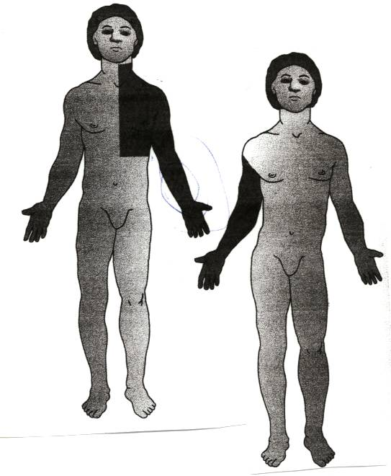

Slide 27
Prep Area: Perineal
Place drip pad under buttocks
Begin at pubic area, move down over the genitalia, perineum, and anus
Discard sponge after going over the anus
If doing an abdominoperineal procedure should use two separate prep sets (changing gloves in between) or prep abdomen first, then perineal area as described
Should not double dip!

Slide 28
Prep Area: Vaginal
Some surgeons may not prep the vagina
Will need sponge stick or forceps for internal vaginal prep
Need pad under buttocks to catch prep fluids
Begin at pubis, moving over vulva, perineum, and anus (discard after going over anus)
Sponge stick with prep solution inserted into vagina to move in circular motion to cleans vaginal vault
Dry sponge stick should be used afterwards in vaginal vault to internally dry

Slide 29
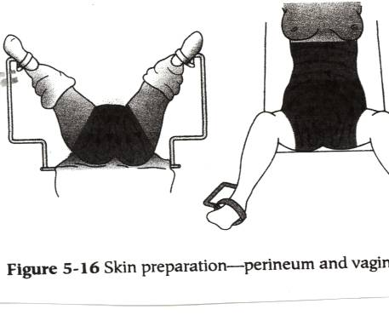

Slide 30
Prep Area: Eyes, Ears, Nose, Face
Eyes are protected
Area surrounding incision site is prepped as much as possible to hairline
Some surgeons will not prep for eye, ear, and nose surgeries

Slide 31
Prep Area: Head
Usually only the immediate area surrounding the incision site is shaven and prepped
Used to shave entire head and prep entire head
May still do this occasionally
Will begin at incision site and move around in a circular motion away from site, avoiding dripping into the ears, eyes, nostrils, and mouth

Slide 32
Prep Area: Back
Begin at incision site and move away in a circular outward motion
Depending on site of incision, may prep to buttocks and or the neck to the hairline

Slide 33
Procedure Completed
Remove drip towels without touching prepped area (circulator will remove these)
Clean up supplies
Remove contaminated gloves
Wash your hands
Note or report any skin abnormalities to the RN or MD immediately, ideally before beginning of the prep.

Slide 34
Summary
Skin Prep
Procedure
Surgical Site Variations
Considerations

