Slide 1
Lasers
Jerri Montelongo
Laser Safety Officer
Mission Hospital

Slide 2
LASER
Light Amplification
by the
Stimulated Emission of
Radiation

Slide 3
Characteristics of Laser Light
Collimated- tightly beamed
Coherent- consistent waves
Monochromatic- one color/spectrum

Slide 4
Lasers Effects on Tissue
Absorbed
Reflected
  Diffuse vs. Specular
Transmitted

Slide 5
Other Factors that Influence
Effects on Tissue
Circulating blood supply
Specific heat
Thermal conductivity
Color of tissue
  Chromophores: Melanin and Hemoglobin
Delivery system

Slide 6
Electromagnetic Spectrum
Visible
  400-700nm
Infrared
  1000-11000nm
Ultraviolet
  150-350nm

Slide 7
Laser Uses
Medical
Commercial
  CD players
  Computer printers
  holograms
Military
  Weapon sights
  Enemy detection
Industrial
  Welding
  Cutting metal
  Sharpening edges

Slide 8
Types of Lasing Media
Liquid
  Tunable Dye
Solid
  Nd:Yag
  Ruby
Gas
  Argon
  CO2

Slide 9
Argon
Gas
Visible and Ultraviolet spectrum 488 blue and 514 green
Absorbed in hemoglobin and melanin
Fiber delivery
Orange glasses
Ophthalmology--Retinopathy

Slide 10
Argon
Argon – produces blue and green light. Argon gas is visible, so no need for added laser to help aim. Can travel through clear fluids and tissues. Useful for the treatment of diabetic retinanopathy. Can also be used thrrough a cystoscope.

Slide 11
CO2
Carbon Dioxide- Gas
10,600 nm infrared
Any tissue but not clear liquids
Mirror/arm articulating delivery system
Invisible so uses HeNe beam
Clear Glasses
GYN, ENT, Plastics

Slide 12
CO2 cont.
The carbon dioxide laser (CO2 laser) was one of the earliest gas lasers to be developed. A helium-neon laser beam is transmitted with the CO₂ to aid in aiming (CO₂ is clear). Advantage – precise cutting and coag due to absorption of the energy by the cellular water content. Not dependent on tissue color or consistency. Not to be used if laser needs to be transmitted through clear fluids. Most frequently used laser in the OR.

Slide 13
Krypton
Gas
568nm Yellow, 647nm and 676nm red
  Blue-green is possible but not commonly used due to weakness of beam. Argon is preferred
Color dependent, absorbed by darker pigments
Free Beam
Glasses are red for 568nm and Blue for 647 and 676
Plastics and Dermatology: Age spots, veins

Slide 14
Krypton
Krypton is gas laser. Requires a water cooling system. Comes in red, green and yellow. Red is most frequently used. Eye surgeons use this on the retina.

Slide 15
Excimer
193nm, 248nm, 308nm, 351nm
Ultraviolet- Gas
Cold laser because it does not produce heat that can harm surrounding tissue
Pink and Amber glasses
LASIK and PRK , Also used in angioplasty

Slide 16
Excimer
Excimer – Uses gas and halogen as an active medium. Beam is ultraviolet. Used to reshape the cornea. Very exact cutting/coag. Disadvantage - Gases are fatal to humans and exposes humans to ultraviolet light.

Slide 17
Holmium YAG
2100-2140nm
Infrared
Absorbed in water
  Pulsing allows delivery
Tears tissue by mechanical destruction
Fiber delivery
Gray Glasses
Urology, Ortho

Slide 18
Holmium: YAG
Holmium: YAG – pulse beam, travels through a flexible fiber. Tip of the fiber held less than 5mm from tissue. Can also be transmitted through clear fluids. Has special electrical needs such as 208-volt service.

Slide 19
Nd: YAG
Neodymium: Yttrium Aluminum Garnet Solid
1064nm- infrared
Invisible, uses HeNe beam
High Absorption in tissue protein
  Coagulation
Fiber or free beam
Transmissible through fluid
Light yellow, green and brown glasses
GI bleeds and tumors, vein treatment, hair removal also used in Neuro for tumors and disks, Endometrial ablation

Slide 20
Nd: YAG
Neodymium:yttrium-aluminum-garnet - A helium-neon laser beam is also transmitted to aid in aiming. Absorbed by darker tissues. Beam can be transmitted through clear fluids – this is a major advantage. Used on bladder tumors, prostatectomies, etc. (also the laser of choice for gastrointestinal endoscopy)

Slide 21
PTP/KTP
Potassium Titanyl Phosphate “K” is potassium on periodic table
532nm Visible green, solid
Absorbed in hemoglobin and melanin
Intermediate tissue penetration
Cuts on contact coagulates non contact
Fiber
Transmissible through fluid
Orange glasses
Urology

Slide 22
Potassium titanyl phosphate (KTiOPO4)
Potassium titanyl phosphate (KTiOPO4) – KTP laser - produces a green wavelength with an affinity for red or darker tissues, such as hemoglobin or melanin. Used to produce "greenlight" to perform some laser prostate surgery.

Slide 23
Ruby
694nm
Solid state, visible light
Blue and blue-green glasses
High energy pulses selectively vaporize tissue
Plastics and dermatology

Slide 24
Tunable Dye
400-900nm continuous wave
Gas, liquid, and solid state
Multi-tuning wavelengths
Blue to Violet glasses
Dermatology, urology, ophthalmology, Plastics

Slide 25
Laser Classifications
Lasers are classified based upon the hazard it presents. Each classification has a standard set of control measures
Class I- no hazard
Class II- Aversion response/Blinking will prevent injury
Class IIIa- blinking can prevent injury unless viewed directly with collecting optics
Class IIIb-beam and reflection can harm if looked at directly including intra-beam viewing of specular reflections
Class IV- extreme hazard to eyes and skin

Slide 26
Laser Hazards
Tissue Injury
  Accidental firing and not using safety precautions
  Skin Burns and Eye damage
Fire
  Sources of ignition
  Your role
  Preventing Fire
Electrical Shock

Slide 27
Effects on Eye
Band | Wavelength | Eye Structure
Ultraviolet-A&B | 200-315nm | Corneal Burn
Ultraviolet-C | 315-400nm | Photochemical Cataract
Visible | 400-780nm | Photochemical and Thermal Retinal injury
Infrared-A | 780-1400nm | Cataract, Retinal Burn
Infrared-B | 1400-3000nm | Corneal Burn, Aqueous Flare, possibly Cataract
Infrared-C | 3000-10600nm | Corneal Burn

Slide 28
Fire
Drapes/Fabrics
Hair
Gases
Plastics
Prep Agents
Notes:
Methane Gas/rectal pack and Anesthetic gases-- O2 enriched atmosphere
Laser resistant ET tubes
No Alcohol prep…wash off betadine
Trim hair
Wet drapes and have fluid on field---need asepto or suction irrigator for lap cases

Slide 29
Laser Safety
Eye Protection
  Laser Specific lens/color related to laser
  Importance of eyewear
Skin Protection
  Precautions for employee
  Precautions for pt
Airway Protection
  Laser Specific Masks
  ET tubes
Environmental
  Signs
  Fire Prevention measures
  Prep Solutions
  Drapes

Slide 30
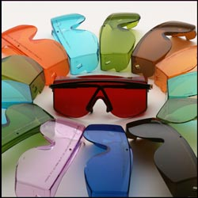
Eyewear

Slide 31
Eyewear Table
Laser | Wavelength | EMS |  |  |  | Glasses
Argon | 193, 488 & 514nm | Visible to FUV |  | Gas |  | Orange
CO2 | 10,600 | FIR |  | Gas | Cutting, Coagulation and Vaporization Not through Clear liquids | Clear
Krypton | 548, 647, 676nm | Visible |  | Gas |  | Blue
Excimer | 193, 248, 308, 351, 364nm | UV |  | Gas |  | Pink , Amber
Holmium: YAG | 2100-2140nm | IR |  | Solid | Not through clear liquids | Gray
Nd:YAG | 1064nm | NIR |  | Solid |  | Green, Light yellow, and Brown
KTP/PTP | 532nm | IR |  | Solid |  | Orange
Ruby | 694nm | Visible |  | Solid |  | Blue to Blue-green
Tunable Dye | 400-900nm | Tunable |  | Liquid |  | Blue to Violet
Free Electron |  | Tunable |  | Electron beam |  | Variable according to Wavelength

Slide 32
Skin protection
Keep body parts out of the beam path
No petroleum products used near laser beams
Wet drapes
Clip hair
Limit laser beam exposure time

Slide 33
Airway Protection
Masks
  No green, white or Orange
  Do not double mask
Smoke evacuators
Field Suction
Air Exchanges in OR
Notes:
Filters up to 0.1 microns

Slide 34
Environmental Controls
Limited Room Access
  Signs
Equipment Controls
Beam enclosures
Experienced Personnel operating and servicing lasers
Notes:
Equipment Controls:
Foot Pedal guards, Laser Operator, Control Panel, Emergency Stop button, beam shutters must be activated
Signs on doors with glasses hanging on them
Enclosed enviornment

Slide 35
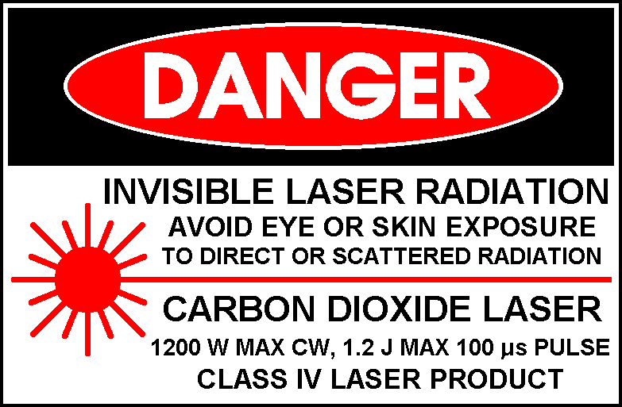

Slide 36
Bottom Line…
Follow the signs
Rely on guidance from Laser Operator, preceptors are not always correct
Not sure about Glasses or Masks, ASK
Always have saline or water on field

