Slide 1
Biomedical Science

Slide 2
Computers
Electricity
Physics
Robotics

Slide 3
Computers
Found in nearly every O.R.
Found in every hospital within many different areas of the hospital
Many of these are joined so that gathering information is just a click away
What considerations do we have to take into account when viewing pt. info?

Slide 4
How have computers help the following areas?
SPD/CSR
Floor nurses and doctors
X-Ray Dept.
Scheduling and the O.R. or Pre-OP
Where else?

Slide 5
As computers change ands evolve, we must stay alert to these changes and continue our education.

Slide 6
Internet
Utilize the internet within your facility to do research (only – not to check your email or IM someone in Zimbabwe).
Look up your next case if you are unsure
At home, go over your cases for the next day.
COME TO WORK PREPARED!

Slide 7
Email
Be aware that your facility will have email setup for you.
This email is your work link to your boss and his/her boss.
This email is for adjunct departments to inform you of changes.
ALL COMPANY EMAIL IS MONITERED BY SOMEONE OTHER THAN YOU, BECAREFUL WHAT YOU WRITE.

Slide 8
Principles of Electricity
Matter
Anything with mass that occupies space
Matter is made of atoms
Atoms are composed of protons, electrons, and neutrons
Atom’s center is the nucleus
Nucleus contains protons (+ charged particles) and neutrons (neutral particles)
Electrons (- charged particles) orbit the nucleus

Slide 9
Atoms held together by attraction between the protons and electrons
Law of Electrical Charges:
Negative and negative repel one another
Positive and positive repel one another
Opposites attract

Slide 10
Electrons may circle close to the nucleus or farther away in their orbit
Electrons farther away are called free electrons
Free electrons are apt to leave the atom if exposed to light, heat, or energy which speeds them up
This is electric current or movement of the electric charge

Slide 11
ELECTRICITY
W.T. Bovie developed first spark-gap tube generator which became know as the current ESU
Electrical burn is a serious risk to patients
Patient Safety Depends on
Knowing basic electrical terminology
Principles of electricity
Proper applications in O.R.

Slide 12
Electrosurgery
Two main types of ESU units
Monopolar – used on large sections of tissue
Requires a grounding pad for the electric current to disperse back to the patient.
Caution is used when placing the pad.

Slide 13
ESU
Electrosurgical Unit (ESU)
Generates current to cut tissue
Direction of current flow:
Generator → active electrode → dispersive (inactive) electrode → generator

Slide 14
Bipolar ESU
Used for fine cautery, when moist tissue is present or nerves are in close proximity.
Tips of bipolar forceps are the grounding unit. Current passes from one tip, through the grasped tissue to the other tip and back to the ESU Generator.
This cord is bi-wired. Monopolar is a single cord.
No grounding pad is used – why?

Slide 15
Application or use of an electrical current to cut or coagulate tissue
Uses AC current
ESU Components:
Generator, optional foot pedal, cords, active electrode, and inactive dispersive electrode

Slide 16
ESU Circuit:
ESU generator
Conductor cord
Active electrode (pencil)
Surgical site
Patient (not part of circuit with bipolar)
Dispersive electrode (grounding pad with Monopolar other tine of forcep with bipolar)
Conductor cord
ESU Generator

Slide 17
Electrosurgery Risks
Burns to the surgeon, surgeon assistants, STSR
Burns to the patient from poor grounding pad placement, pad becoming loose due to oils, hair, air pockets, or prep-solutions
Cautery plume: vaporized tissue contains carcinogens, BBP, and mutagens
Smoke evacuators should be used to counteract these hazards
Contain an air and charcoal filter

Slide 18
Basic Electrical Safety Guidelines
Remove jewelry when operating equipment
Secure long hair and loose clothing around power equipment
Wear PPE
Use equipment for intended purpose only
Never use equipment you are not trained to use

Slide 19
Basic Electrical Safety Guidelines Cont.
Inspect equipment prior to use
Disconnect power prior to maintenance on equipment
TURN OFF equipment power prior to unplugging or plugging in equipment
Never disconnect a plug by pulling on cord (pull on plug)
Hands should be DRY prior to handling equipment or cords/plugs
Keep equipment out of line of traffic to avoid injury to person or equipment
Tape cords down to floor if they are in traffic to avoid tripping

Slide 20
Electrical Safety Guidelines
Do not use electrical equipment when you’re touching metal or water
Unplug electrical equipment before cleaning, inspecting, repairing, or removing anything from them
Keep electrical equipment areas clean/free from flammable materials
Keep access panels and junction boxes clear
Know where fuse boxes and circuit breakers are
Make certain all electrical equipment is grounded
Do not use water on electrical fires
Report unsafe conditions/equipment to supervisor or biomedical/engineering department stat (Know policy of institution regarding damaged equipment)

Slide 21
Energy
Potential energy= energy that an object has stored related to its position
Kinetic energy = the energy of motion
Mechanical energy= energy that makes an object move or change course
PE + KE = TME

Slide 22
Currents
Measured in amperes (amps)
Rate of flow of electrons
Current flow is the movement of free electrons
Free electrons attracted from point of excess electrons to a point with fewer electrons

Slide 23
Circuits and Currents
Currents:
Direct Current (DC)
Electrical current flows in one direction – negative to positive pole
Example: Batteries
Serve as storage device; keep electricity until needed
Negative (-) and positive (+) terminals
When switch is closed, current flows from one terminal to the other

Slide 24
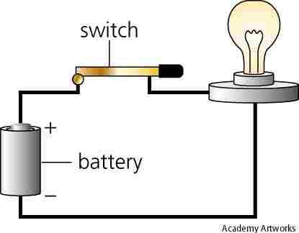

Slide 25
Batteries
Four components of DC circuit
Battery: source of electricity
Wire (battery to load): conductor
Switch: control device
Load: bulb

Slide 26
Alternating Current
Current that periodically reverses direction
Complete cycle is current that moves in one direction, then reverses direction
Hertz (Hz): one AC cycle
Frequency: number of AC cycles in a second; symbol ƒ
Most common AC in U.S. is 60 cycle AC
Typical voltage is 110V or 120V

Slide 27
Volt is electrical potential
– Voltage is potential energy of electrons
– Named after Alessandro Volta, a 17th
century scientist who invented the battery
Electric system: battery creates voltage to move electricity
Circuit is the path electricity travels

Slide 28
AC Can Change Voltage
AC delivered as high voltage, then “stepped down”
Example:
Transformers “step up” exiting voltage
Power lines (transformer) deliver electricity at high voltage
Voltage is stepped down before use

Slide 29
Circuits
Comprised of 4 components:
Power: defined as “the rate at which work is done, expressed as the amount of work per unit time.”
Note: Current is the flow of electrical charge and voltage is the measure of electrical charge between two points

Slide 30
Power
The product of Voltage and Current is Power or:
P(power (W)) = I (amps or current) x V (volts)
Measured in watts (W)
Converted to kilowatts (KW): 1 KW = 1,000 W
Example: DC Circuit is 12V & 20A, Power is
P = 20 x 12 = 240W or 0.24KW

Slide 31
Conductor
Conductor: Electrical conduction is the movement of electrically charged particles through matter
The material used for this movement is called the conductor.

Slide 33
Materials that have few free electrons and inhibit the flow of electrons are called insulators
Insulators are just poor conductors
Copper or another metal are wrapped in insulators such as rubber or plastic to ensure that electrons flow to a designated area

Slide 34
Load
Device that uses electricity to perform a function
Can change amount of energy from power source
Examples: surgical lamps, ESU, power drills, video monitors
Resistive energy loads: conductor has high resistance to flow of electricity
Example: filament (conductor) in light bulb; electricity has to force way thru resistance to cause filament to glow

Slide 35
Switch
Device used to open or close circuit
Controls flow of electricity
Example: Flashlight
Batteries (power)
Wires (conductors) connected to battery that is connected to switch activated by user
Bulb (load) must have voltage
Voltage carried by conductors and switch controls flow of current to load; open switch – no flow, closed switch bulb lights up

Slide 36
When a light bulb is on the circuit is said to be closed.
When the light bulb if off, the circuit is open.

Slide 37
Physics
Physics involved in all aspects of O.R.
No longer sufficient to only know how to operate machines
Basic concepts of equipment design must be understood
Surgical technologist must evolve as the O.R. advances into the future

Slide 38
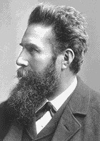
Physicists have contributed to practice of medicine
Wilhelm Conrad Röntgen: Discovered X-rays
http://nobelprize.org/physics

Slide 39
Waves shorter than ultraviolet
Discovered by Wilhelm Röntgen
Pass thru objects made visible on fluorescent screen
Thomas Edison invented fluoroscope
X-ray Machine
Cathode Tube (Coolidge tube)
Aims accelerated electrons at heated atoms (Tungsten filament)
Anode: electrons strike metallic electrode
Electrons slow down
Electrons penetrate metal
Stopping of electrons produces X-rays

Slide 40
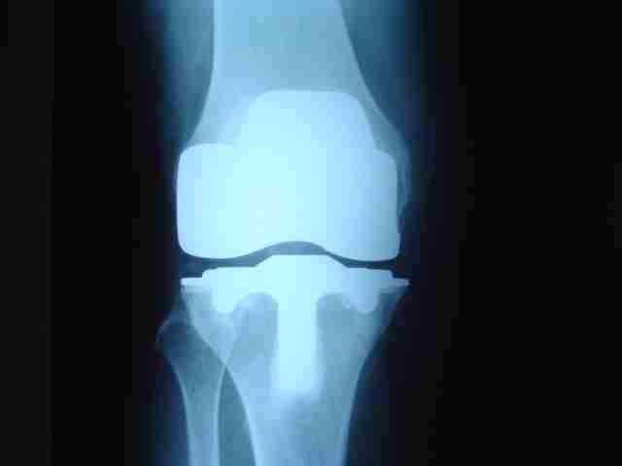

Slide 41
Cont.
CAT Scan
Uses X-rays for detailed imaging of tissues
MRI
Uses radio frequencies to excite protons in tissue
Protons return to equilibrium, emit RF signal analyzed as image
PET
Patient consumes radiopharmaceutical agent that emits positron
When positron meets electron, both are destroyed
Gamma rays are emitted
Detectors locate each destruction event; creates colored image indicating activity

Slide 42
Cont.
Ultrasound Imaging
Transforms sound waves into images
Tissue reflects source signal
Image is created from “echoes”

Slide 43
Mechanics
Study of objects in motion
Dynamics: Study of motion & forces that cause it
Kinematics: Study of objects in motion; does not include study of the forces that caused motion

Slide 44
Speed and Velocity
Speed:
Describes how fast something is moving
Important: Direction is not considered
Average Speed = distance traveled ÷ time taken to travel distance
Velocity
Involves direction and speed
Expressed as velocity = distance ÷ time

Slide 45
Acceleration
Acceleration
Acceleration: Object’s velocity has changed
Change in velocity over time
Involves change in direction, speeding up, slowing down
In physics, no separate term for slowing down

Slide 46
Projectile Motion
Motion of any object launched into air at an angle
Projectile launched vertically
Comes back to launching level in accelerated motion

Slide 47
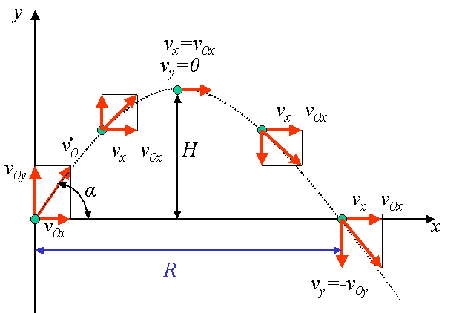

Slide 48
Satellite
Projectile since gravity acts upon it
Falls toward earth, but does not complete descent due to earth’s curvature

Slide 49
Newton’s Laws of Motion
First Law
Expresses physical concept of inertia
Object will not move unless outside force acts upon it
Object moving at constant velocity will continue so in a straight line until acted upon by an object
Second Law
External force causes an object to accelerate

Slide 50
Third Law
Also called Law of Conservation of Momentum
Whenever force is exerted, equal and opposite force occurs in reaction

Slide 51
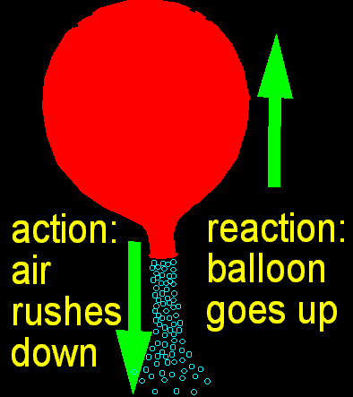

Slide 52
Momentum
M = m x v
A force exerted on an object causes force on other object in opposite direction
Cannon recoils after shooting cannonball
Total momentum before event is equal to momentum after event
Before cannonball is fired, momentum of cannon and ball is zero
Recoil of cannon after firing gains opposite direction momentum; equalizes momentum

Slide 53
Simple Harmonic Motion
Object displaced from equilibrium will oscillate about its equilibrium position

Slide 54
Laser
Light Amplification Stimulated Emission of Radiation
Device that transforms energy into electromagnetic radiation

Slide 55
Cont.
3 main parts:, energy pump, gain medium, and the resonator cavity
Energy pump: Sets particles from energy source in motion
Gain medium: Made of solid, liquid or gas
Amplifies light as it passes thru material
Determines type of laser: solid state, semiconductor or liquid

Slide 56
Resonator Cavity: Mirrors that direct and redirect particles through the gain medium

Slide 57
How Lasers Work
Spontaneous Emission
Excitation: Electron moves to outer orbit
De-excitation: Electron spontaneously falls back to inner orbit simultaneously emitting a photon of light, like a neon sign
Unpredictable and uncontrollable
Einstein’s Discovery
Photon runs into excited atom, energy state will decrease and a new identical photon will be created.
Photon emitted with properties same as original photon

Slide 58
Cont.
Photon Movement
Photon emitted parallel to resonator
Photon travels to mirror
Photons bounce back and forth 18 times
Photons hit excited atoms; atoms give up photons creating more, causing a cascading effect, making a monochromatic beam (all one wavelength).

Slide 59
Nuclear Physics
Study of the properties of atomic nucleus
Nucleons are protons and neutrons
Quarks: Subatomic particles that make up nucleons
Repulsive Force
Keeps tightly packed nucleons from overlapping
Nucleus appears as closely packed spheres, almost touching
Binding Energy: Forces apart nucleons, energy is released.

Slide 60
Nuclear Physics
Particle accelerators and nuclear reactors

Slide 61
Robotics
Used to improve surgical patient care by helping to overcome limitations in human precision and reliability
Require surgeon control and input via remote control and voice activation

Slide 62
Will eventually replace expensive surgical personnel
Enable surgeons to perform procedures from a distance (telesurgery)
Protect surgical team members from infection
Eliminate hand tremors by the surgeon that normally results from fatigue

Slide 63
A machine is defined as a robot if it features some degree of mobility and once programmed operates automatically for given tasks.
1961: First industrial robot in U.S.

Slide 64
First Generation Robots
Mechanical arms without artificial intelligence (AI)
Precise repetitive motions at high speeds
Constant monitoring by humans
Second Generation Robots
Some AI
Tactile sensors
Some vision and hearing
Do not require constant monitoring

Slide 65
Third Generation Robots
Autonomous robots: work independently w/o human supervision
Insect robots: controlled by central AI computer; collective intelligence
Fourth Generation
Not yet developed
But will display abilities to learn and evolve

Slide 66
Nanotechnology: A technology that creates small materials at the scale of molecules by manipulating single atoms. The name nano comes from the size of molecules. The dimension of single atoms is ten fold smaller

Slide 67
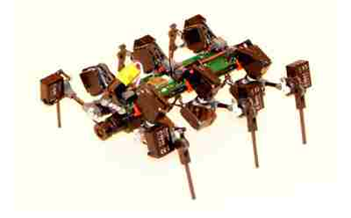

Slide 68
Nanoscience and nanotechnology involve studying and working with matter on an ultra-small scale. One nanometre is one-billionth of a meter and a single human hair is around 80,000 nanometers in width.

Slide 69
A branch of science and engineering devoted to the design and production of extremely small electronic devices and circuits built from individual atoms and molecules.
Cancer Inst: http://www.youtube.com/watch?v=5jqQxuVncmc

Slide 70
Nanomedicine would make use of these nanorobots, introduced into the body, to repair or detect damages and infections. A typical blood borne medical nanorobot would be between 0.5-3 micrometres in size, because that is the maximum size possible due to capillary passage requirement.

Slide 71
Carbon would be the primary element used to build these nanorobots due to the inherent strength and other characteristics of some forms of carbon

Slide 72
Cancer can be treated very effectively, according to nanomedicine advocates. Nanorobots could counter the problem of identifying and isolating cancer cells as they could be introduced into the blood stream.
Medical nanorobots would then destroy these cells, and only these cells.

Slide 73
Nanorobots could also be useful in treating vascular disease, physical trauma , and even biological aging.
How Stuff Works: http://videos.howstuffworks.com/howstuffworks/462-how-nanotechnology-works-video.htm
Nano Takes Off

Slide 74
Surgical Robots
AESOP 3000
(Automated Endoscopic System for Optimal Positioning)
Developed by Computer Motion
Position endoscope
Foot pedals or voice-activated software to position camera
Leaves surgeon’s hands free

Slide 75
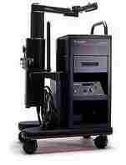

Slide 76
Endoscopy
Insertion of a flexible or rigid scope that has a light source and camera and is used to diagnose or treat pre, intra, and post-operatively

Slide 77
Fetoscopy
Hysteroscopy
Esophagoscopy
Gastroscopy
Colonoscopy
Bronchoscopy
Sigmoidoscopy
Laparoscopy
Thoracoscopy
Arthroscopy
Cystoscopy
Choledochoscopy
Mediastinoscopy (viewing between AND in front of the lungs)
Ureteroscopy

Slide 78
da Vinci and ZEUS
Similar set-ups: computer workstation; video screen; robot next to patient; three manipulators
Gallbladder surgery
3 sm. incisions for 3 rods held by 3 manipulators
1 rod holds camera; 2 rods hold surgical instruments for dissecting and suturing
Surgeon sits at workstation with joystick control

Slide 79
ZEUS was used by a surgeon in New York to perform a gallbladder surgery in France in September 2001

Slide 80
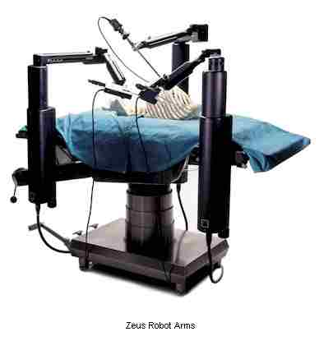

Slide 81
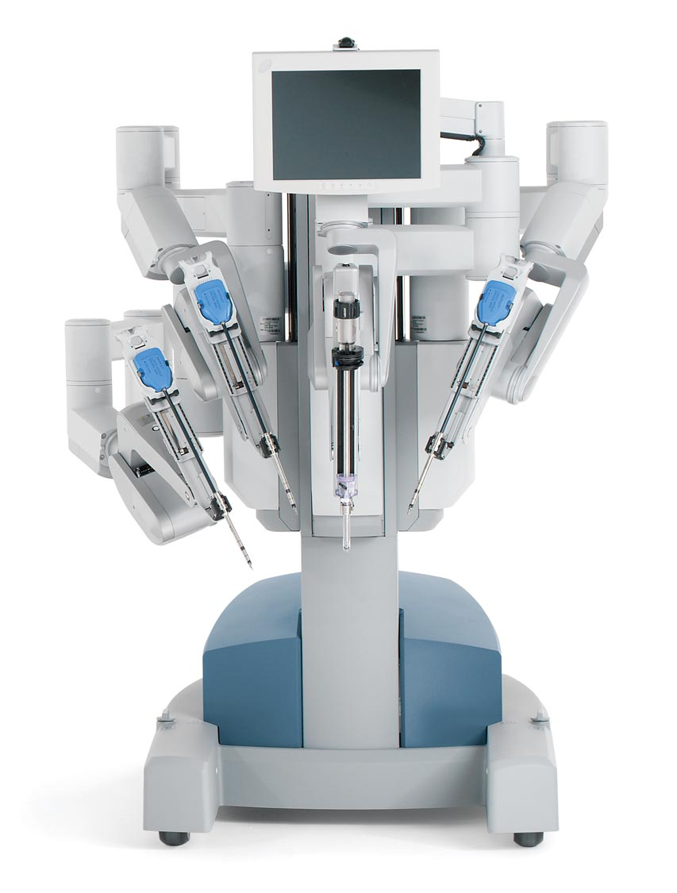
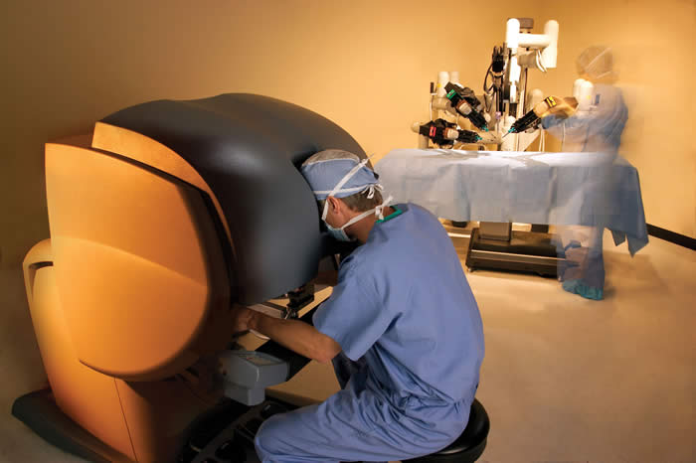
Da Vinci Console

Slide 82
Da Vinci Video
Da Vinci overview: http://www.metacafe.com/watch/1015317/davinci_robotic_surgery/http://video.google.com/videoplay?docid=4013743839854966148&ei=B1E9SeW-KJOwrALVi9muCQ&q=da+Vinci+robot&hl=en
The World’s Shortest Nurse (a patients thoughts): http://www.dailymotion.com/video/x6s2iu_da-vinci-roboticassisted-prostate-s_webcam

Slide 83
Telesurgery
Telesurgery
Perform a procedure in real time at a distance
Surgeon remotely controls robotic arms
Obstacle: time delay between surgeon and robotic response

Slide 84
Definitions
AI: Artificial Intelligence
Articulated: broken into sections by joints.
Binaural Hearing: determining where sound is coming from, the direction sound is coming from.
Cartesian Coordinate Geometry: system used for graphing mathematical functions, the x and y axes.

Slide 85
Cont.
Cylindrical Coordinate Geometry: rotational axes movement.
Degrees of Freedom: the number of ways a robot arm may move.
Degrees of Rotation: The degrees of rotation a robot arm moves around it’s axis.
Expert Systems: rules used in AI for control

Slide 86
Machine Hearing: An AI picking up sound and determining where it came from, voice recognition.
Manipulators: robot arms
Resolution:The amount of pixels that are displayed on a screen, differentiate between two objects.

Slide 87
Revolute Geometry: movement to mimic human motion, 360 degrees of motion.
Sensitivity: ability to see in dim light, not the ability of a Robot to cry.
Telechir: remotely controlled robot.
Telepresence: operating a robot at a distance.

Slide 88
Parts
Robotic Components
Manipulators

Slide 89
Manipulator
Manipulator
Transported on special cart
Special O.R. table not necessary
Move cart next to O.R. table
Attach manipulator after patient positioned

Slide 90
Manipulator con’t.
Placement depends on surgery
Lower abdominal procedures: manipulator placed at top of O.R. table
Upper abdominal procedures: manipulator placed at bottom of table
Freedom of movement: markings on manipulator

Slide 91
Parts cont.
Surgical instrumentation
Remote console
Computers
Voice activation system

Slide 92
The Future
Robots increasingly used for MIS
Virtual-reality simulations for training purposes
Realistic anatomical models
Biomechanics-based simulations for training
Surface-based registration
Surgical robotics
Advanced human-computer interaction

Slide 93
Surface-based Registration
How It Works
Tissue, such as brain, is scanned – MRI or CAT scan
Normal and abnormal tissue differentiated by computer analysis by color
3-dimensional images of structures produced by computer

Slide 94
How It Works
O.R. images superimposed on head of patient
Laser scans patient’s head
Obtains 3-dimensional coordinates
MRI combined with laser scan
Patient’s virtual head superimposed on real head
Surgeon can “see” inside patient’s head before incision is made
Problems are seen and dealt with ahead of time!

Slide 95
Our Role in THE FUTURE
Surgical Technologists Will Understand:
Physics
Biomechanics
Computer Science and Advanced Software
Electronics
Robotics
Maintain, troubleshoot, operate robotic equipment

