Slide 1
SUR 111
Cholecystectomy

Slide 2
Anatomy of the Biliary System

Slide 3
Cholecystectomy
with/without Cholangiography
Complete Surgical Removal of Gallbladder
Performed to Prevent or Treat Inflammation or Obstruction
Notes:
Cholecystectomy is complete surgical removal of the gallbladder and the reconstruction of the biliary ducts so bile can empty directly into the intestine.
This is done to prevent or treat acute inflammation and obstruction.
Two common diseases of the biliary system are cholelithiasis—the presence of gallstones—and inflammation of the gallbladder, called cholecystitis.

Slide 4
Biliary Tract
Gallbladder, cystic duct, common bile duct, and common hepatic duct
Function: transport bile, store bile and release bile into the duodenum
Aids in digestion and absorption of fats
Gallbladder divided into fundus, body and Hartman’s pouch
Hartman’s pouch: most common site of gallstones (clog and prevent passage of bile into cystic duct)
Sphincter of Oddi: where CBD empties into duodenum/controls release of bile into duodenum
Ampulla or papilla of Vater is an enlarged area of the common bile duct where it merges with the pancreatic duct and empties into the duodenum

Slide 5
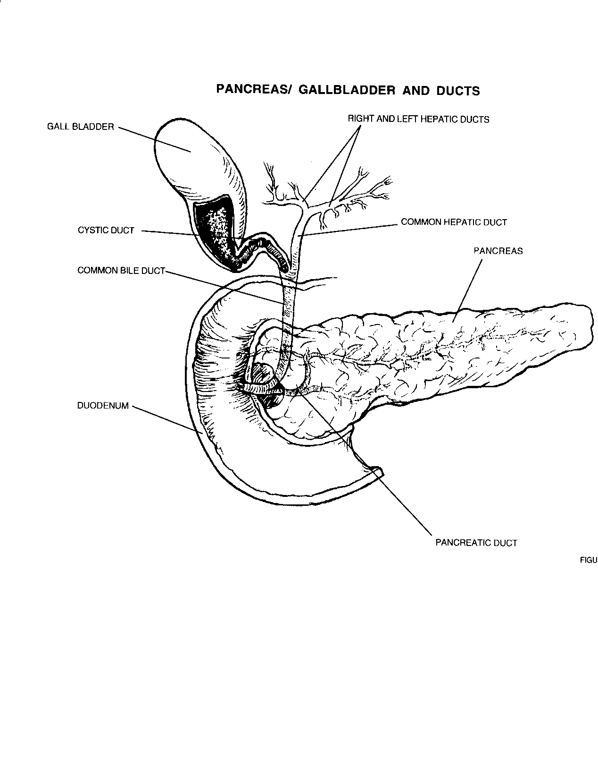
Notes:
Biliary tract: gallbladder, cystic duct, CBD, CHD. Function: transport bile, store bile, and release bile into the duodenum to aid in the digestion and absorption of fat. Divided into: fundus, body, and Hartman’s pouch. Hartman’s pouch is the most common site of gallstones which will clog and prevent passage of bile into the Cystic duct. Sphincter of Oddi is where the CBD empties into the duodenum and it controls the release of bile into the duodenum.

Slide 6
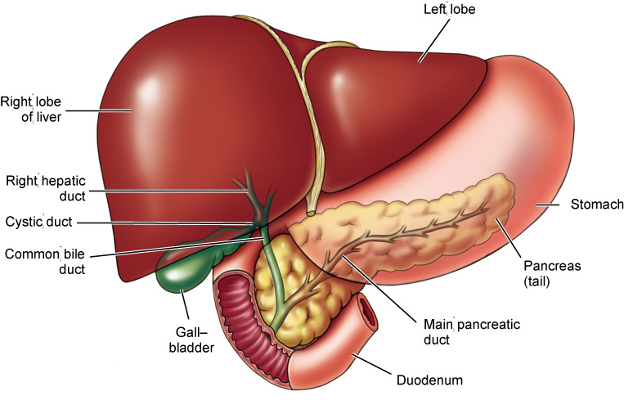
Surgery of the Biliary System, Liver, Pancreas, and Spleen, continued
Locations of the liver, gallbladder, and pancreas
(Modified from Herlihy B and Maebius NK: The human body in health and illness, ed 2, Philadelphia, 2003, Saunders.)
Fuller
Notes:
The liver, gallbladder, spleen, and pancreas are situated in the mid-abdominal cavity.

Slide 7
Gallbladder Pathology
Cholecystitis
Inflammation of the gallbladder
Acute or chronic
Cholelithiasis
Presence of gallstones
Gallbladder calcification
Tumor (benign or malignant)

Slide 8
Gallbladder Dissection
This is what the gallbladder looks like when it gets to path.
http://www.youtube.com/watch?v=6qyY9NLfZYo&feature=related

Slide 9
Gall Stones
Types:
Cholesterol gallstones
Cholesterol gallstones are made primarily of cholesterol. They are the most common type of gallstone, comprising 80% of gallstones in individuals from Europe and the Americas. Cholesterol is one of the substances that liver cells secrete into bile.

Slide 10
Types cont.
Pigment gallstones
Pigment gallstones are the second most common type of gallstone.
There are two types of pigment gallstones 1) black pigment gallstones, and 2) brown pigment gallstones.
Black pigment gallstones: too much bilirubin in bile
Brown pigment gallstones: If there is reduced contraction of the gallbladder or obstruction to the flow of bile through the ducts, bacteria may ascend from the duodenum into the bile ducts and gallbladder. The bacteria alter the bilirubin in the ducts and gallbladder, and the altered bilirubin then combines with calcium to form pigment.

Slide 11
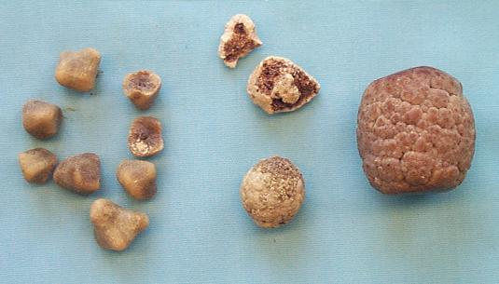
Bilirubin - a yellow pigment that is excreted in the bile
It is responsible for the yellow colour of bruises and the yellow discolouration in jaundice.

Slide 12
Gallstones Video
http://www.youtube.com/watch?v=H6zOBKjVRag

Slide 13
Medications
Contrast Media (Hypaque)
Dye
Antibiotic Irrigation
Topical Hemostatics
Local
Notes:
Hypaque is versatile used in cholagiography, peripheral arteriography, cerebral angiography, urography is 45% iodine percentage refers to megaglumine ((60%) per 100cc of solution not the amount of iodine. Supplied 50 and 100ml glass vials

Slide 14
Anesthesia
General
MAC (IV Sedation)
MAC (IV Sedation with Local)
Spinal
Epidural
Local

Slide 15
Instrumentation
Minor tray
Major Tray
Intestinal Tray
Gallbladder Tray
Laparoscopic Tray
Laparoscopic Accessories
Extra Long Instrument Tray
Scopes

Slide 16
Equipment
X-Ray Table
Laparotomy
Endoscopic Tower (video monitor, insufflation tubing, insufflator, light cord, light source, camera box, camera, scope, scope warmer)

Slide 17
Supplies
Laparotomy Pack
Basic Pack
Laparotomy Sheet
Universal Sheet
Minor Basin Set
Suture of Surgeon choice
Kittners
Gloves
Blades
Cholangiogram Supplies (Sterile specimen cup, stopcock, IV tubing, 30cc syringes x 2)

Slide 18
Incision Open Cholecystectomy
Right Subcostal
gallbladder, biliary system

Slide 19
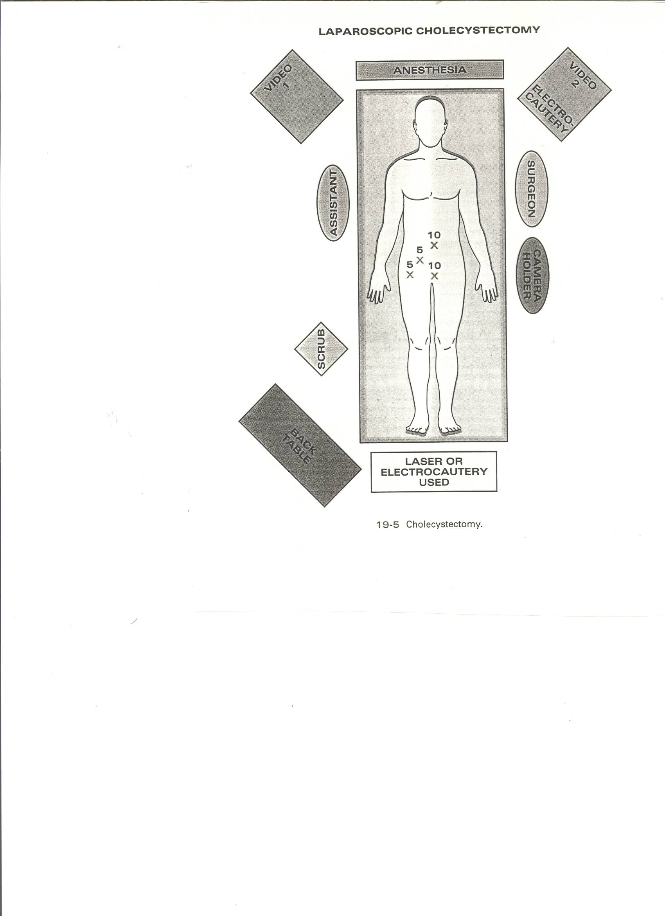
Port Sites Laparoscopic Cholecystectomy

Slide 20
Operative Sequence
Discussion

Slide 21
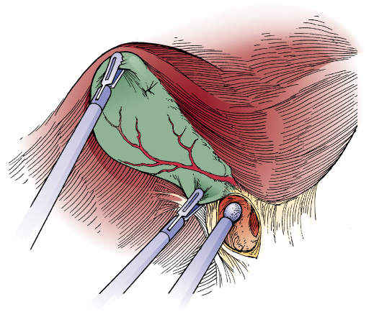
Laparoscopic Cholecystectomy with Cholangiography, continued
The gallbladder is retracted, allowing dissection of the cystic duct and artery
(Colorized from Moody FG: Atlas of ambulatory surgery, St Louis, 1999, Mosby.)
Notes:
Technique:
A pneumoperitoneum is established.
Trocars are placed in the abdomen.
The gallbladder is retracted upward using a toothed grasper.
The cystic duct, cystic artery, and common bile duct and exposed.
The assistant maintains gentle traction on the gallbladder.
The cystic artery and cystic duct are identified and exposed using sharp dissecting instruments.
The cystic duct and artery are occluded with endoscopic clips, and each is divided by sharp dissection or ESU.
Cholangiography is performed.
The gallbladder is dissected from the underside of the liver using the ESU probe, hook, or scissors.
The gallbladder is removed from the abdomen through a 10-mm trocar site using a grasper with teeth.
The abdominal cavity is irrigated.
A T-tube may be inserted for continuous postoperative drainage.

Slide 22
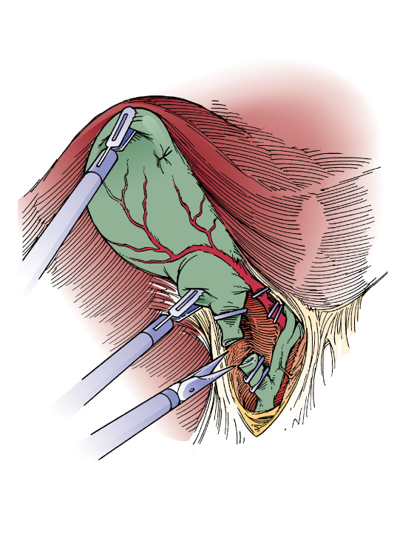
Laparoscopic Cholecystectomy with Cholangiography, continued
The cystic artery and duct are clipped and cut
(Colorized from Moody FG: Atlas of ambulatory surgery, St Louis, 1999, Mosby.)
Notes:
Figure 21–46B shows the ligation of the cystic artery and cystic duct during cholecystectomy.

Slide 23
Lap Chole Video The Good
Excellent: http://www.youtube.com/watch?v=Pr3Md9XlLvw
Excellent: Harmonic technology http://www.youtube.com/watch?v=7tTGfYCqH5w

Slide 24
The bad
Laparoscopic perforated cholecystectomy (abscess) (nasty) http://www.youtube.com/watch?v=G0w9YSmFang
This case: a 74 year old man on anticoagulation for atrial fibrillation, presents with acute cholecystitis and sepsis; after a brief improvement with initial conservative management with rehydration, antibiotics and cardiology review for reversal of Warfarin, 48 hours later he deteriorates rapidly and is taken to surgery for cholecystectomy. At laparoscopy a large inflammatory mass is found in the right upper quadrant; gentle blunt dissection frees the omentum and colon from the liver and diaphragm and reveals a large perforated gallbladder.

Slide 25
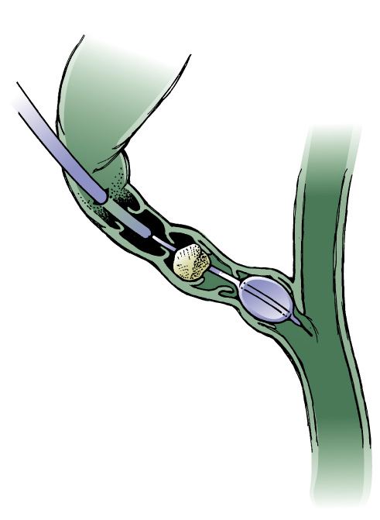
Laparoscopic Cholecystectomy with Cholangiography, continued
Extraction of a cystic duct stone using a balloon catheter
(Colorized from Moody FG: Atlas of ambulatory surgery, St Louis, 1999, Mosby.)
Notes:
If stones are located, the surgeon extends the exploration by dilating the cystic duct with a balloon catheter. This is performed by threading a guide wire through the cystic duct and into the common duct. The balloon catheter is then inserted over the guide wire and slowly inflated with saline solution.
Single stones can be removed by slowly withdrawing the catheter as in the illustration. The common-duct stones can also be flushed out by using a high-pressure irrigation device.
Any stones that fall into the abdominal cavity are retrieved with an endoscopic grasper.

Slide 26
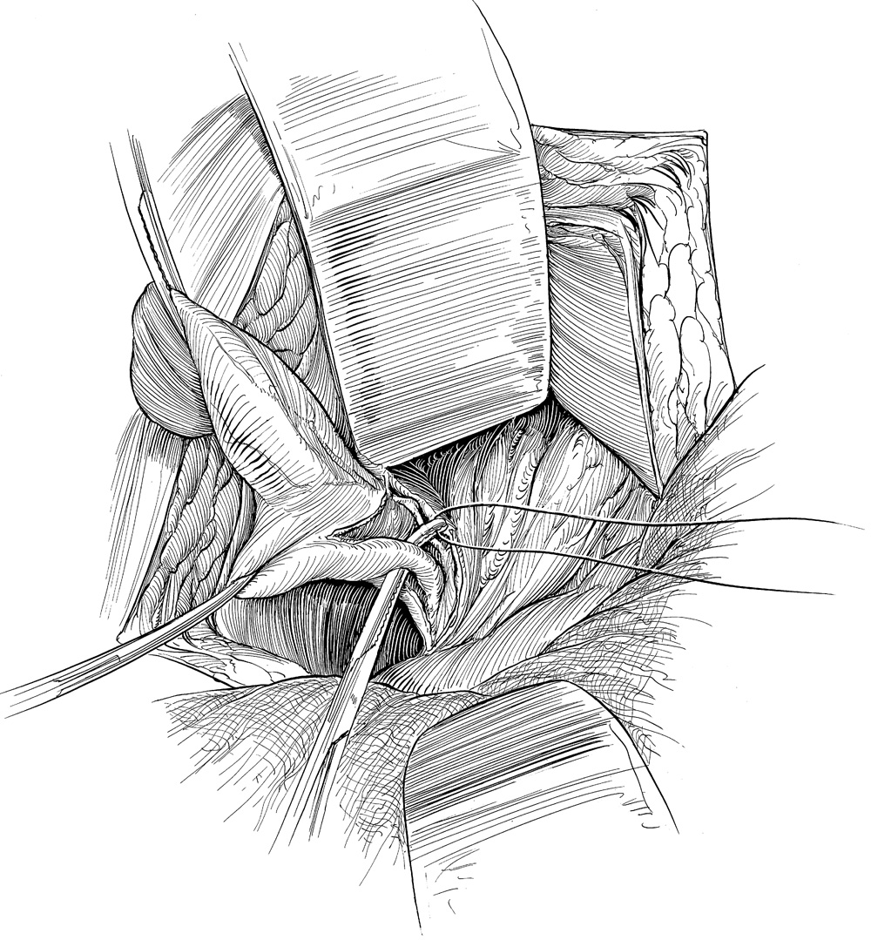
Cholecystectomy (Open)
Cystic duct is tied close to the gallbladder with a 2-0 silk
(From Economou SG and Economou TS: Atlas of surgical technique, ed 2, Philadelphia, 1996, Saunders.)
Notes:
In acute cholecystitis, the normally bluish green gallbladder becomes distended and inflamed due to obstruction by one or more gallstones. In removing the gallbladder, the common bile duct is left unimpaired so that it becomes a functional passageway through which bile can enter the duodenum.
Technique:
The abdomen is entered.
The bile ducts are identified and isolated.
The cystic artery is identified and ligated.
The cystic duct is ligated.
The gallbladder is dissected from the liver bed.
The wound is closed.

Slide 27
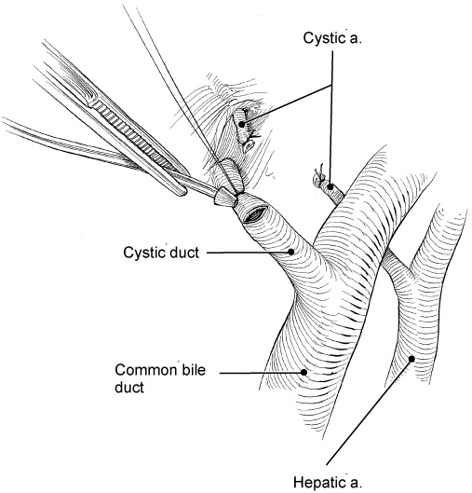
Operative Cholangiography
The catheter is inserted into the cystic duct and advanced into the common bile duct
(From Economou SG and Economou TS: Atlas of surgical technique, ed 2, Philadelphia, 1996, Saunders.)
Notes:
Regardless of the type of cholecystectomy performed (open or laparoscopic), cholangiograms will be performed to check for the presence of stones in the common duct.
Once a stone or group of stones is located on the radiograph, the stones are removed and the ducts are dilated.
Once the surgeon has identified the common duct, two traction sutures of 3-0 silk are placed through the wall of the duct.
An incision is then made between the sutures with a No. 15 or No. 11 scalpel blade or Potts scissors.
The scrub should have a catheter for insertion into the duct, radiopaque dye, and a 30- or 50-mL syringe available.
All air bubbles must be removed from both the syringe and catheter. To do this, the scrub holds the syringe upright and injects a tiny amount of dye solution through the catheter. Tapping the syringe gently should cause the bubbles to rise to the top of the syringe, where they can be ejected out of the catheter.

Slide 28
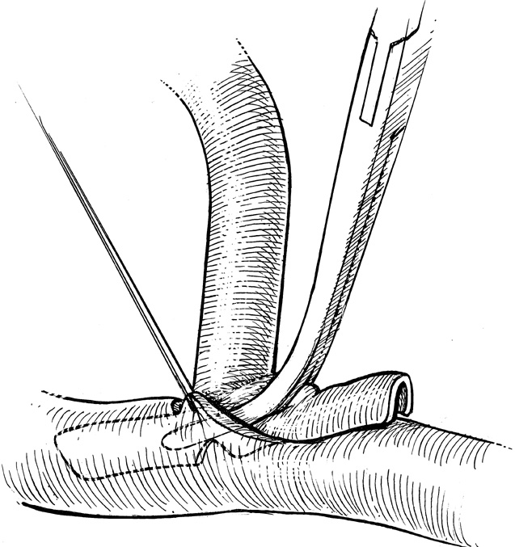
Operative Cholangiography, continued
Insertion of the T-tube into the common duct
(From Economou SG and Economou TS: Atlas of surgical technique, ed 2, Philadelphia, 1996, Saunders.)
Notes:
Once the surgeon is finished with the exploration and stone removal, he might, at the close of the procedure, insert a T-tube into the common duct.
The surgeon will state which size tube is preferred. The tube is inserted using fine tissue forceps such as Cushing forceps.
The ductal incision is then closed with size 3-0 or 4-0 silk on a fine tapered needle.
The long end of the T-tube is brought out from the wound and later attached to a special “bile bag,” which collects bile while the wound heals.

