Slide 1
The Surgical Scrub

Slide 2
Today’s Topics
Surgical Scrub
Drying hands
Donning surgical gown
Closed gloving
Turning
Open gloving

Slide 3
The Surgical Scrub
You must scrub your hands and arms up to inches above the elbow rendering them surgically clean
Transient microorganisms are removed and resident flora are reduced
  Occurs by two actions:
  Mechanical friction brings microorganisms to the surface
  Chemical action of antimicrobial soap which also provides a film that lasts several hours after the scrub
See Technique, pg. 333-339

Slide 4
Equipment
Scrub sink
Scrub brush with nail cleaner
Antiseptic solution
PPE
Proper OR attire

Slide 5
Scrub Techniques
Brush Stroke
  Each surface is scrubbed a designated number of times
  We will use this
Timed Method
  Scrub for a designated time (5 Min)
  Not used here.

Slide 6
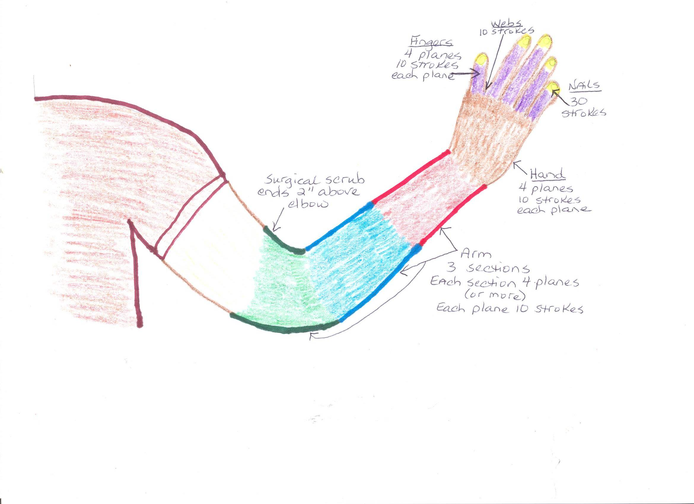

Slide 7
Counted Brush Stroke
Each stroke consists of one back and forth motion
You will perform 30 strokes to your nails
You will perform 10 strokes to each plane of your fingers (4 planes)
You will perform 10 strokes to each of your web spaces as you progress to each finger
You will perform 10 strokes to each of the four planes of your hand
Your arm is divided into three sections
Each section has four planes or more
You will perform 10 strokes to each plane of your arm beginning at your lower forearm, proceeding to your upper forearm and ending with your lower upper arm
STOP at 2”above your elbows
Please measure at home so you know how far this is
Not as far as you think

Slide 8
Counted Brush Stroke
Bunch up your nails and apply 30 counted strokes to your nail tips with bristle side of brush
Switch hands and apply 30 strokes to the other hand
Begin with thumb, apply ten strokes to lateral side and progress to each of the four planes, web space between index finger and thumb, moving to index finger, etc.
Ten strokes to hand’s four planes
Move to lower forearm, apply ten strokes to each of the four planes
Move to upper forearm, apply ten strokes to each of the four planes
Move to lower upper arm, apply ten strokes to each of the four or more planes
Stop at 2” above elbow
DO NOT TOUCH your scrub sleeves
KEEP YOUR fingers up, arms away from your body and hands in front of your face
AVOID touching spigot or sink
Proceed to other hand beginning with fingers and progress in same manner described

Slide 9
Counted Brush Stroke
Keeping your hands up in front of yourself and away from your body, turn to the side you intend to rinse first
Beginning with your fingertips, place them under the water, wiggle them and rotate hand to thoroughly rinse, progress up your arm
KEEP your arm in an arc (U), fingers pointed at the ceiling
DO NOT GO BACK
Once you have rinsed an area, you can’t go back down
Once you have reached your elbow, step away from the water, turn body to other side and rinse using same technique
Turn off water with your hip or leg
DO NOT SHAKE your hands, can drip a minute
KEEP HANDS up in front of you!
Putting them out to the side endangers you being run into by someone and having to start over!
Progress to OR suite door and open with your hip or buttocks (BACK IN!)

Slide 10
Hand Drying and Donning Surgical Gown
Keep arms above waist and hands up
Open door with the back, hip, or rear end (back in the room)
Avoid touching anything with hands and arms
Avoid dripping on the sterile field when grasping drying towel
Grasp gown on outside and lift up and away from the sterile field it is on (the gown is packaged for you to do this without readjusting the gown/grab it as where it lays just below the collar)
Step away from sterile field when donning gown to avoid touching unsterile areas
Be aware of surroundings so you do not inadvertently touch anything around you or above you
Only touch the item you are retrieving, one at a time!
See technique, pg. 335-339

Slide 11
Self-Gowning
Fasteners at the shoulders and waist are secured by the circulator
Circulator will assist in pulling gown over the shoulders
Do not turn your back to the sterile field
Use the closed glove technique to put on gloves
Hand the Ticket to the circulator to turn gown and tie
Do not spin around
Do not pull the tie strap from the ticket vigorously
See technique, pg. 335-339

Slide 12
Closed Glove Technique
Used for donning gloves after the sterile surgical gown is put on
Should NOT use a back table to don the surgical gown and gloves
Use a mayo stand or other clean, flat surface such as a prep stand
See technique, pg. 338

Slide 13
Open Glove Technique
For sterile procedures that need to be performed by a non-sterile OR team member
Used in skin preps, catheterization, or any procedure that does not require a surgical hand scrub
You should always wash and dry your hands before and after using the open glove technique
See technique, pg. 198 and 340

Slide 14
Summary
Surgical Scrub
Drying hands
Donning surgical gown
Closed gloving
Turning
Open gloving

