Slide 1
Specialty Instrument Trays
Tracheotomy, Vascular, Chest
Plus
Large Self-Retaining Retractor Systems

Slide 2
DON”T FREAK OUT!
Note the instruments that you have been learning are part of the Minor and Major Instrument Trays from AB-TECH and Mission Hospitals used in General Surgical and minor Procedures
You will find a few variations or “specialty” instruments with ALL SPECIALTY TRAYS
Focus on the variations as you learn these new trays

Slide 3
“TRACH TRAY” Tracheotomy Tray
Tracheotomy- to make a “temporary” opening into the trachea
EXAMPLES:
Acute Head/Neck Trauma
Aspiration of foreign body
Trouble weaning off a ventilator
Tracheostomy- “permanent” opening into the trachea
EXAMPLES of Surgeries:
Total laryngectomy surgery for throat cancer/cancer of the larynx
Vocal Cord Surgery/Removal
Chronic Head/Neck Trauma
Chronic Ventilator Patient

Slide 4
“TRACH TRAY” Instrument Variations
What you don’t know yet:
Trach hook
Trach spreaders

Slide 5
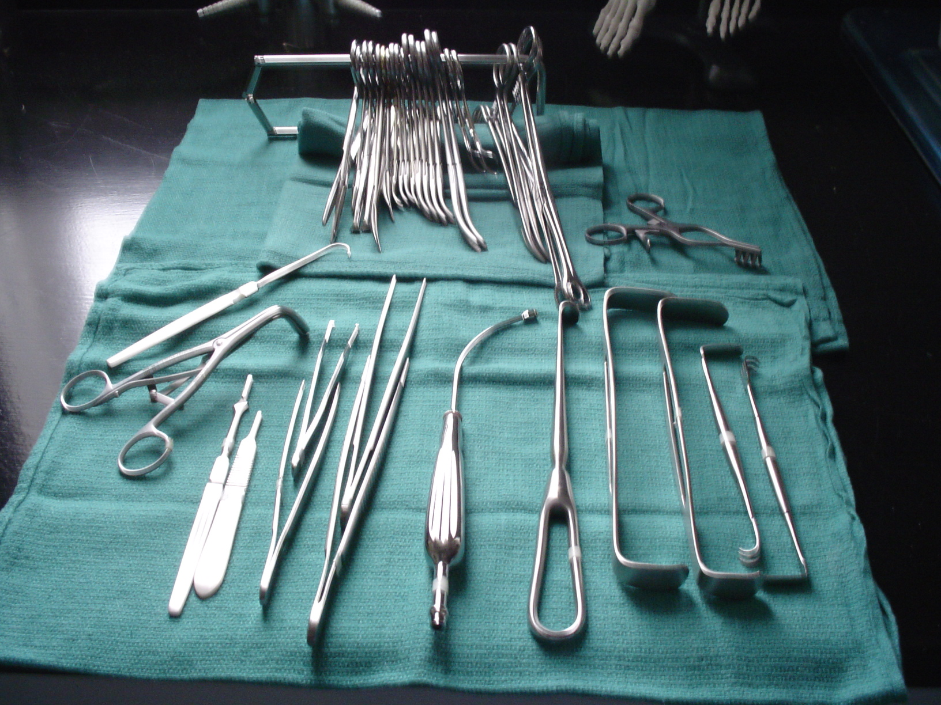
Tracheotomy Tray

Slide 6
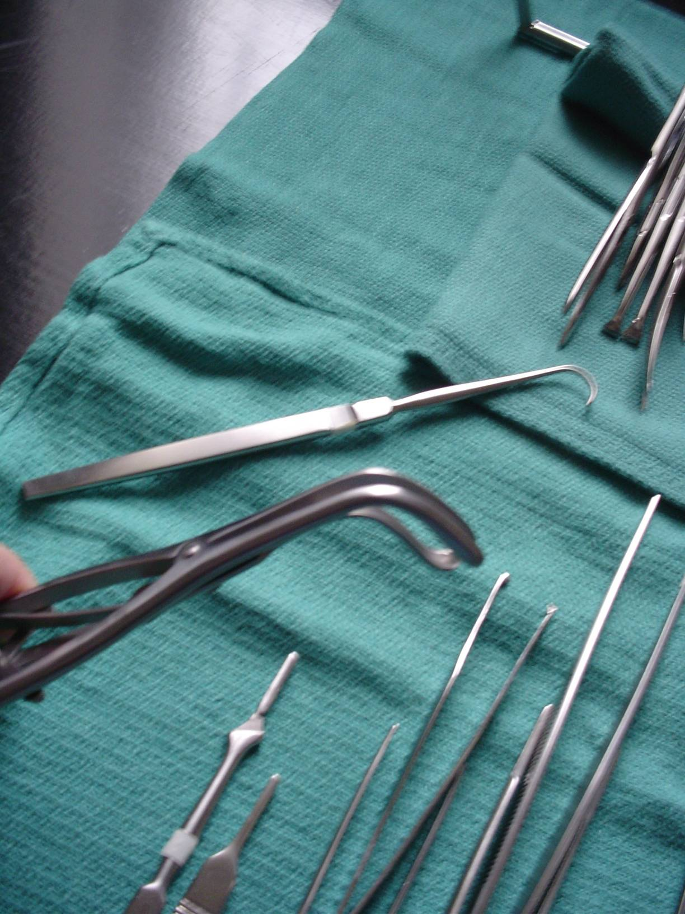
The two instruments you didn’t recognize:
Trach Hook
(blunt tip)
Trach Spreader
“Three prong”
Also come two prong

Slide 7
Peripheral Vascular (PV) Trays
I. Minor PV Tray
Arteriovenous Fistula (AV Fistula)
Embolectomy = removal of an embolus from a vessel
Embolus is undissolved matter in the form of liquid, solid or gas
Thrombectomy = removal of a thrombus from a vessel
Thrombus is a blood clot
Carotid Endarterectomy (CAE)
Any MINOR vascular procedure

Slide 8
Carotid Endarterectomy Instruments
Carotid Endarterectomy- Removal of atherosclerotic plaque from the carotid artery for carotid artery disease
FYI:
Arteriosclerosis = hardening of the arteries with age (we will all have this with age)
Atherosclerosis = blockage/plaque formation in an artery (affected by severity of arteriosclerosis)
Can endarterectomize ANY artery, however, the carotid is the most common one done to the long term positive outcome, unlike endarterectomies of other arteries.

Slide 9
Carotid Tray/Instruments
What you don’t know yet: (See instrument book)
Peripheral vascular clamping and occluding instruments
Rummel/tourniquet keeper p. 152
Bulldog clamps
Freer elevator p. 112
#4 Penfield elevator p. 79
Nerve hook p. 157
Potts-smith (potts) scissors p. 152
Tenotomy scissors p. 152
Dietric forceps (are just fine debakey forceps)
Geralds or Potts forceps p. 157
Mills ring forceps p. 157
Castro-viejo needle holders p.151 (come delicate or heavy and short or longer)
4-12 Used in neuro and ophthalmic surgery as well

Slide 10
Carotid Endarterectomy Instruments
Peripheral vascular clamping and occluding instruments:
Peripheral debakey clamps p. 147 instrument book
Right angle peripheral debakey clamp
*FYI peripheral debakeys come in different sizes as well
PDA (patent ductus arteriosis/coartation clamp/glassman) p. 148 instrument book
Fogarty hydrogrip clamps (take disposable inserts) p. 147 top
Bulldogs (see p.145 instrument book for examples of non-disposable variations)
Henley clamp
Martinez vascular clamp
Javid shunt clamp p. 146

Slide 11
Peripheral Vascular Trays
Major PV Tray:
Femoral-Femoral Bypass Graft
Femoral-Popliteal Bypass Graft
Femoral-Tibial Bypass Graft
Axillo-Femoral Bypass Graft
AAA Repair (Abdominal Aortic Aneurysmectomy)
All of the above are done to correct a stenosis or obstruction somewhere along the flow of these arteries. Lower extremity arterial blood flow is compromised (ischemia), which compromises the limb involved (potential necrosis of limb). We “bypass” or re-route the blood flow to go around the obstruction or stenosis. Obstructions usually caused by atherosclerosis or trauma.
May also be used in conjunction with a “CHEST TRAY” for thoracic (lung) surgeries

Slide 12
Peripheral Vascular Instruments
What you don’t know yet:
Peripheral debakey clamps
Satinsky clamps p. 149
Cooley clamps
Aortic clamps
Fogarty clamps
Fogarty bulldog spring applier p.146

Slide 13
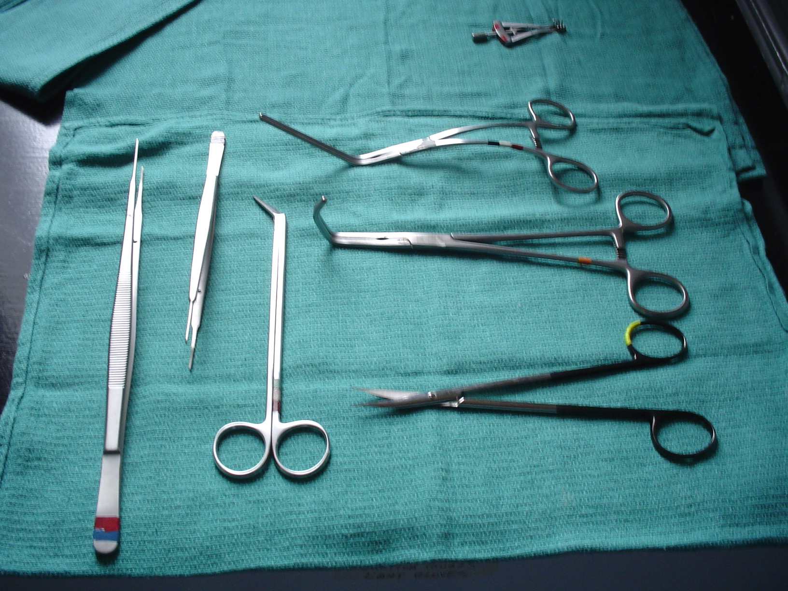
Alms retractor
Potts-smith forceps
AKA Geralds
Peripheral debakey clamp
Satinsky clamp
VASCULAR INSTRUMENTS

Slide 14
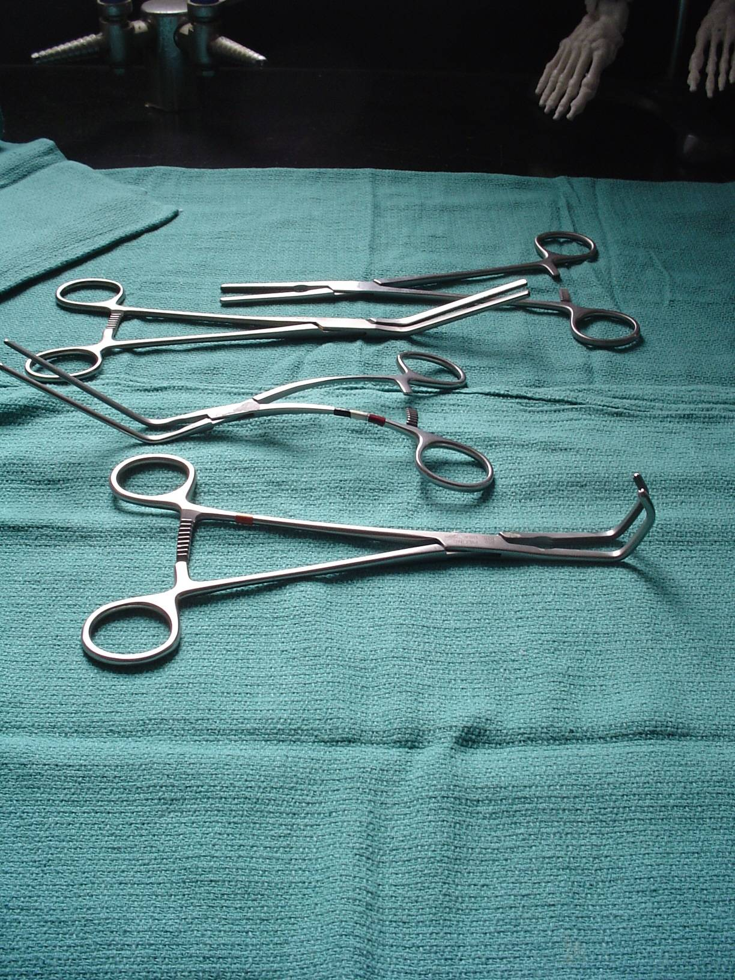
PDAs (patent ductus arteriosis)
Glovers/ Coarctation clamps
Angled and straight
Peripheral Debakey
Satinsky
VASCULAR CLAMPS
All vascular clamps have debakey lined jaws
and are considered clamping/occluding instruments

Slide 15
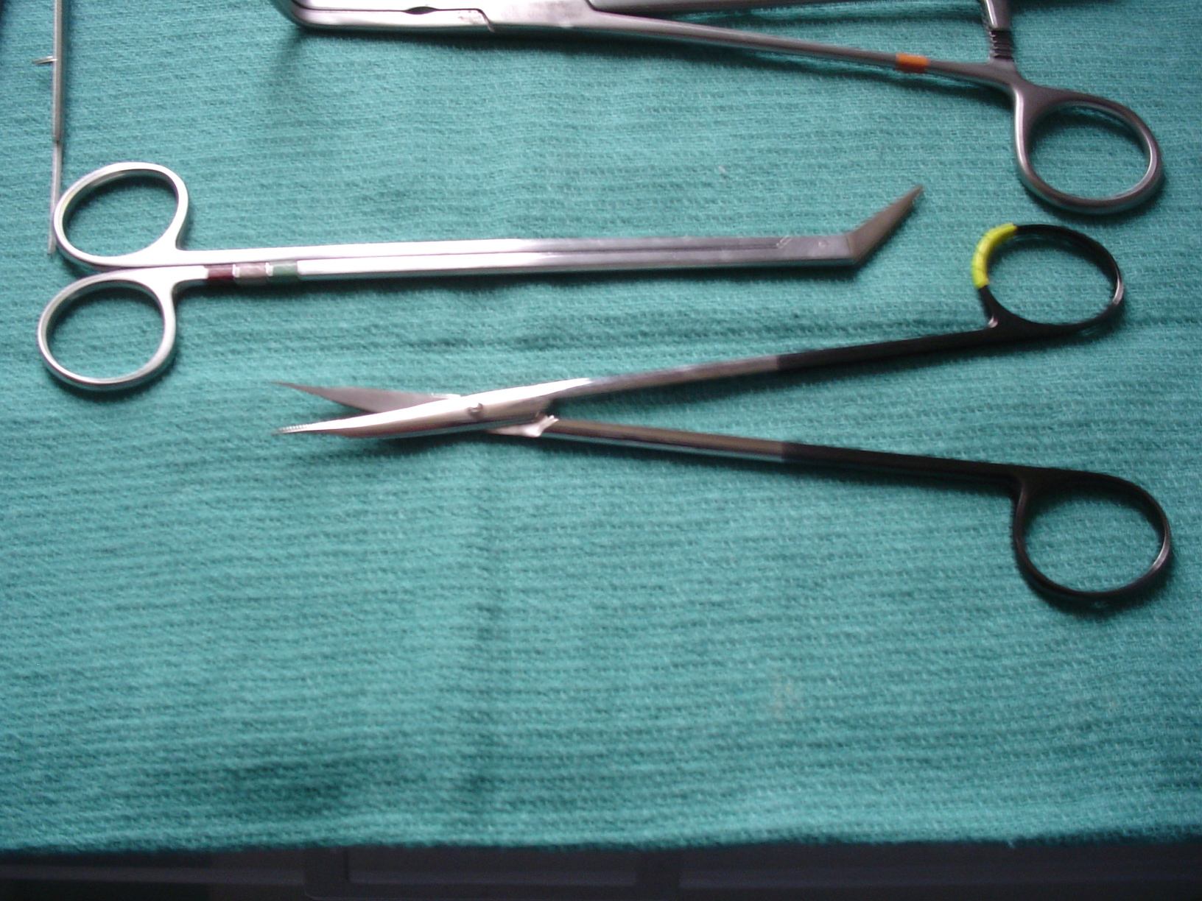
Potts-Smith scissors
or
Potts
Tips come 25º, 45º, 60º, and reverse
Also come in a castro style called “finger Potts”
Used for extending an arteriotomy or duct incision
Tenotomy scissors
See used to cut delicate tissue such as vessels, ducts, nerves

Slide 16
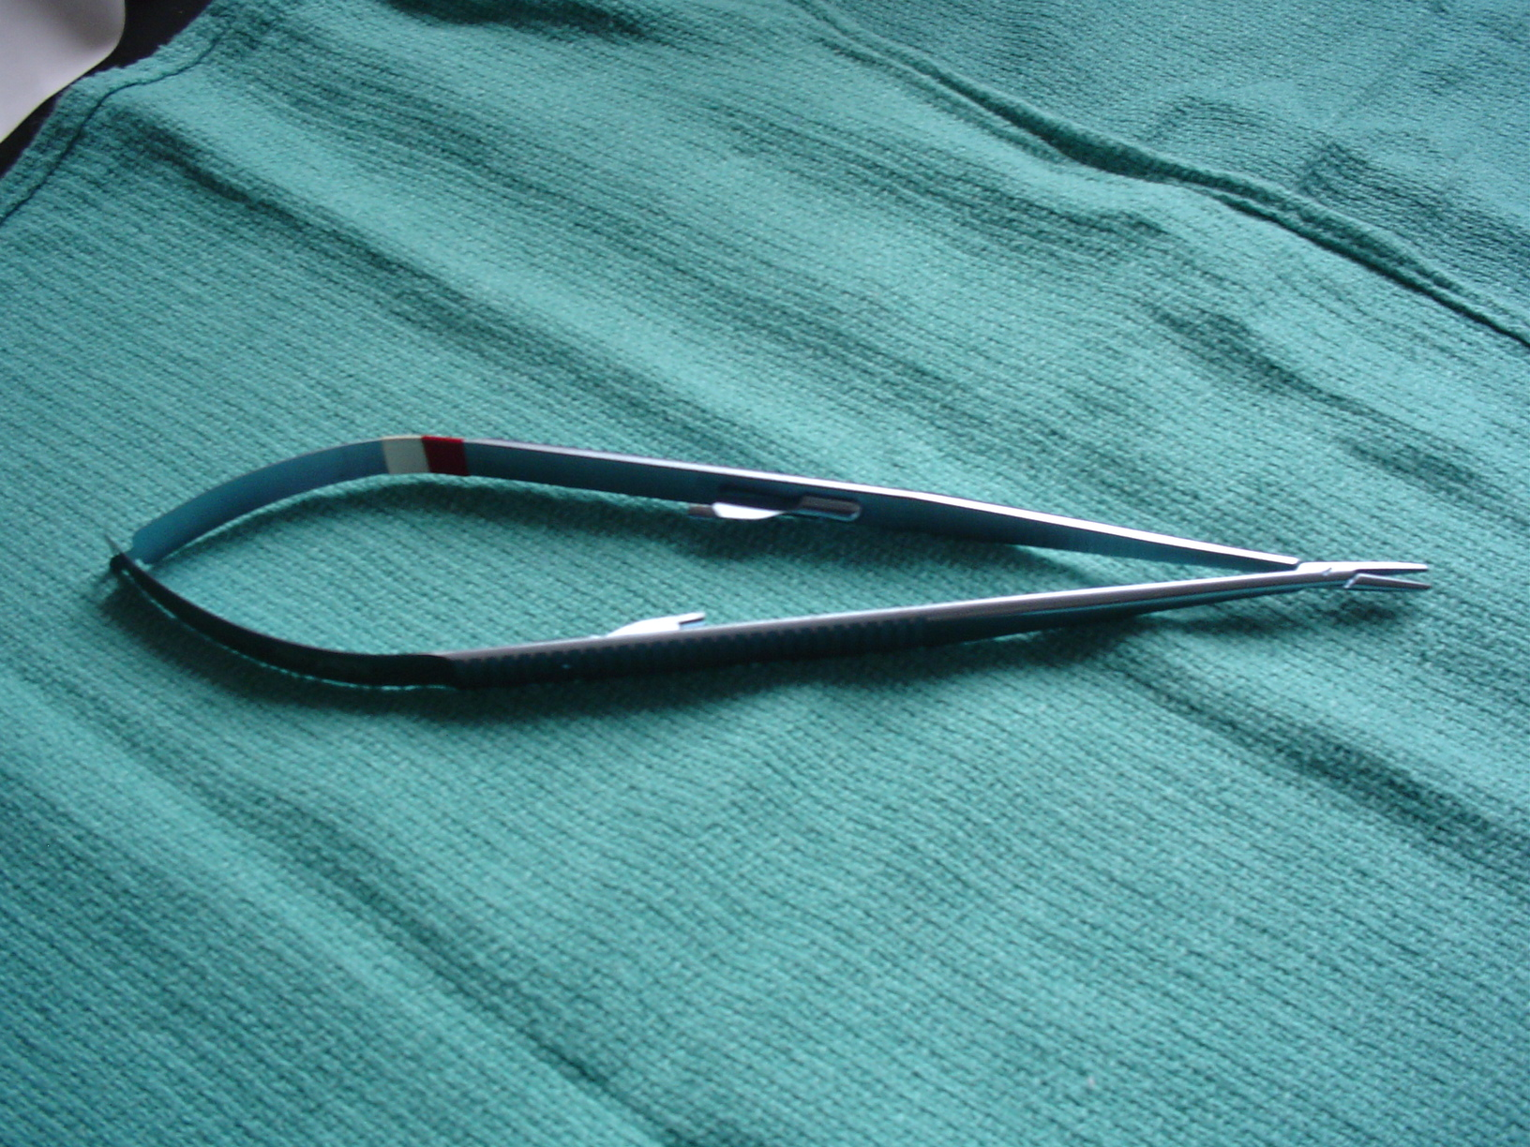
Titanium “locking” Castro-Viejo Needle Holder
Also come non-locking
Come in a variety of finishes, lengths and jaw sizes
See used in Ophthalmic, Cardiovascular, peripheral vascular,
Neurosurgical and plastic surgeries
Jaws are smooth for gripping delicate suture needles
Should not use “fine tipped” castros on larger than 7-0 needle
To preserve tips

Slide 17
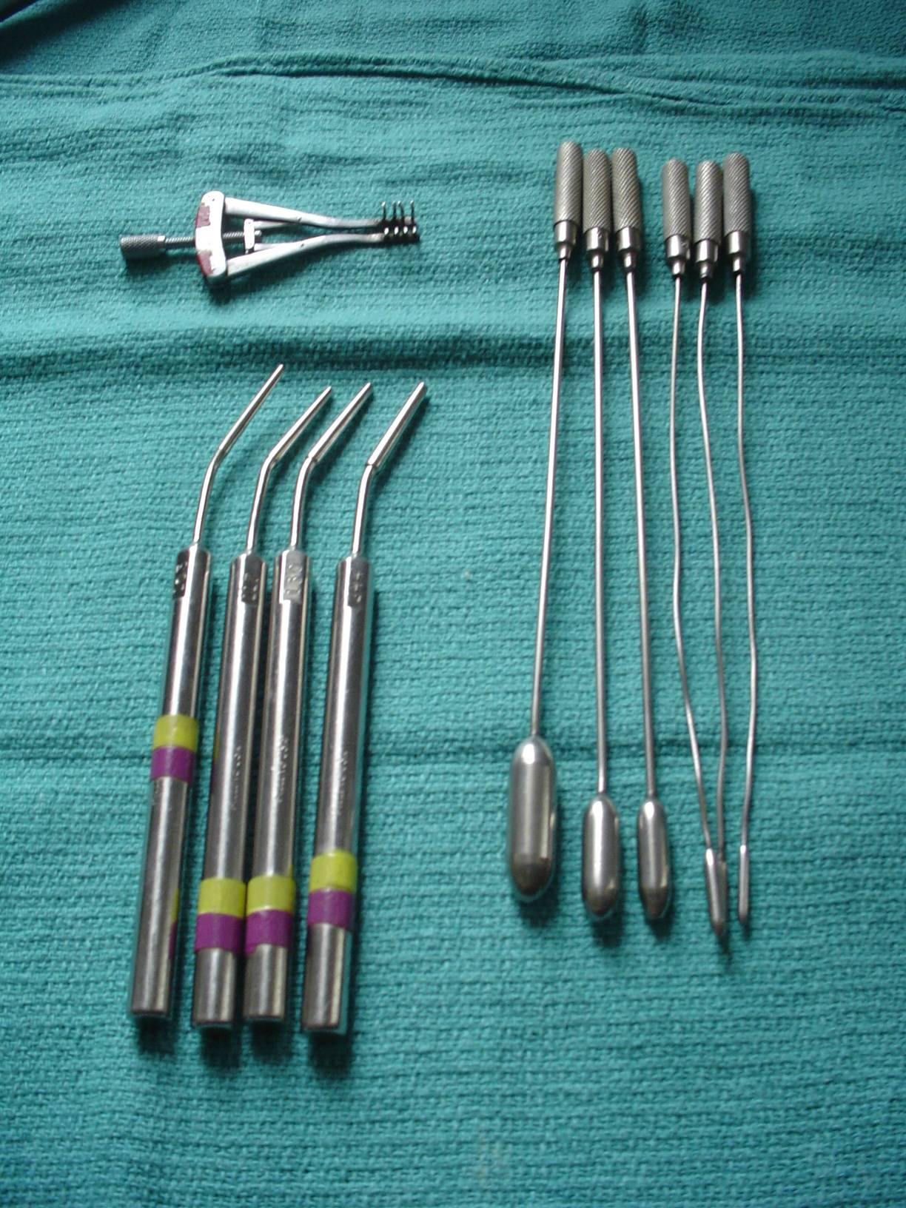
Alms retractor
Garrett dilators
For dilating blood vessels
Vascular dilators

Slide 18
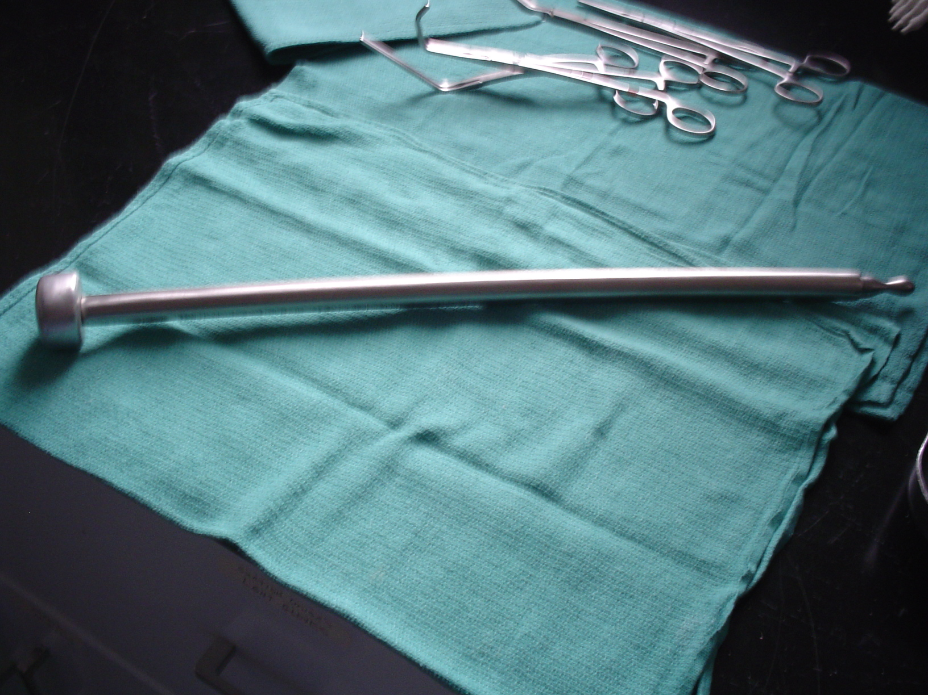
Jackson Tunneler

Slide 19
Chest Trays
Please note following instruments in your instrument book:
Pennington forceps p. 12 (the Pennington has a much smaller
than the Lovelace clamp but identical otherwise)
Duval or Lovelace Lung forceps p.150
Sarot bronchus clamp p. 150
Giertz-Shoemaker rib shears (Guillotine) p. 153
Doyan raspatory p. 154
Alexander raspatory p. 154
Bailey rib approximator p. 155
Allison lung retractor (wisk/egg-beater) p. 155
Tuffier rib spreader/retractor p. 156
Burford rib spreader/retractor p. 156
Davidson scapula retractor (p. 890 ST for the ST)

Slide 20
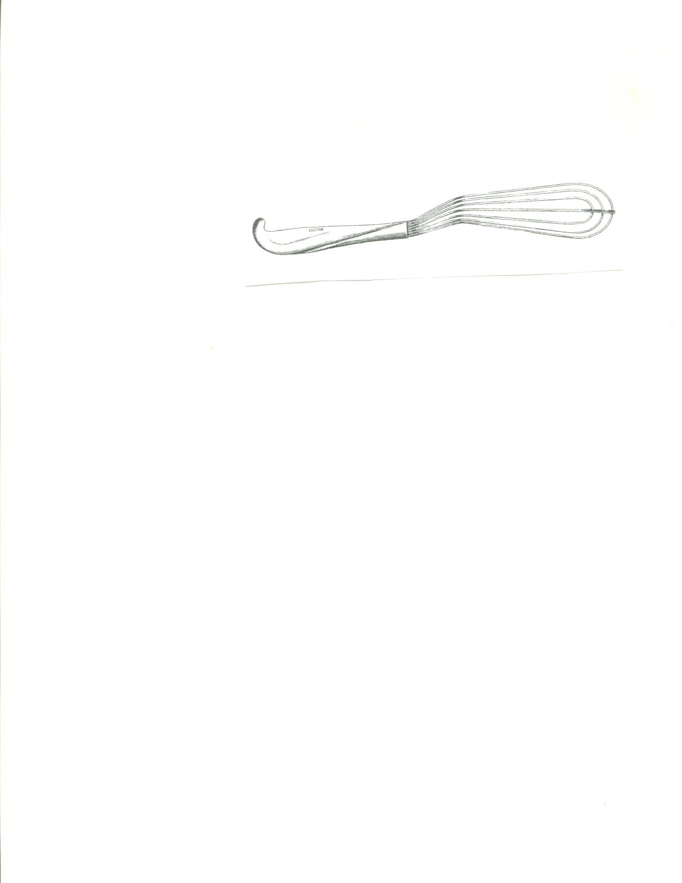
Allison Lung Retractor

Slide 21
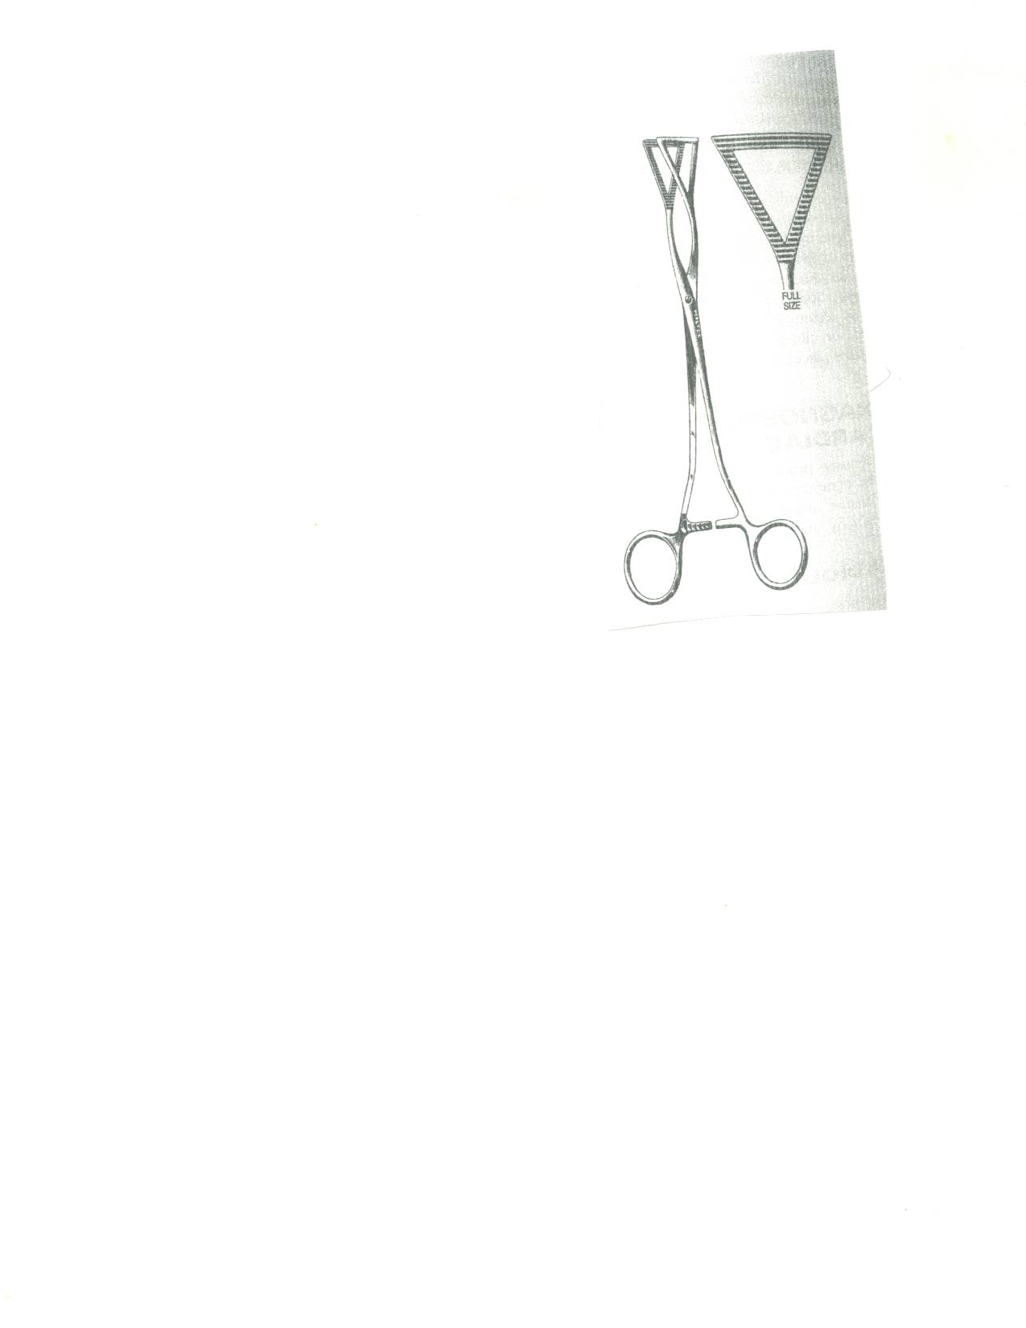
Duval Lung Clamp

Slide 22
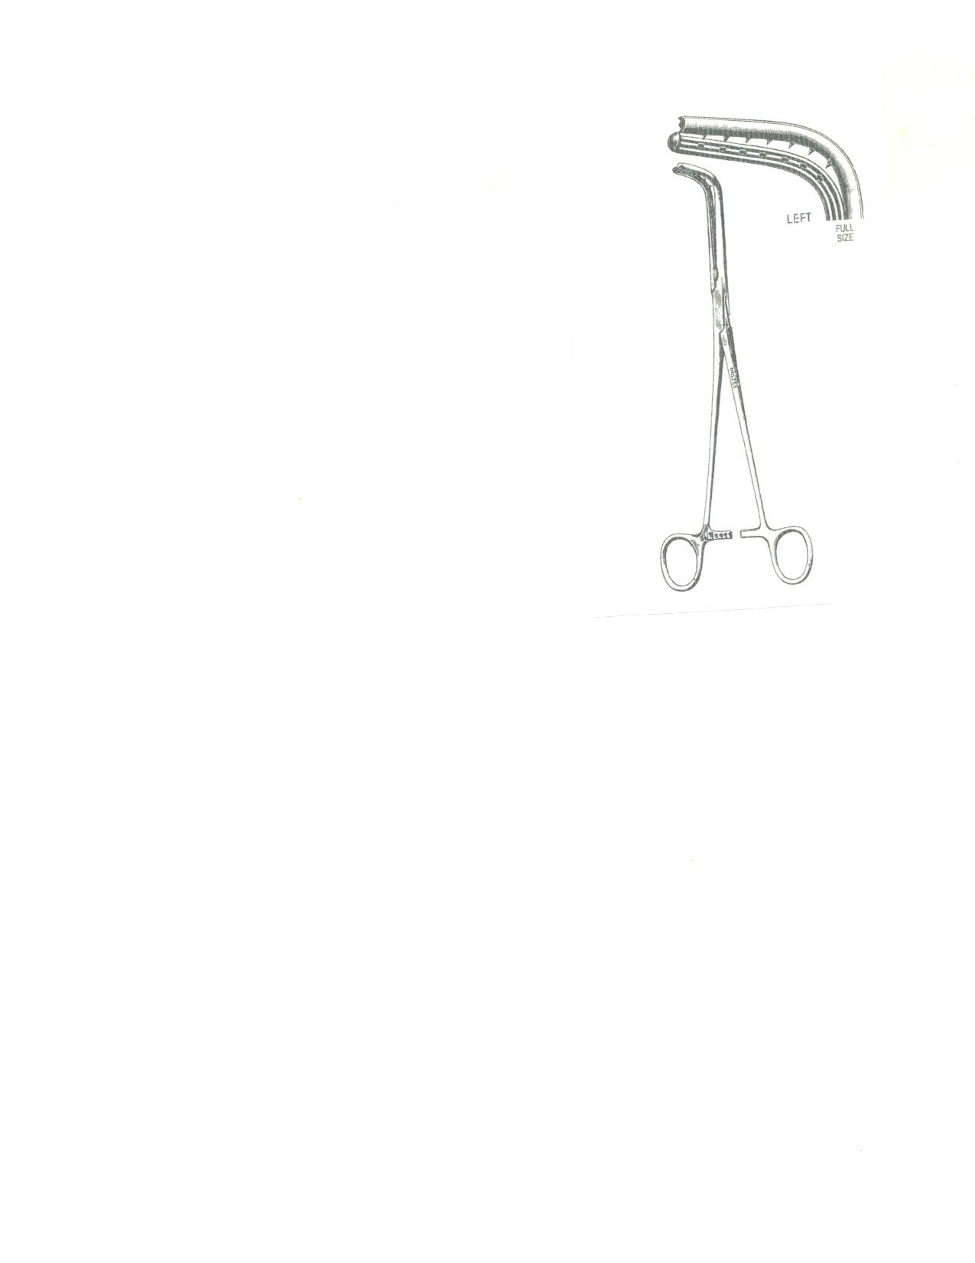
Sarot Bronchus Clamp

Slide 23
Davidson Scapular Retractor

Slide 24
Giertz-shoemaker
aka:”guillotine”
Bethune
Rib Shears

Slide 25
Bailey Rib Approximator

Slide 26
Doyan Pig Tails
raspatories

Slide 27
Cameron
Alexander
Periosteal elevators

Slide 28
Finochietto Rib Retractor

Slide 29
Large Self Retaining Retractor Systems

Slide 30
Self-Retaining
Bookwalter Retractor
(Surgeon preference as there are others)
Self-Retaining abdominal retractor
Used with abdominal procedures
Table post
Rings x 2 (small & large)
Couplers for connection
Blades: Balfour, Richardson, Harrington, Malleables of various widths & lengths
Will hand up wet/wrung out lap with each blade passed for protection

Slide 32
Omni-Tract
(Surgeon preference as there are others)
Self-Retaining abdominal retractor
Used with abdominal procedures
Table post
Arm
Couplers for connection
Blades one piece: Bladder blades, Richardson, Harrington, Malleables of various widths & lengths
Handles and screws for some of the three piece blades
Will hand up wet/wrung out lap with each blade passed for protection

Slide 33
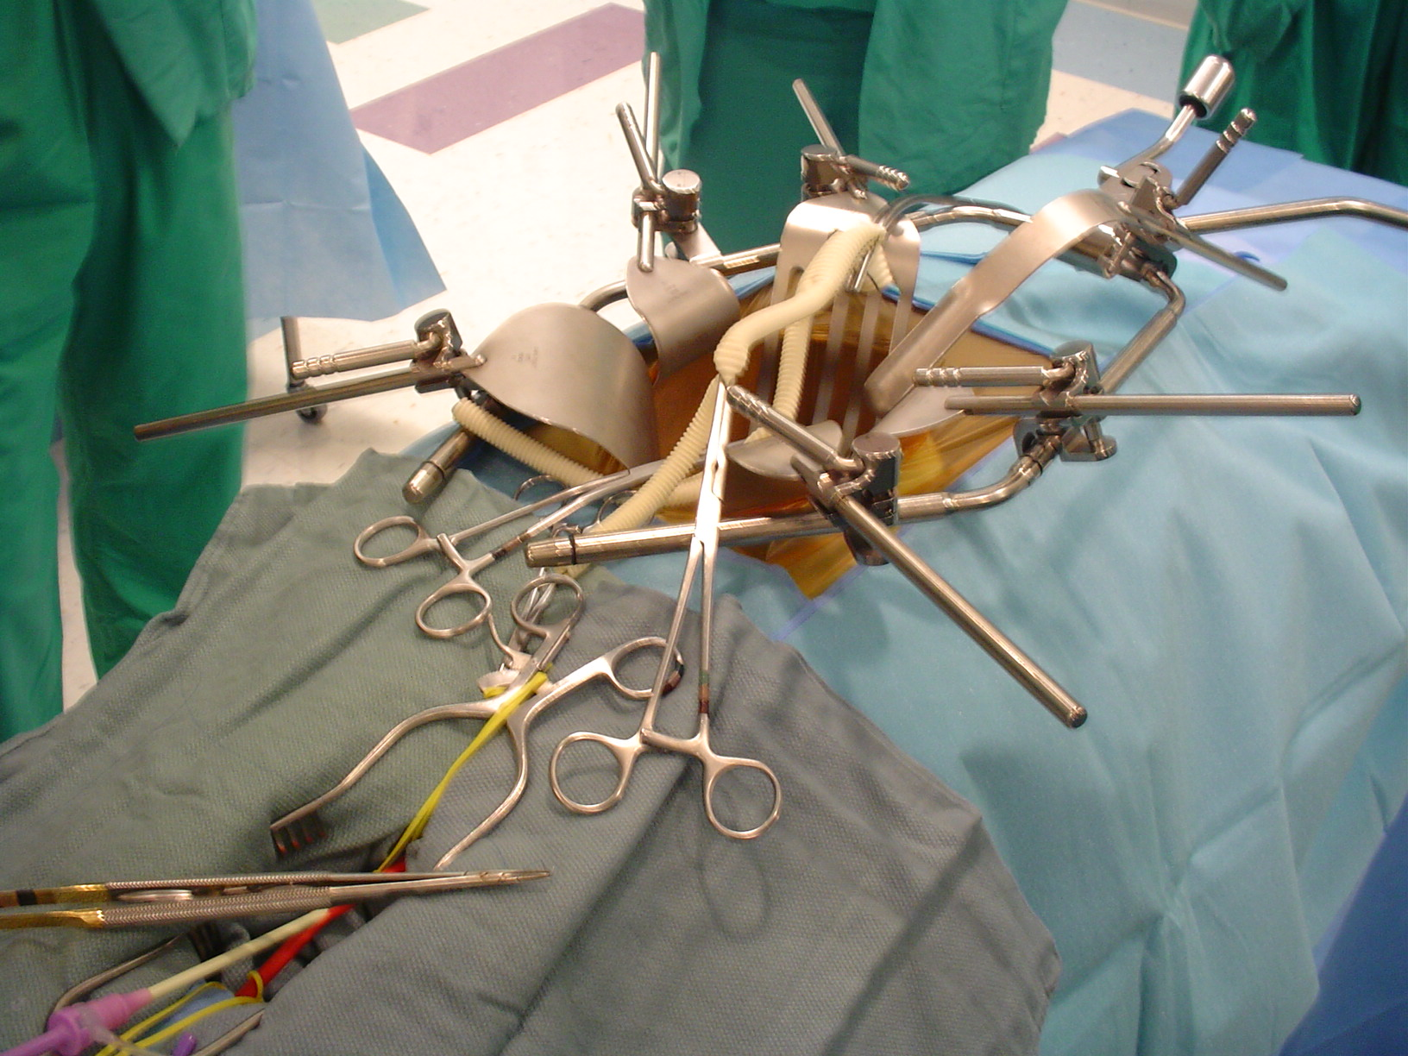
Omni-Tract
Heavy Castro-viejo
Needle holder

