Slide 1
Casts, Drains and Dressings

Slide 2
Fracture management stabilization devices
External fixation
  Casts
    Plaster (fast, medium, slow-setting)
    Fiberglass
    Types
      Shoulder spica
      Minerva jacket
      Body cast
      Short arm/leg
      Long arm/leg
      Hip spica
      Cylinder cast

Slide 3
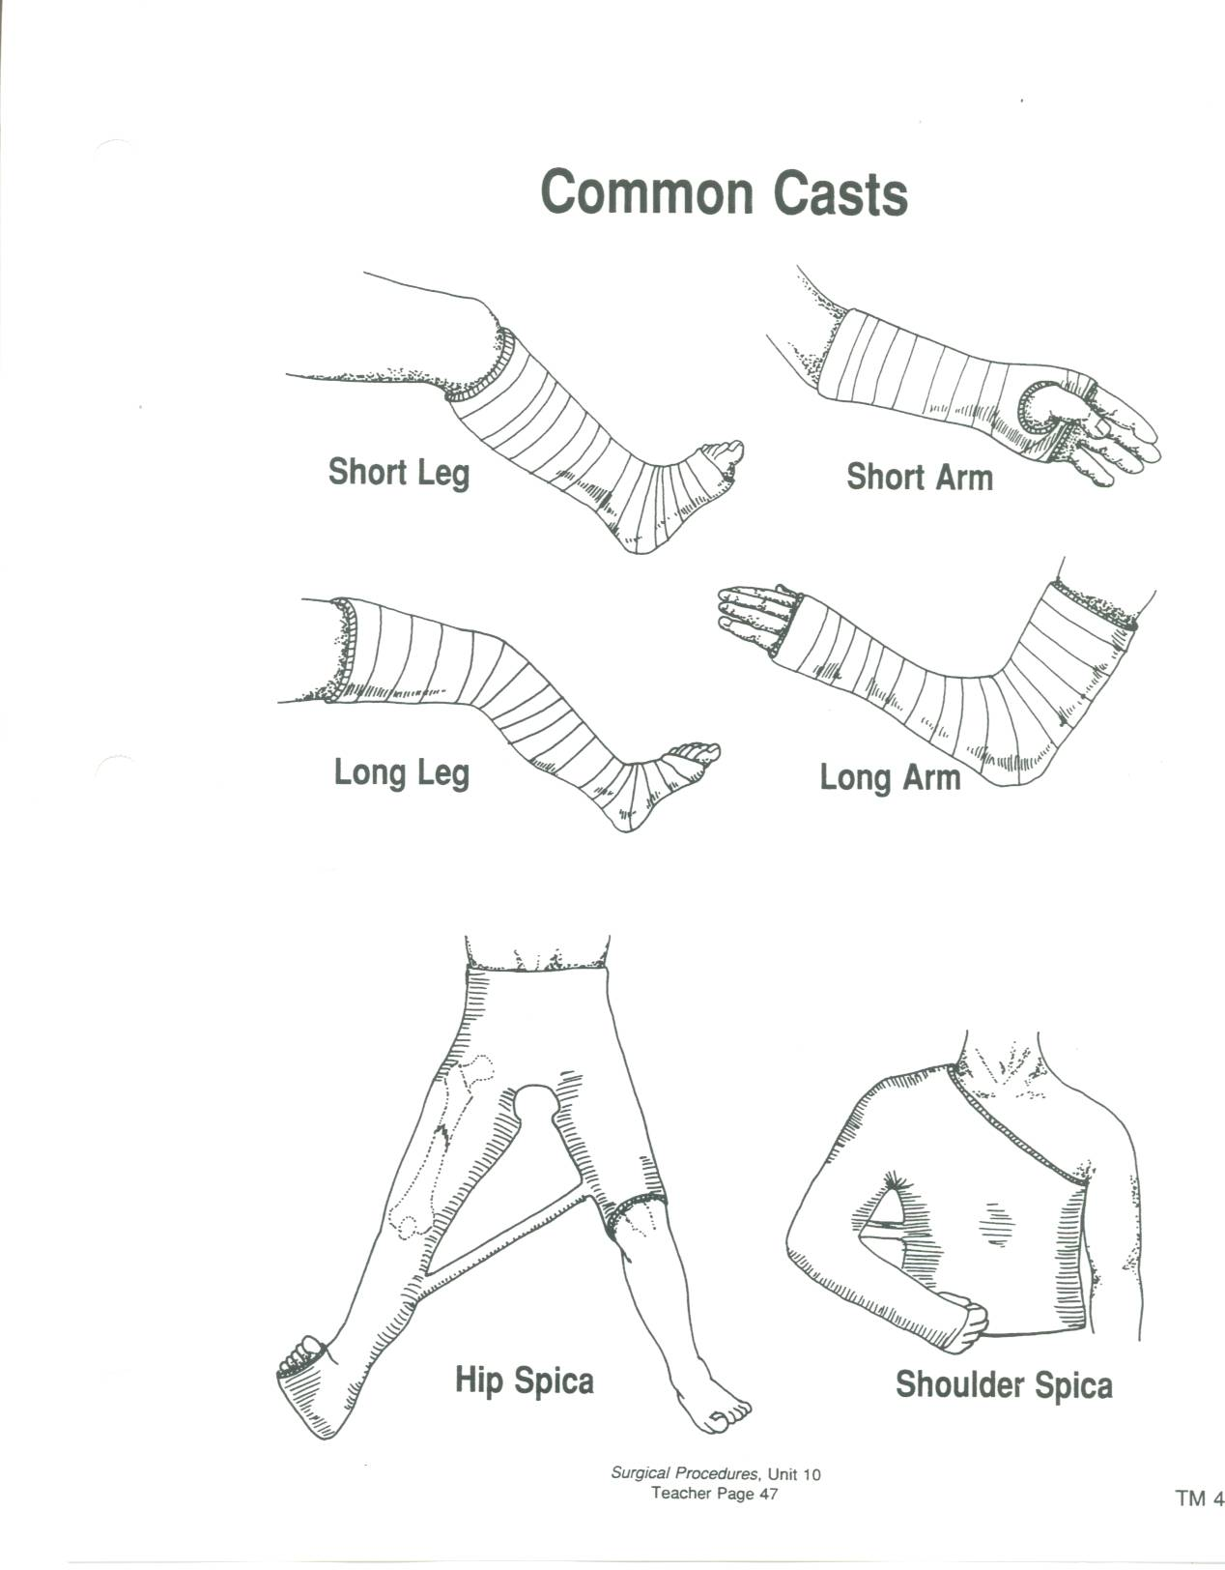

Slide 4
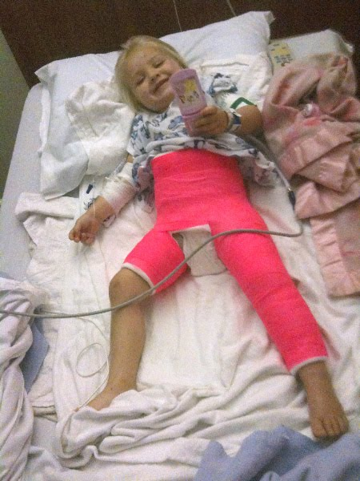
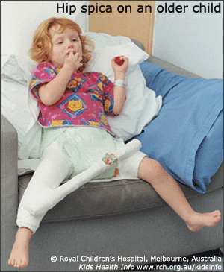
Hip Spica

Slide 5
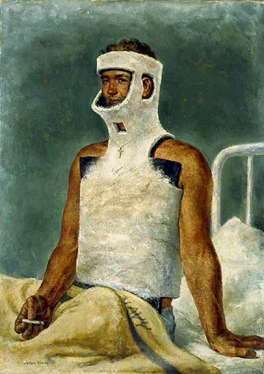
Minerva Jacket
A plaster of Paris body cast incorporating the head and trunk, usually for fracture of the cervical/thoracic spine.

Slide 6
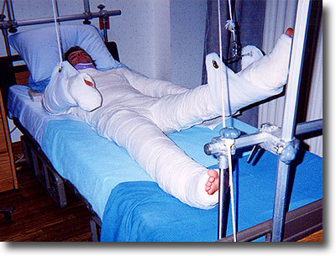
Body cast
Often not a true one piece cast.
What people call a full body cast is often a combination of many smaller casts around a Hip Spica or a Minerva Jacket.

Slide 7
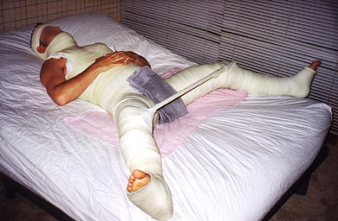
A true(er) full body combo

Slide 8
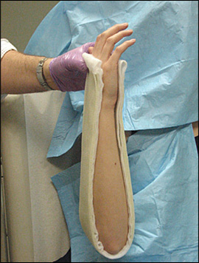
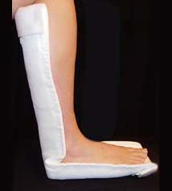
Splints
Sugar Tong splint
Combination of the two – posterior sugar tong splint

Slide 9
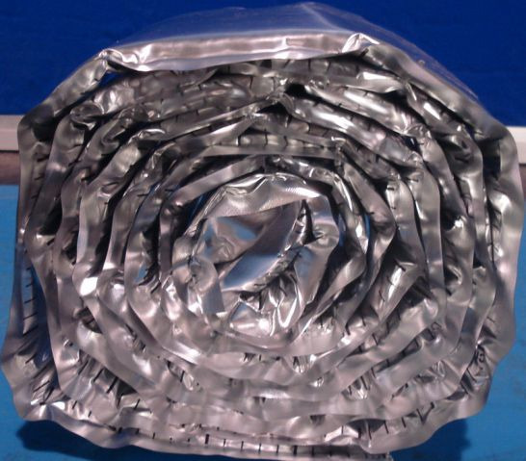
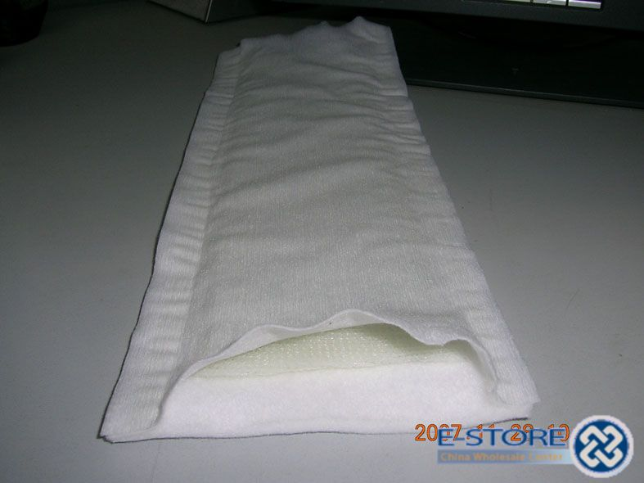
Splint Material
Ortho Glass

Slide 10
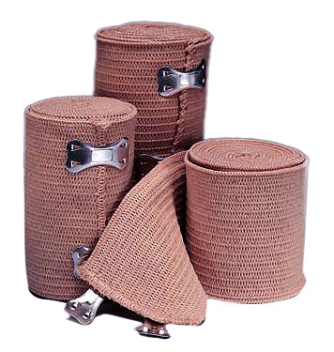
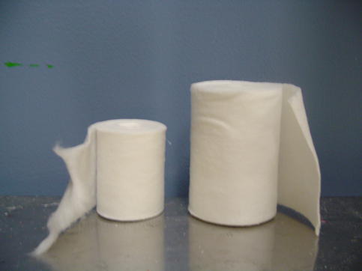
Splint Material

Slide 11
Goals of Casting/Splinting
Relieve pain
Augment healing
Stabilize fracture
Prevent further injury
Splinting better if practical because it is easier to manage swelling considering the entire limb is not isolated by a circumferential cast

Slide 12
Casting Considerations
    Casts
      Proper placement of cast brings patient safety issues
        Patient’s limb should be elevated
        Webril should be placed so no wrinkles are in cotton to cause pressure sores
        As plaster or fiberglass is placed, assistant must not make marks in plaster as it dries—these may cause pressure sores
        Reflective materials will reflect heat given off by
        casting material if fiberglass and may burn patient’s limb
        Tip of limb should be cleaned of all prepping solution so patient may be monitored for signs of circulatory disruption: increasing pain, pain that progresses into numbness, cyanotic skin, cold skin, poor capillary refill

Slide 13
Drains
Catheters –
  used to remove fluid or other objects, such as stone or thrombi, from the body. They are used to monitor body functions and to insert fluids.
Drains are inserted to:
  Evacuate collections of pus, blood or other fluids
  Drain potential collections from a surgical or traumatic wound.
Tubes –
  used for the purpose of decompression (fluid or air)

Slide 14
Drains
Arguments for their use include:
  Drainage of fluid removes potential sources of infection
  Drains guard against further fluid collections
  May allow the early detection of anastomotic leaks or hemorrhage
  Leave a tract for potential collections to drain following removal

Slide 15
Drains
Arguments against their use include:
  Presence of a drain increases the risk of infection
  Damage may be caused by mechanical pressure or suction
  Drains may induce an anastomotic leak
  Most drains abdominal drains infective within 24 hours

Slide 16
Drains
Drains can be:
  Open or closed
  Active or passive – more important
Drains are often made from inert silastic material
They induce minimal tissue reaction

Slide 17
Open drains
Open drains
Include corrugated rubber or plastic sheets
Drain fluid collects in gauze pad or stoma bag
They increase the risk of infection

Slide 18
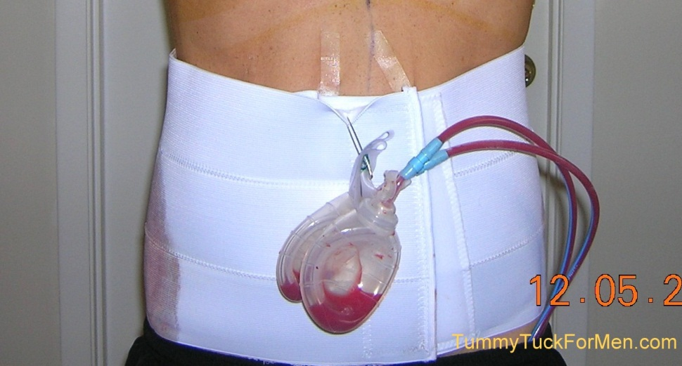
Closed drains
Consist of tubes draining into a bag or bottle
They include chest and abdominal drains
The risk of infection is reduced

Slide 19
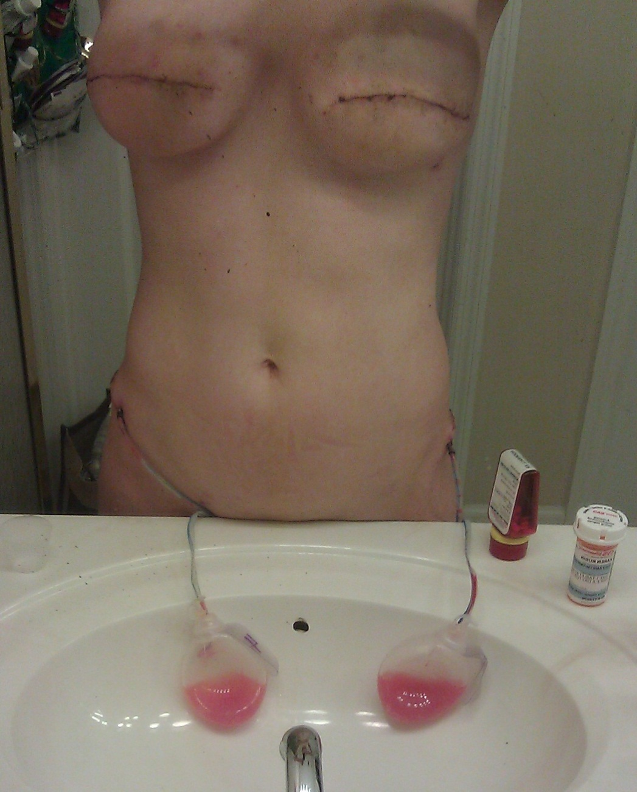
Active drains
Active drains are maintained under suction
They can be under low or high pressure

Slide 20
Passive drains
Passive drains have no suction
Function by the differential pressure between body cavities and the exterior

Slide 21
Examples of drains and operations
Plastic surgery including myocutaneous flap surgery
Breast surgery (to prevent collection of blood and lymph)
Orthopedic procedures (associated with greater blood loss)
Chest drainage
Chest surgery (with for example the associated risks of raised intrathoracic pressure and tamponade)

Slide 22
Examples of drains and operations
Pancreatic surgery (to drain secretions)
Biliary surgery
Thyroid surgery (concern over hematoma and hemorrhage around the airway)
Neurosurgery (where there is a risk of raised intracranial pressure)
Nasogastric tubes
Urinary catheters

Slide 23
Nasogastric tubes
Following abdominal surgery gastointestinal motility is reduced for a variable period of time
Gastrointestinal secretions accumulate in stoma and proximal small bowel
May result in:
  Postoperative distension and vomiting
  Aspiration pneumonia
Little clinical evidence is available to support the routine use of nasogastric tubes
May increase the risk of pulmonary complications
Of proven value for gastrointestinal decompression in intestinal obstruction
Tubes are usually left on free drainage
Can be also aspirated maybe every 4 hours
Can be removed when volume of nasogastric aspirate is reduced

Slide 24
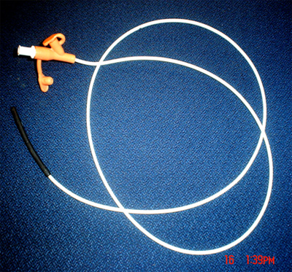
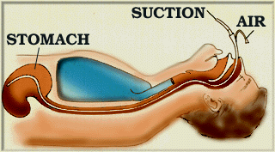
Nasogastric tubes

Slide 25
Urinary catheters
A urinary catheter is a form of drain
Commonly used to:
  Alleviate or prevent urinary retention
  Monitor urine output
Can be inserted transurethrally or suprapubically

Slide 26
Urinary catheters
Catheters vary by:
  The material from which they are made (latex, plastic, silastic, teflon-coated)
  The length of the catheter (38 cm 'male' or '22 cm 'female')
  The diameter of the catheter (10 Fr to 24 Fr)
  The number of channels (one, two or three-irrigation)
  The size of the balloon ( 5ml to 30 ml)
  The shape of the tip – i.e. Coude tip

Slide 27
Do's and don'ts of urinary catheters
Choose an appropriate sized catheter
Insert using an aseptic technique
Never insert using force
Do not inflate the balloon until urine has been seen coming from the catheter
Record the residual volume
Do not use a catheter introducer unless you have been trained in its use
If difficulty is encountered inserting a urinary catheter consider a suprapubic
Remove at the earliest possibility

Slide 28
Types of Active Drains
JP’s
Hemovac’s
Pleuravac

Slide 29
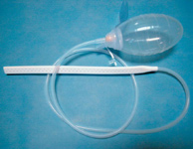
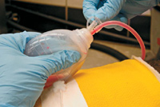
JP’s
Can be flat or round
Will always have a “grenade” – the bulb section.
The bulb provides the suction, thus making it an active drain.

Slide 30
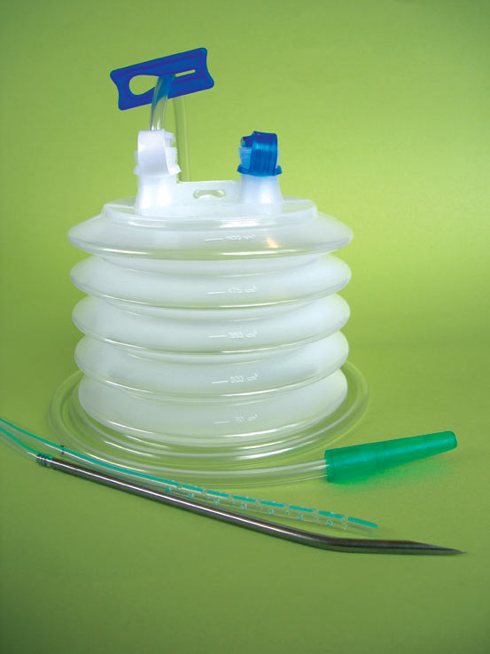
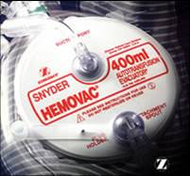
Hemovac’s
Used post-op;
for up to 400mL of drainage;
uses negative pressure by spring action.
Springs are inside the drain container.

Slide 31
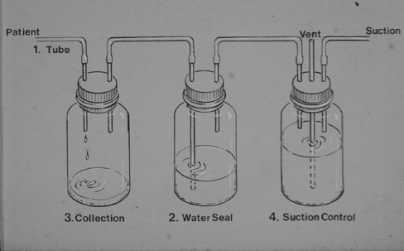
Pleur-vac
Chest drainage units are used after open heart, thoracic or emergency surgery procedures to evacuate air and fluid present in the thoracic cavity. Without chest drainage, positive pressure may build up in the thoracic cavity and lead to significant patient problems.
Pleur-evac inventor and surgeon, Dr. Sidney Mishkin, was inspired to act after he saw a nurse drop and break glass bottles traditionally used in chest drainage.
Look to BB for further information – Chest Tubes.docx

Slide 32
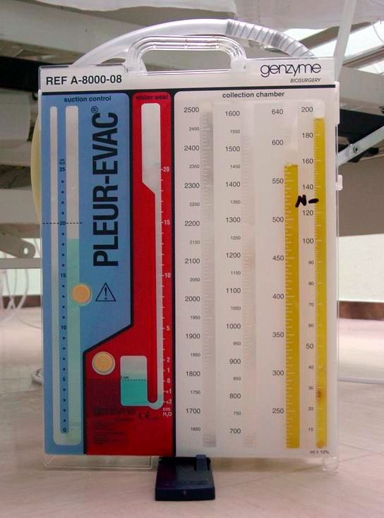
Pleur-vac
This is the new system!
Much improved.
Chest tubes hook up to the large tubes in the top of the active drain chamber.
Another tube hooks up to regulated wall suction.
Chest Tube Placement Video-- Messy :)

Slide 33
Types of PassiveDrains
Penrose
Cigarette
T-Tube
Gastrostomy Tube
Cystostomy tube
Nephrostomy tube

Slide 34
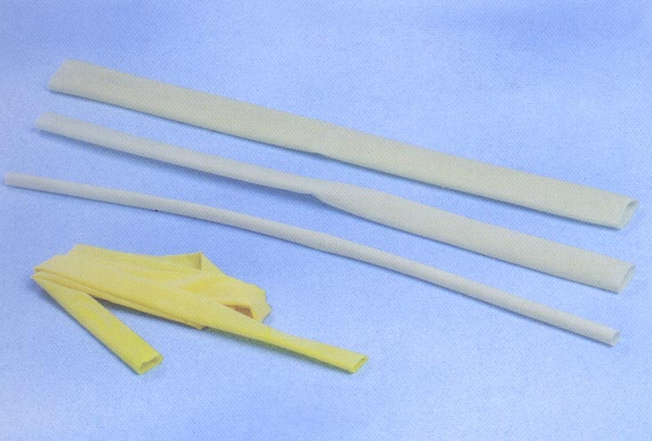
Penrose
A Penrose drain is a surgical device placed in a wound to drain fluid.
It consists of a soft rubber tube placed in a wound area, to prevent the build up of fluid.

Slide 35
Cigarette Drain
A drain made of gauze surrounded by a rubber tissue, rubber dam, or rubber tubing.
Encourages draining by wicking action

Slide 36
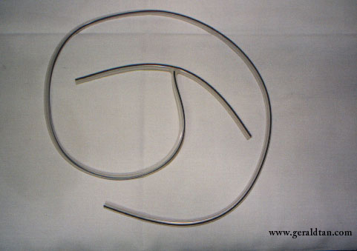
T-Tube
Placed within the biliary system.
The T-tube allows bile to drain out of the patient's body into a small pouch, known as a bile bag.

Slide 37
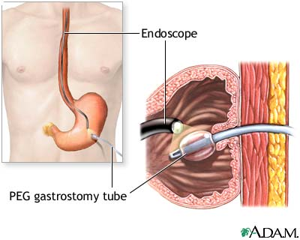
Gastrostomy Tube
used to provide nutrition to patients who cannot obtain nutrition by swallowing.
Also used to remove gastric contents.
Also called a feeding tube
a tube inserted through a small incision in the abdomen into the stomach

Slide 38
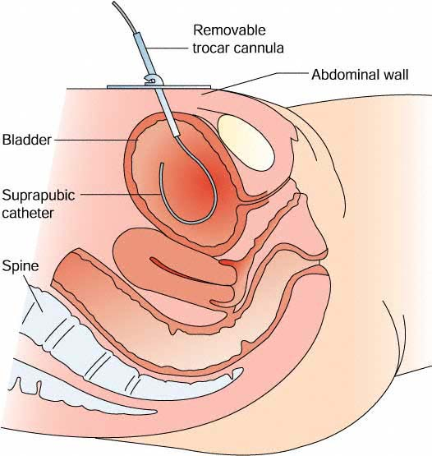
Cystostomy tube
the construction of an artificial opening from the bladder through the abdominal wall, permitting the drainage of urine.

Slide 39
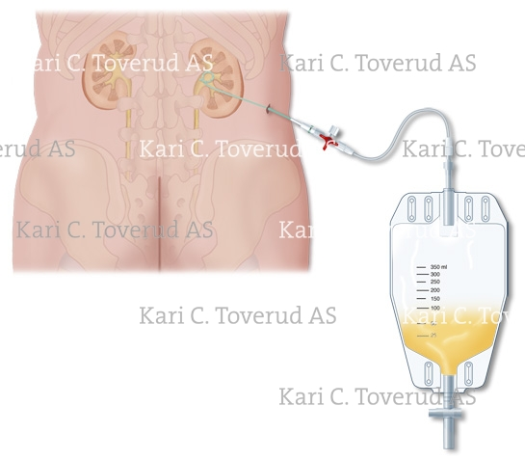
Nephrostomy tube
Tube inserted into the kidney to drain urine.
The ureter is the fibromuscular tube that carries urine from the kidney to the bladder. When this tube is blocked, urine backs up into the kidney.
Serious, irreversible kidney damage can occur because of this backflow of urine. Infection is also a common consequence in this stagnant urine.

Slide 40
Drain considerations
General guidance
If it is an active drain, the drain can be attached to a suction source (and set at prescribed pressure).
Ensure the drain is secured (dislodgement is likely to occur when transferring patients after anesthesia). Dislodgement can increase the risk of infection and irritation to the surrounding skin.
Accurately measure and record drainage output.
Monitor changes in character or volume of fluid. Identify any complications resulting in leaking fluid (particularly for example bile or pancreatic secretions) or blood.
Use measurements of fluid loss to assist intravenous replacement of fluids.

Slide 41
Dressings
Look at ST 270-272

