Slide 1
Otorhinolaryngological Surgery
ENT
SURGERY

Slide 2
Purpose
Ear: improve, restore, preserve hearing
Nose: restore or improve breathing/ventilation, ensure drainage of the sinuses, control epistaxis
Throat: prevent infection, remove a tumor/mass, perform life-saving procedures

Slide 3
Otorhinolaryngological Surgery
Ear
Nose
Throat
Endoscopy
Triple endoscopy
Thyroid & Parathyroids
Tracheotomy
Terms
A & P
Pathology
Anesthesia & Meds
Positioning, Prep, & Draping
Supplies, Equipment, & Instrumentation
Considerations & Complications

Slide 4
The Ear

Slide 5
TERMINOLOGY of the EAR
Auditory- related to sense of hearing
Auditory acuity- sharpness/acuity of sense of hearing
Aural – related to the ear
Conduction – transmission of sound waves through air or bone (conduction media)
Conductive loss – hearing loss related to external or middle ear defect, disease, infection, trauma (can be restored by surgery)
Decibel – unit used for measuring sound and degree of hearing loss
Mastoiditis – inflammation in mastoid process
Meniere’s Disease or Syndrome- disorder of inner ear’s labyrinth
(sx: deafness, tinnitus, dizziness, feeling of ear pressure or fullness)
Ossicle – referring to one of the following small ear bones: malleus, incus, stapes

Slide 6
Terminology of the Ear Continued
Otitis media – acute or chronic inflammation of the middle ear
Oto – related to the ear
Otology – related to the ear
Otosclerosis – formation of spongy bone around the oval window that causes immobility of the stapes resulting in deafness
PE Tubes (pressure equalization) – drainage tubes placed in the eardrum or tympanic membrane allowing drainage of fluid in the middle ear preventing fluid build up that leads to infection
Sensorineural loss – defect in the inner ear from nerve tissue damage that causes hearing loss (surgery does not help)
Tinnitis – a subjective symptom of ringing in the ear
Vertigo – sensation of dizziness

Slide 7
Anatomy of the Ear
Outer Ear
Auricle or pinna
Auditory meatus extends to the tympanic membrane
Lined with fine hairs
Ceruminous glands secrete cerumen
Function to collect sound and direct it down a hole in the temporal bone

Slide 8
Anatomy of the Ear
3. Tympanic Membrane
Eardrum
Separates outer ear from middle ear
Normally pearly grey

Slide 9
Anatomy of the Ear
Middle Ear
Tympanic cavity
Eustasian tube/canal equalizes pressure
Auditory ossicles: lateral to medial (from tympanic membrane in):
Malleus (hammer)
Incus (anvil)
Stapes (stirrup)

Slide 10
Anatomy of the Ear
Inner Ear (labyrinth)
Bony
Membranous
Are complex canals and chambers called the semi-circular canals
Equilibrium (Vestibular Apparatus)
Hearing (Organs of Corti in the Cochlea)
Notes:
Vestibular apparatus primary organ of equilibrium

Slide 11
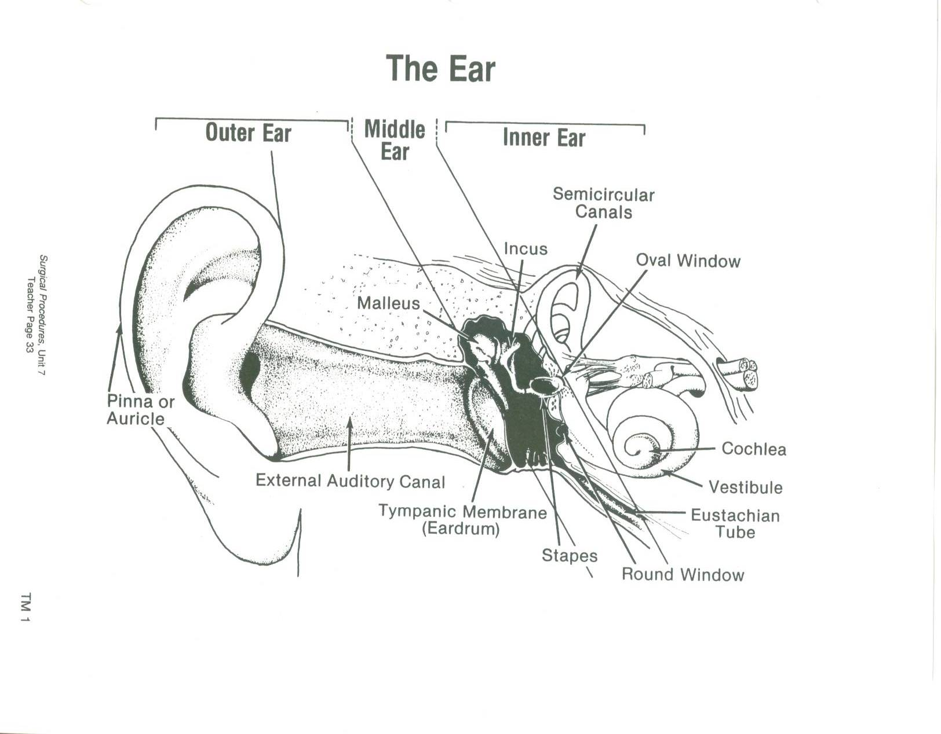

Slide 12
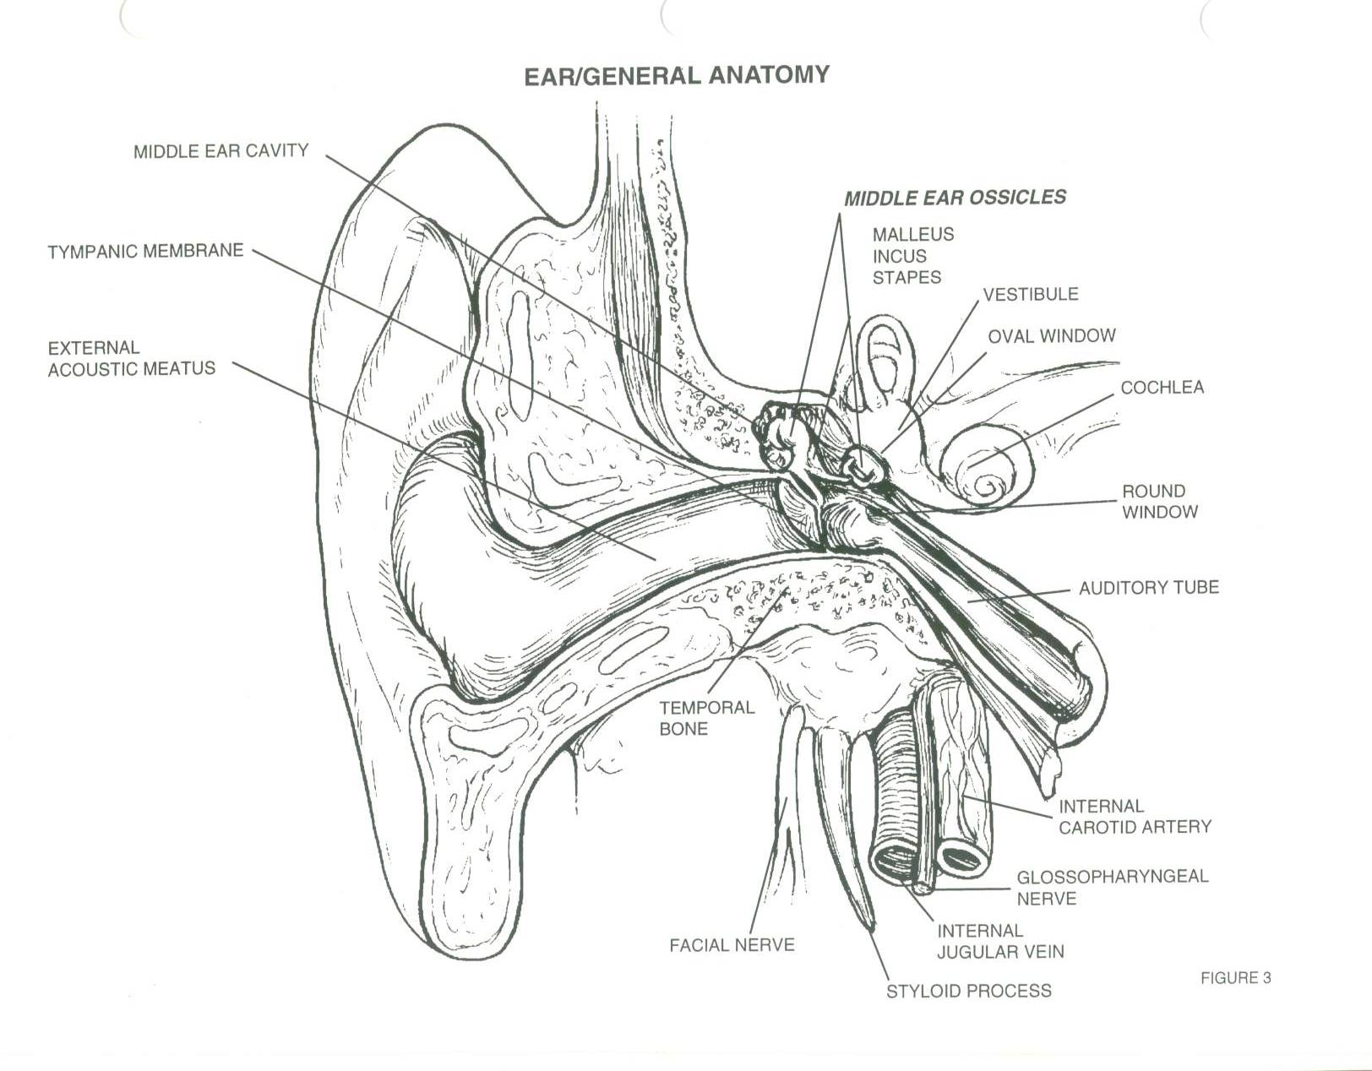

Slide 13
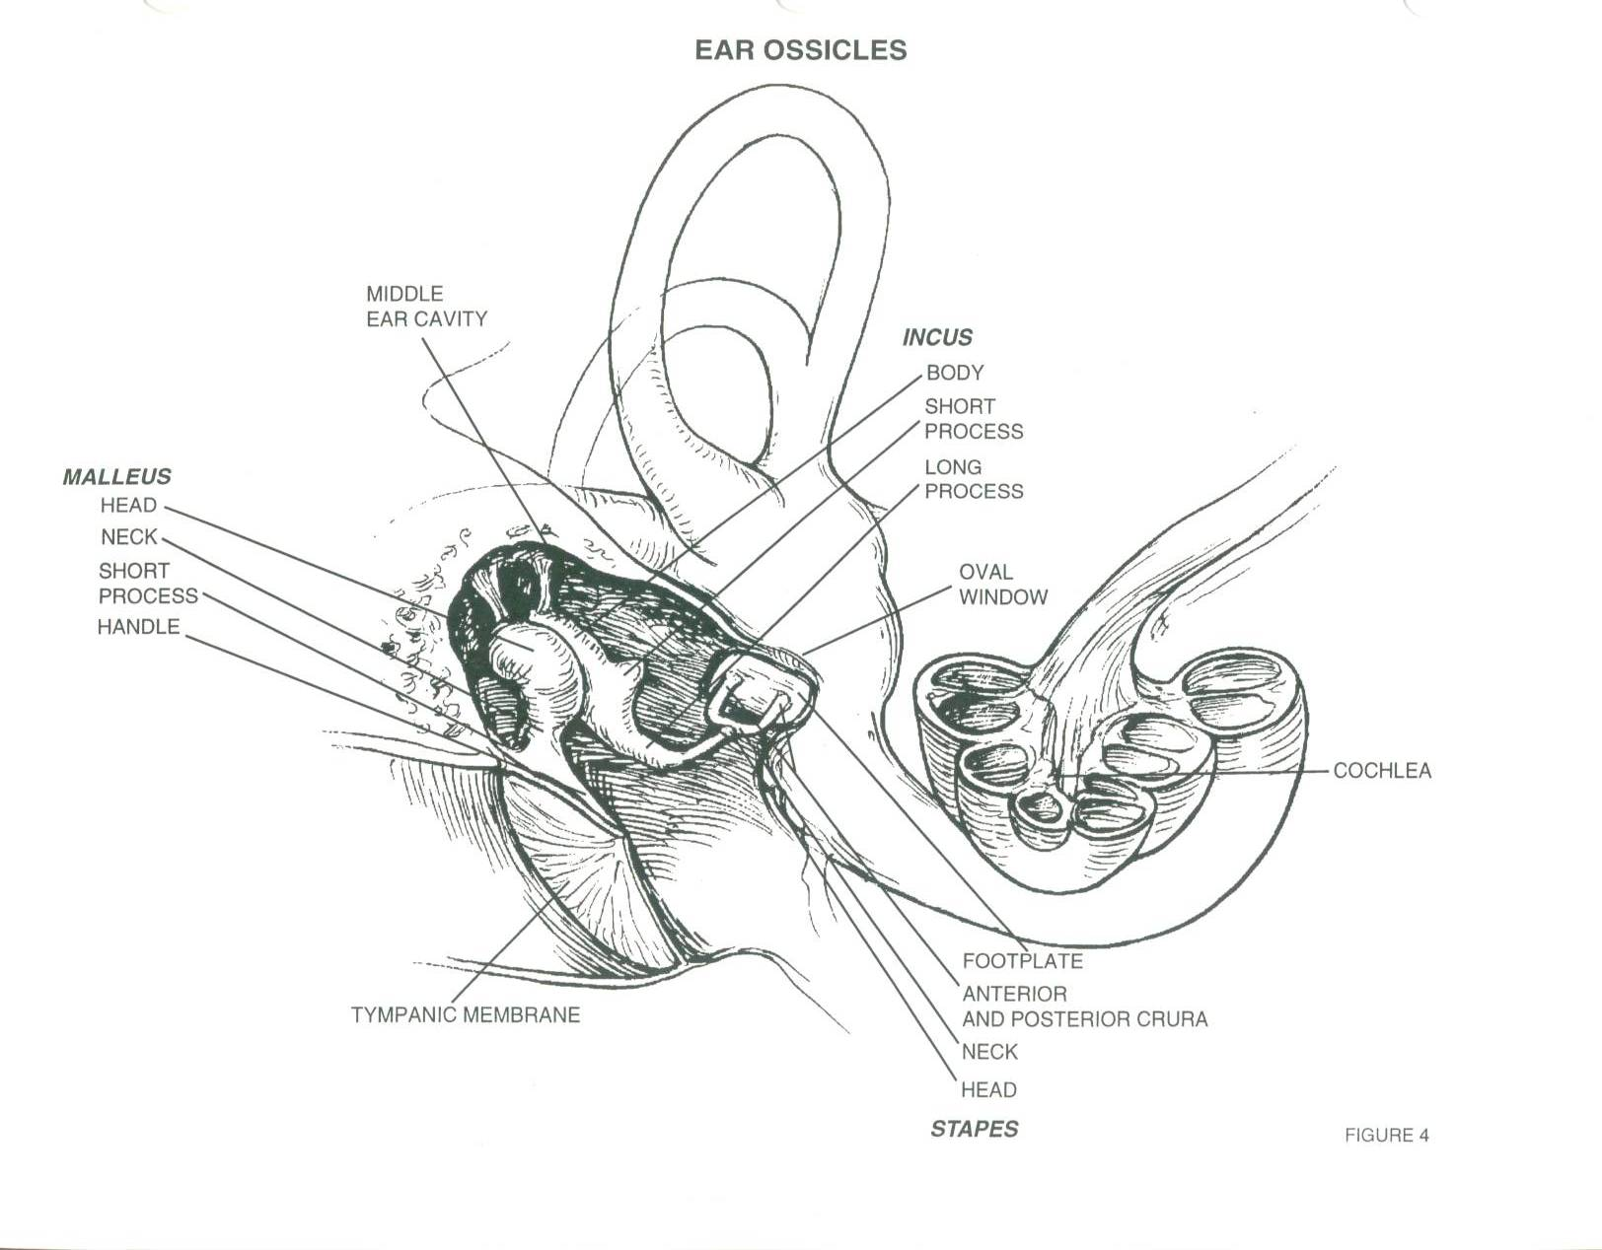

Slide 14
Physiology of Hearing
Hear a sound>hits auricle>external auditory canal>tympanic membrane (vibration occurs) >malleous connected to tympanic membrane and therefore moves>incus moves>stapes moves>in and out of oval window>pushes on perilymph fluid in bony canal of vestibule>pushes on vestibular membrane and pushes endolymph fluid in the hollow of the chambers>which pushes against a membrane of the organ of corti housed in the cochlea to move>this stimulates axons which become the cochlear branch of vestibulo-cochlear nerve>ending in the auditory area of cerebrum that interprets sounds

Slide 15
Equilibrium
Semicircular canals (3 per ear)
Hollow filled with fluid endo-lymph
Axons form vestibular portion of vestibulo-cochlear nerve
Fluid when turn or spin stimulates dendrites and tell body you are moving in a certain direction
Detect 3 planes of movement
Primarily interpreted in cerebellum

Slide 16
Cranial Nerve VIII
Vestibulo-cochlear (VIII)
Vestibular portion balance
Cochlear portion hearing

Slide 17
Pathology
Hearing Loss
Three main types:
Conduction type (interference)
Sensorineural (nerve death-cochlea))
Mixed-Type (conduction and nerve)-can only treat conduction
Other types:
Congenital-rubella or toxic drug exposure in utero
Neonatal-prematurity, trauma, Rh incompatibility
Central-acoustic portion of cerebral cortex
Notes:
P. 477 Caruthers

Slide 18
Outer Ear
Obstruction
Exostoses-outgrowths in outer ear canal
Polyps
Infection
Abscess

Slide 19
Pathology
Tympanic membrane
Perforation
Rupture
Middle Ear
Trauma
Perforation
Fluid accumulation
Otitis media
Otosclerosis-overgrowth of stapes (stapedectomy)
Notes:
p. 478

Slide 20
Pathology
Mastoid
Mastoiditis
Cholesteatoma-benign tumor usually result of ruptured eardrum that has not healed properly, can erode into mastoid one and into brain untreated
Inner Ear
Meniere’s syndrome-endolymphatic fluid absorption failure-can tx surgically with a shunt if medical treated is unseccuessful
Notes:
p. 478

Slide 21
Diagnostic Testing
Audiometry - measures hearing
Otoscope –scope used to view external and middle ear
CT scan
MRI
Tympanogram contrast middle ear through Eustachian (auditory) tube
Electronystagmogram (ENG) - assesses
extra-occular muscles (nystgmus=involuntary back and forth movement of eyeballs) caused by lesions of labyrinth or vestibular branch of VIII

Slide 22
Anesthesia
General:
Inhalation (LMA)
Intubation

Slide 23
Medications
Local anesthetics (with or without epinephrine)
Gelfoam
Bone wax
Antibiotics (topical or systemic)
Anti-inflammatory agents
Notes:
Ear drops may be irrigant or drops ointment or suspension

Slide 24
Position
Bed reversed to allow operative team to sit with feet under bed
Supine
Headrest with operative ear up
Arms tucked
Pillow under the knees

Slide 25
Prep
Small area may be shaved
Hairline to shoulders and from midline of face to behind operative ear
If a solution is used prevent pooling in the ear or contact with the eyes

Slide 26
Draping
Head wrap
Towels
Body drape
ENT drape

Slide 27
Supplies, Equipment, Instrumentation
Moistened cottonoid sponges
Burrs
Micro Rotating drill
Microscope
Argon Laser
Cautery
Speculum Holder
Nerve stimulator
Buck (ear) currette
Iris scissors
Ear speculum
Applicator
Bayonet forceps
Hartman (alligator) forceps
Sexton ear knife
Frazier suction
Baron suction tip
Elevator
Kerrison ronguer
Chisel
Mallet
Notes:
p. 481

Slide 28
The Nose

Slide 29
Terminology of the Nose
Anosmia-loss of smell
Apnea-not breathing
Epistaxis-nose bleed
Hyperosmia-oversensitive to odors
Nares (Naris)-nostrils
Nasal-related to the nose
Nasal Turbinates-four bony projections or ridges in the nasal cavity (supreme, superior, middle, inferior)
Olfactory- related to smell
Paranasal sinuses- air cavities in the bone around the nasal cavity lined with mucous membranes (frontal, ethmoid, sphenoid, maxillary)
Parosmia-disorder affecting smell
Rhinitis-inflammation of the nasal mucosa
Rhino-related to the nose
Sinus-cavity in a bone
Notes:
p. 489 sinuses

Slide 30
Anatomy of the Nose
External Nose - tip to face
Internal Nose - turbinates (scroll-like bone in nasal cavity) divided by septum
Paranasal Sinuses – cavities within respectively named bones

Slide 31
Function of Nose
Olfaction
Warming and filtration of inspired air

Slide 32
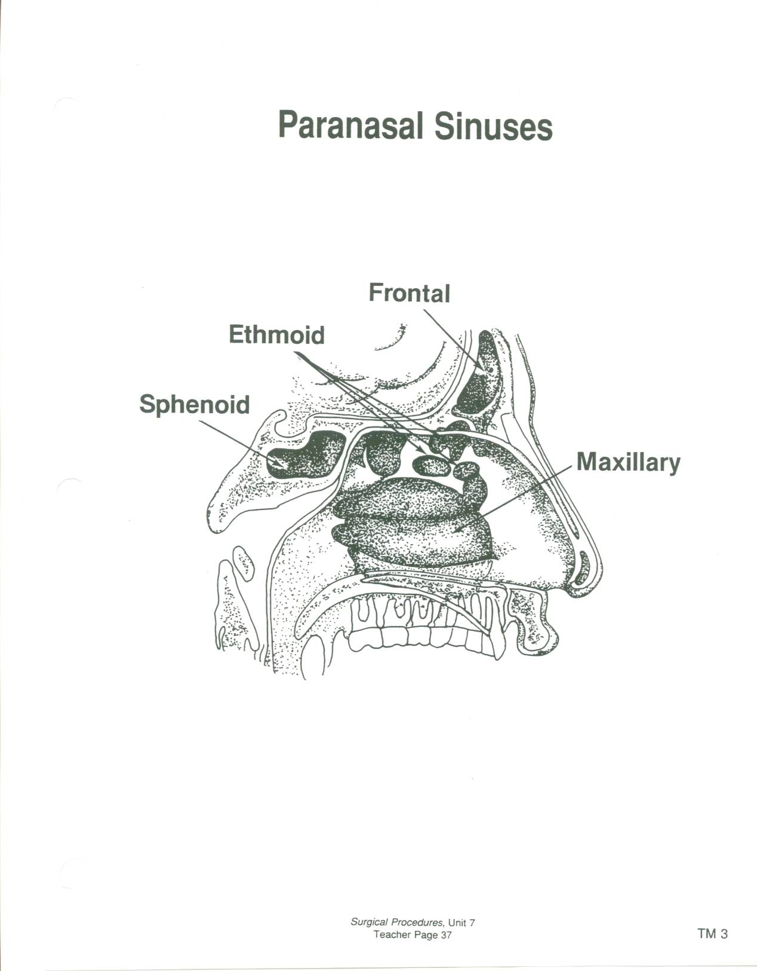

Slide 33
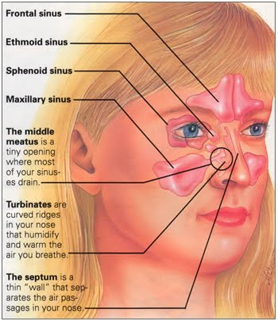

Slide 34
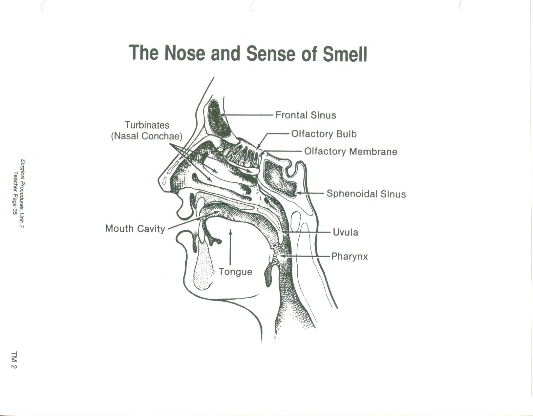

Slide 35
Physiology of Smell
Receptors in upper or superior nasal cavity
Bipolar neurons (receptors) pick up a different chemoreceptor
Are about 50 receptors
Axons form olfactory nerve (I)
These go into cribiform plate (sieve-like bone in skull)
End in olfactory bulbs under frontal lobe of cerebrum

Slide 36
Cranial Nerve I
Olfactory (I) smell (olfaction)

Slide 37
Pathology
Rhinitis
Sinusitis
Nasal polyps
Hypertrophied turbinates
Deviated septum
Septal perforation
Epistaxis

Slide 38
Diagnostic Testing
Direct Vision
Mirror Examination
Radiographic exams

Slide 39
Anesthesia
General
Inhalation
Intubation
Local with IV sedation

Slide 40
Medications
Topical anesthetic (cocaine 4%)
1% or 2% Lidocaine with or without epinephrine
Topical Hemostatics: absorbable gelatin, microfibrillar collagen, oxidized cellulose, neo-synephrine preparations
Packing dressing may be impregnated with antibiotic or vaseline
Anti-inflammatories - Afrin (pseudoephedrine)

Slide 41
Positioning
Supine with General Anesthesia
Modified Fowler’s with Local Anesthesia
Pillow under head
Arms tucked or secured across chest
Footboard with Fowler’s
Safety strap

Slide 42
Prep
Nare hair clipping
Eye protection
Mild antiseptic on face
Cotton tipped applicator nostril cleansing
Begins at upper lip, beyond hairline, below chin
Prevent prep solution from entering eyes

Slide 43
Draping
Turban like head wrap
3 triangle folded towels
Forehead bar towel or sheet
Split sheet
Body drape

Slide 44
Supplies, Equipment, Instrumentation
Medicine cups
2 local syringes
2” 25 or 27gauge needles
Long cotton tipped applicators
Packing gauze, cotton, or cottonoids
Headlight
Microscope
Nasal or septum speculum
Bayonet forceps
Small scissors (Joseph)
Curettes
Skin hooks
6, 30, 70° endoscopes
Nasal chisel & mallet
Nasal dressing forceps
Hartman nasal forceps
Septal knife (Joseph or Cottle)
Ballenger swivel knife
Freer elevator
Nasal Rasp (Foman)
Fine suction tips (irrigate often)
Notes:
p.493-495

Slide 45
Considerations
Ear and Nasal Surgery not truly sterile surgical procedures, however, aseptic technique imperative to prevent infection

Slide 46
Oral Cavity and Throat

Slide 47
Terminology of the Oral Cavity & Throat
Adenoids-(pharyngeal tonsils if enlarged) lymphatic tissue in nasopharynx (atrophies with age)
Epiglottis-small structure at back of throat, covers larynx when swallowing
Fauces-opening of the oropharynx
Glottis-space between the vocal cords
Larynx (voice box) cartilaginous structure above the trachea, houses the vocal cords
Palatine tonsils-lymphatic oval masses of tissue in the oropharynx
Papilloma-benign epithelial tumor
Pharynx-(throat) begins at internal nares and ends posterior to the larynx where it joins the esophagus
Stomatitis-inflammation of the mouth
Thyroid cartilage-(Adam’s apple)
Trachea-(airway) cartilaginous tube extending from the larynx to the bronchial tubes
Vocal cords-fibrous bands of tissue, stretched across the hollow interior of the larynx which vibrate to create sound

Slide 48
Anatomy of the Upper Aerodigestive Tract
Pharynx
1. Nasopharynx nares to uvula
Eustachian tubes auditory tube
Pharyngeal tonsils enlarged called adenoids
2. Oropharynx uvula to hyoid (tongue base)
Palatine tonsils back of oropharynx
Lingual tonsils base of tongue
3. Laryngopharynx hyoid to larynx/esophageal bifurcation
Salivary glands
Sublingual under tongue
Submandibular under jawbone
Parotid largest / in front of mastoid process and below zygomatic arch
Larynx voicebox
Trachea
Bronchi & Lungs
Esophagus
Notes:
Salivary glands produce saliva>initiate carbohydrate digestion. Parotid largest. Facial nerve damage poss. complication. P. 783-784 Alexanders

Slide 49
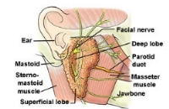
Tonsillectomy – removal of palatine tonsils
Adenoidectomy removal of pharyngeal tonsils
Parotidectomy risk of Facial nerve (VII) damage due to its proximity to the parotid gland

Slide 50
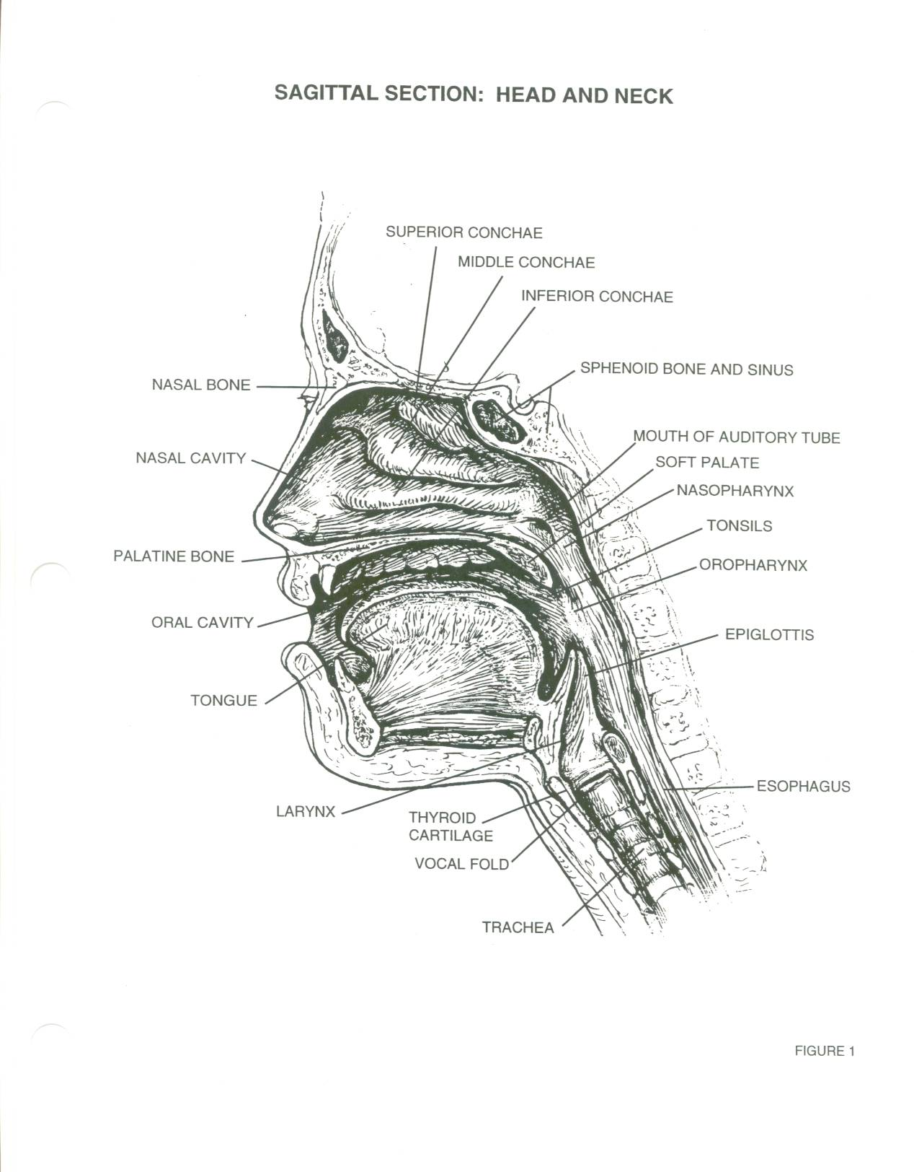

Slide 51
Physiology of Taste
Gustatory sense = taste
Bipolar neurons in taste buds
4 chemicals detected: sweet, sour, salt, bitter
Taste related to smell
Taste detected 2/3 anterior taste buds from facial nerve (VII), 1/3 posterior tongue from glossopharyngeal nerve (IX)
Are most sensitive to bitter
Takes a lot of sweet to detect
Interpreted in cerebrum

Slide 52
Pathology of the Upper Aerodigestive Tract
Pharyngitis
Epiglottitis
Tonsillitis
Peritonsillar abscess
Sleep apnea
Foreign bodies
Laryngitis
Polyps
Vocal cord nodules
Laryngeal neoplasms
Tumor
Tracheitis
Bronchitis
Croup

Slide 53
Pathology of the Esophagus
Esophagitis
Ulceration
Neoplasms
Foreign bodies
Zenker’s diverticulum located in esophagus – dx w/ esophagoscopy - 1°sx dysphagia
Esophageal varices - esophagus erodes due to severe alcoholism

Slide 54
Diagnostic Testing
Direct Visualization
Culture & Sensitivity (C&S)
CBC
X-Ray
CT Scan
MRI
Endoscopy

Slide 55
Anesthesia
General
Site of intubation typically opposite that of operative site (nose verses throat)
MAC with IV Sedation
Local Anesthesia

Slide 56
Anesthetic considerations
No pure oxygen
Risk of fire especially with laser use
Laser-safe ET tube

Slide 57
Medications
Steroids per anesthesia
Anti-inflammatories (Afrin)
Water soluble lubricant
Topical anesthetics: Lidocaine jelly lubricant, (Cetacaine spray, 4% cocaine (topical ONLY)
Local anesthetics: Lidocaine or Marcaine with or without epinephrine
Topical hemostatics: Gelfoam, neo-synephrine

Slide 58
Positioning
Supine
Sitting
Arms tucked
Shoulder roll
Head support (donut)
Pillow under knees
Safety strap

Slide 59
Prep
None to extensive
Surgeon’s preference

Slide 60
Draping
Head wrap
Towels
Impervious drape (Ioban)
Fenestrated sheet
U-sheet
None

Slide 61
Supplies, Equipment, Instrumentation
Basic pack
Basin set
Raytex
Tonsil sponges
Cottonoids
Small basin
Suction tubing
Suction tip (fine)
Blade of surgeon choice (#12)
Cautery
Suction/cautery
Plain, vicryl, silk suture or reels
Luken’s specimen trap
Lubricant
Specimen container
Tongue depressor
Headlight
ECU
Microscope
Endoscopes (rigid or flexible)
Video tower
CO₂ or Nd:YAG laser
Mouth gag
Tonsil snare
Dental or laryngeal mirror
Biopsy forceps
Alligator forceps
Curettes
Fisher tonsil knife
Bougies or Malonies

Slide 62
Lasers
CO2
Most commonly used
Superficial tissue not clear liquids
Effect dependent on heat build-up
Invisible beam
Use helium + neon (“He-Ne beam) red beam as aiming source
Nd-Yag
Most powerful and precise
Fiber delivered
Contact or noncontact modes
Transmissible thru fluids
Invisible beam
Use helium + neon (He-Ne beam) or white light as aiming source

Slide 63
Post-operative Considerations
Laryngospasm
Keep backtable sterile until patient extubated and you receive CRNA clearance
Sore throat
Hoarse
Bleeding
Be aware of ET tube as drapes removed
Infection

Slide 64
Endoscopies

Slide 65
Endoscopies
Laryngoscopy
Microlaryngoscopy
Bronchoscopy
Esophagoscopy
Endoscopes:
Rigid – larger viewing surface
Flexible – easy insertion and manipulation
For: diagnostic or operative use: cytology (cultures), biopsy, foreign body removal, bougie or maloney (esophageal dilators) insertion

Slide 66
Review
Cytology cell type only
Biopsy for frozen or permanent
Permanent specimen delivery to pathology not urgent, is obvious, or pathology has already been diagnosed
Frozen specimen immediate tissue identification or malignancy identification is needed
Tissue to go dry or on a telfa NEVER a counted sponge
NEVER placed in solution (saline or Formalin)

Slide 67
Laryngoscopes
L-shaped – intubation
Flexible – assist with intubation, diagnostic, biopsy
Rigid U-shaped – biopsy, foreign body removal, vocal cord procedures
Notes:
Microlaryngoscopy p.792-794 Alex.

Slide 68
Microlaryngoscopy
Laryngoscopy
Microscope (400mm focal length=40cm focal length)
Microlaryngeal instruments (22cm)
Laser attached to microscope
CO₂ single beam, more precise (used with helium-neon beam to provide red beam for proper aiming)
Vocal cord, tracheal, bronchial lesions
Nd: YAG Laser tracheal or bronchial lesions
Notes:
Focal length=distance from lens to working area=clear visualization

Slide 69
Bronchoscopes
Flexible
Rigid
Longer than laryngoscopes
Adaptor required for oxygenation
Nd: YAG (prn)

Slide 70
Esophagoscope
Flexible
Used with flexible gastroscope (EGD)
Rigid
Flared at distal end due to collapsibility of esophagus (better visibility)
Nd: YAG laser (prn)
Diagnostic for: esophageal cancer, hiatal hernia, stricture, stenosis, esophageal varices, tumor
Notes:
EGD esophagogastroduodenoscopy See 746 Alexanders (flared end esophagoscope). Varices (varix) varicose veins in esophagus 2° cirrhosis

Slide 71
Triple Endoscopy/Panendoscopy

Slide 72
Triple Endoscopy or Panendoscopy
Term describes all three procedures combined:
Esophagoscopy
Laryngoscopy
Bronchoscopy
Diagnostic

Slide 73
Thyroid and Parathyroid Glands

Slide 74
Thyroid and Parathyroid Surgery
1° performed by general surgeons

Slide 75
Thyroid Gland
2 lobes
Anterior to larynx
Connected by isthmus at 2nd tracheal ring
H-shaped
Two hormonal cell types:
Follicular – produce, store, release
Thyroxine and Triidothyronine
Are basal metabolic rate regulation hormones
Parafollicular – secrete
Calcitonin
Hormone that maintains calcium homeostasis

Slide 76
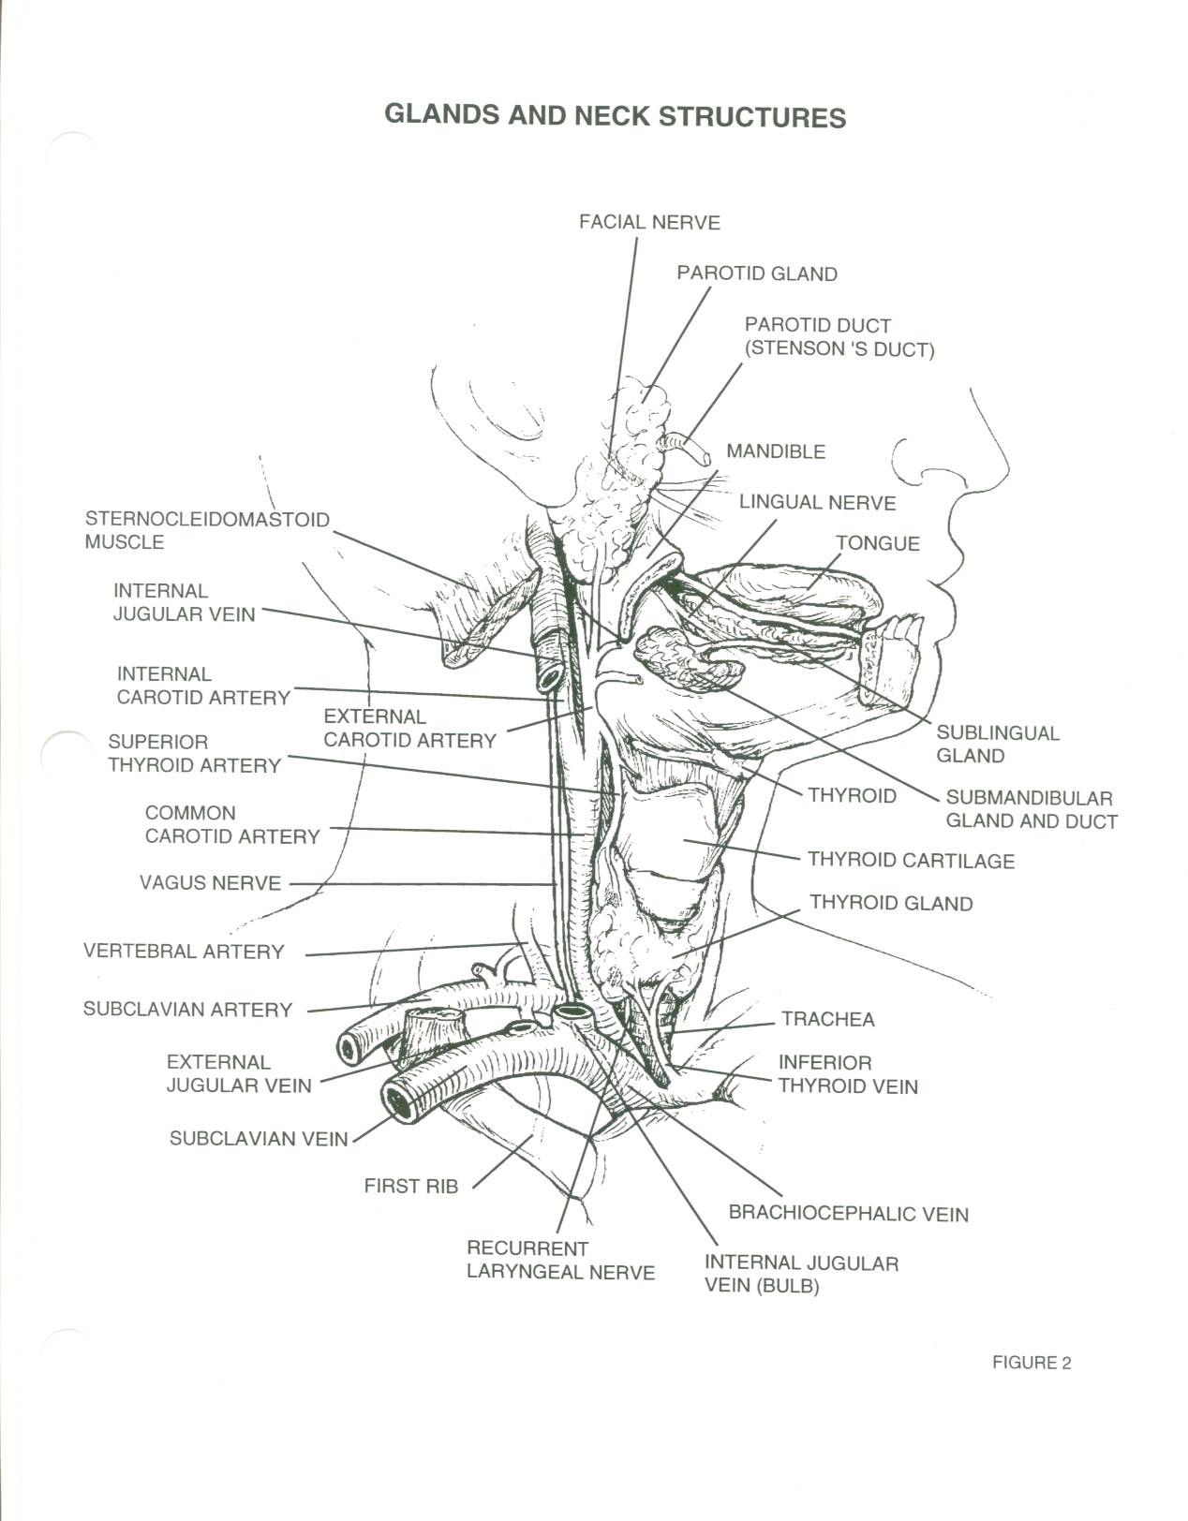

Slide 77
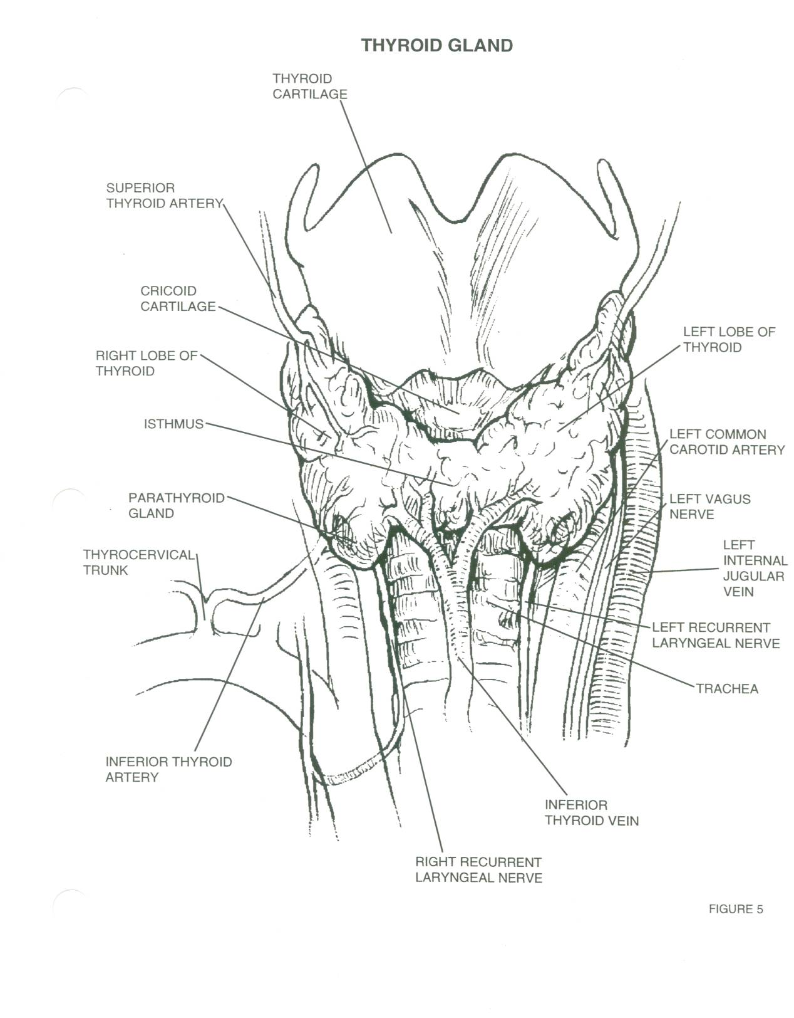

Slide 78
Parathyroid Glands
Numbered 1 to 6
Small, flat, oval dorsal to thyroid gland
Hormone - Produce
Parathormone which maintains a normal blood and skeletal calcium relationship
Cannot remove all of them due to certain tetany and death
May see some re-implanted elsewhere in body (thigh, upper arm)

Slide 79
Pathology of Thyroid and Parathyroid Glands
Hyperthyroidism: restlessness, fast speech, tachycardia, palpitations, arrythmias, dyspnea, heat intolerance, diaphoresis, weakness, tremor, hair loss
Hyperparathyroidism: asymptomatic to skeletal damage
Thyroid carcinoma: signs of hyperthyroidism, hypothyroidism, hoarseness, difficulty swallowing, dyspnea
Notes:
Hypothyroidism: obesity, dry skin and hair, hypotension, bradycardia, sluggishness, goiter

Slide 80
Diagnostic Testing
Physical Exam
Serum TSH levels
Ultrasound
Biopsy
CT Scan
MRI
Laryngoscopy

Slide 81
Anesthesia
General

Slide 82
Medications
Lidocaine with or without epinephrine
Bupivicaine with or without epinephrine
Antibiotic irrigation
Topical hemostatic agents

Slide 83
Positioning
Supine
Donut headrest
Shoulder roll
Arms tucked
Pillow under knees
Safety strap

Slide 84
Prep
Surgeon’s preference: Duraprep, Betadine scrub and/or paint
End of chin to midchest and bedsheet to bedsheet

Slide 85
Draping
Towels
Small fenestrated sheet (Pediatric sheet)
Thyroid sheet
U-Sheet
Surgeon’s preference

Slide 86
Supplies, Equipment, Instrumentation
Minor basin
Basic pack
Blades of choice
Suture of choice
Silk ties
¼” penrose
Bipolar forceps
Headlight
Minor Tray
Headlight
Minor tray

Slide 87
Post-operative Considerations
Will need medical hormonal therapy
Potential damage to bilateral laryngeal nerve with dissection
Hemorrhage
Infection
Laryngeal edema

Slide 88
Tracheotomy & Tracheostomy

Slide 89
Tracheotomy/Tracheostomy
Tracheotomy temporary opening into the trachea to facilitate breathing
Tracheostomy permanent opening of the trachea and creation of a tracheal stoma
Must place tracheal tube with either
Patient will be hooked up to a ventilator
Long term tracheostomy may eventually be able to wean off ventilator, but maintain stoma that will function as their nose did prior to surgery

Slide 90
Indications For Tracheotomy or Tracheostomy
Vocal cord paralysis
Neck surgery
Trauma
Prolonged intubation
Secretion management
Cannot intubate
Stridor due to tracheal blockage
Sleep apnea

Slide 91
Anesthesia
General
Local

Slide 92
Medications
Local anesthetic: Lidocaine or bupivicaine with or without epinephrine
Antibiotic irrigation

Slide 93
Positioning
Supine
Shoulder roll
Donut headrest
Pillow under knees
Safety strap

Slide 94
Prep
End of chin to midchest and bedsheet to bedsheet
Prep of choice: Duraprep, betadine scrub and/or paint

Slide 95
Draping
Towels
Small fenestrated sheet (Pediatric lap sheet)

Slide 96
Supplies, Equipment, Instruments
Minor basin
Basic pack
Pediatric lap sheet
Other small fenestrated sheet
Blades
Suture or ties of surgeon’s choice (prn)
Tracheotomy tray
Tracheotomy tube (Shiley)
Twill tape

Slide 97
Considerations
Will make sure obturator goes with patient to PACU or ICU
Complications: hemorrhage, infection, laryngeal edema, damage to other structures

Slide 98
Summary
Ear
Nose
Throat
Endoscopy
Triple endoscopy
Thyroid & Parathyroids
Tracheotomy
Terms
A & P
Pathology
Anesthesia & Meds
Positioning, Prep, & Draping
Supplies, Equipment, & Instrumentation
Considerations & Complications

