Slide 1
PERIPHERAL VASCULAR SURGERY

Slide 2
Summary
Anatomy & Physiology
Pathology
Diagnostic Exams
Preparation Prep/Positioning
Basic Supplies, Equipment, Instrumentation
Peripheral Vascular Procedures:
Vascular access
Carotid endarterectomy
Bypass procedures

Slide 3
Terminology
Arrhythmia-irregular heart rhythm
Arteriosclerosis-hardening of the arteries (part of aging process)
Atherosclerosis-build-up of plaque
Autogenous/autologous-originates in the body
Bifurcation-fork/point of branching
Cannula-tube/sheath allowing passage of fluids
Cardiopulmonary-r/t heart and lungs
Claudication-cramping, aching, stiffness caused by exercise relieved by rest (1° sx. PVD)
Cyanosis-blue discoloration of an extremity or the skin caused by lack of oxygenation (Hgb)
Embolus-matter traveling through a vessel
Extracorporeal-outside the body
Fibrillation-rapid, ineffectual contractions of the heart
Defibrillation-to stop fibrillation by drugs or electrical means
Lumen-space within an artery, vein or tube

Slide 4
Terminology Continued
Occlusion-abnormal obstruction/closure of a vessel
Palliative-to relieve without curing
Plaque-patch of atheromatous matter (cholesterol, lipids, cellular debris) that forms in the inner lining of an artery (intimal lining)
PVC (premature ventricular contraction)-arrhythmia that precedes normal electrical impulse/may precede ventricular fibrillation
Septum-wall that separates two cavities
Stenosis-narrowing or constriction of a vessel
Thrombus-blood clot (thrombus)
TIA (transient ischemic attack)-temporary interference of brain oxygenation by the arteries
Symptoms may last a few minutes to several hours
Vasoconstriction-narrowing of a vessel

Slide 5
The Peripheral Vascular System
A closed system of the body that carries blood from the left side of the heart that has been oxygenated in the lungs→ to the heart itself, all organs, and tissues of the body where the oxygen is utilized→ back to the right side of the heart where it will be sent back to the lungs for re-oxygenation to start the cycle over again

Slide 6
Peripheral Vascular System Composition
Two Types of VESSELS:
Arteries
Veins

Slide 7
VESSELS (Arteries)
Arterial blood is pumped from the heart to the rest of the body via vessels called arteries
Arterial blood is going away from the heart
Arteries are large vessels originating with the AORTA that come directly out of the heart
Arteries divide into smaller braches as they reach their destination in the body
Arteries→arterioles→capillaries

Slide 8
Capillaries
Microscopic level of:
oxygen & carbon dioxide exchange
nutrient exchange
waste exchange
between blood and tissue fluid in
areas called capillary beds

Slide 10
Venules
Capillaries join the smallest veins called venules which become larger in size to become veins which ultimately end at the superior vena cava and inferior vena cava in the right atria of the heart where unoxygenated blood is sent back to the lungs via the pulmonary artery for reoxygenation

Slide 11
VESSELS (Veins)
Veins take blood back to the heart for reoxygenation
Capillary bed→Venules→Veins→Vena Cava (Superior and Inferior)

Slide 12
Vessel Structure
3 layers called tunics
Inner = tunica intima
Middle = tunica media
Outer = tunica adventitia

Slide 13
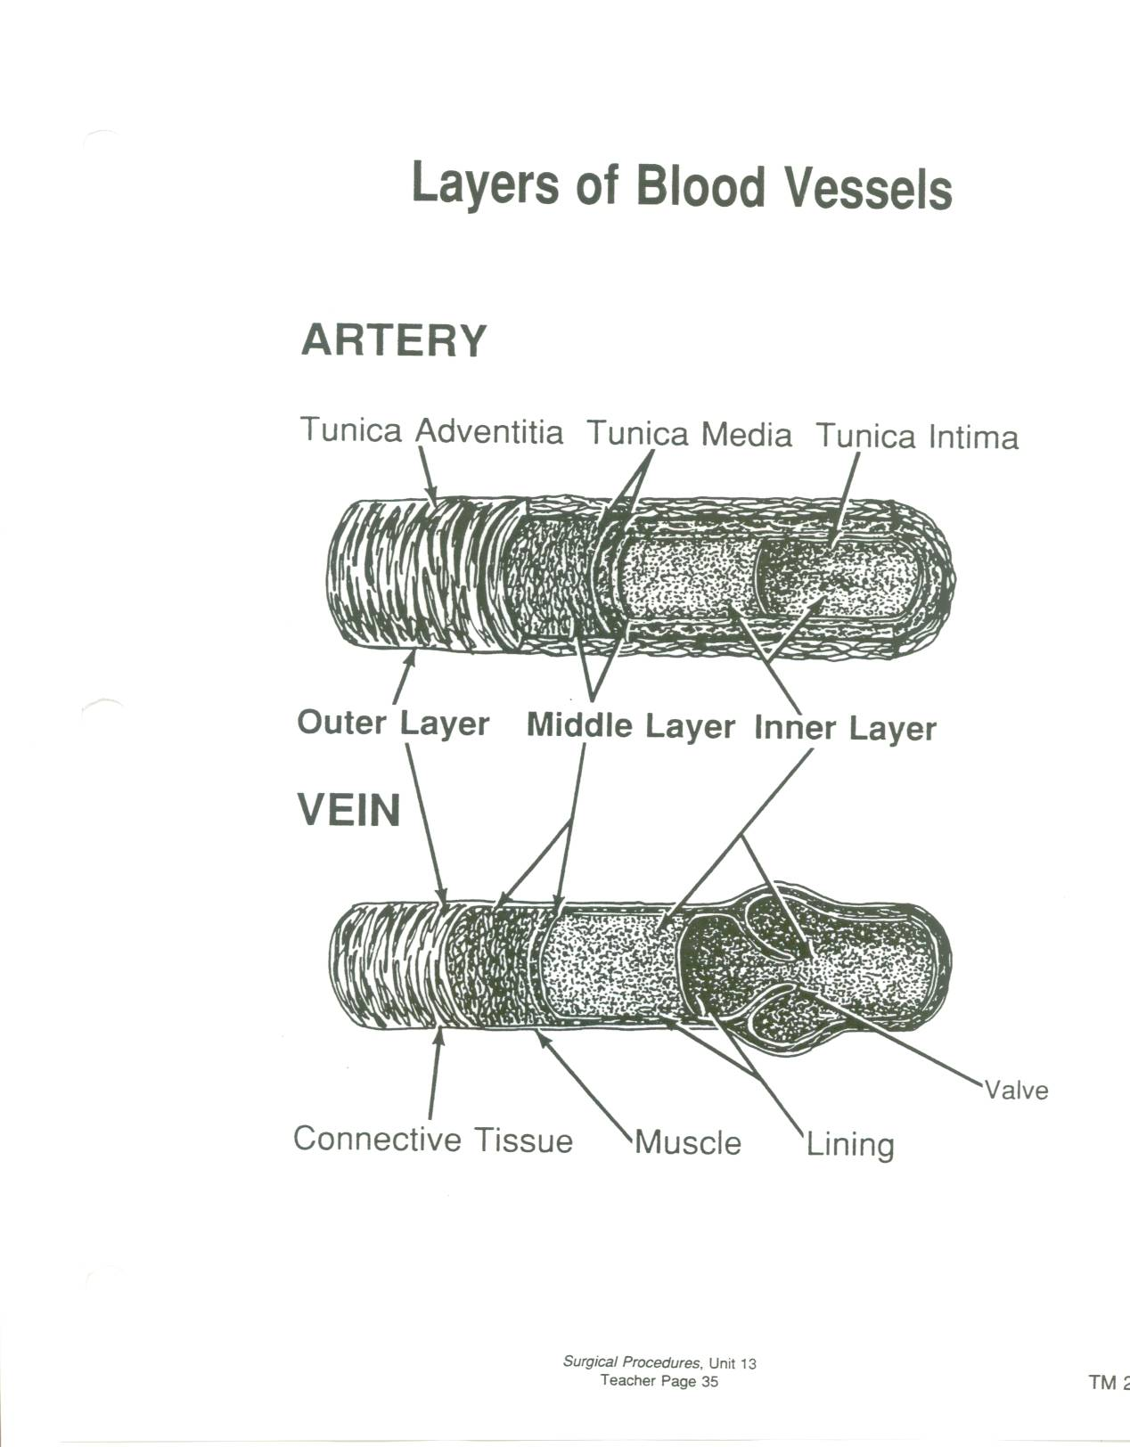

Slide 14
Differences in Vessel Structure (Arterial)
Tunica Intima
Inner tunic has an endothelium lining
Smooth layer that is in contact with blood to promote flow and prevent damage to the platelets

Slide 15
Differences in Vessel Structure (Arterial)
Tunica media
thickest layer
layer of smooth muscle can contract or dilate with autonomic nervous system impulses
contraction = vasoconstriction = ↑ BP
dilation = vasodilation = ↓ BP

Slide 16
Differences in Vessel Structure (Arterial)
Tunica Adventitia
Outer tunic
Consists of connective tissue that connects arteries to tissues that surround them
Contains vaso vasorum which are vessels that nourish the arterial wall

Slide 17
Differences in Vessel Structure (Veins)
Same three layers as arteries
Differences are in the thickness of each layer
Tunica adventitia is thickest layer
Tunica media has less smooth muscle tissue than arteries
Tunica intima is thinner than an artery and contains valves
Vein lumen is larger than an artery lumen
Notes:
Veins are often used in bypass surgery as replacements to arteries. The fact that their lumens are larger makes them the obvious choice for bypass use, plus the fact that they are so closely related structurally, as well as the fact that they are a autologous creating virtually no chance of body rejection as a foreign body such as a graft would or a homograft (cadaver vein)

Slide 19
Blood Pressure
Force blood exerts on the inner walls of vessels as it passes through them
Veins:
Low pressure
Working against gravity
Movement by skeletal muscle contraction as blood moves up to the heart (Veins are surrounded by skeletal muscle)
Backflow prevented by valves in the veins

Slide 20
Blood Pressure
Arteries:
High pressure
Dependent On:
Volume
Ventricular contraction strength
Resistance
Viscosity (thickness)
Heart rate

Slide 21
Blood Pressure
Systole = contraction
Diastole = relaxation
Central Venous Pressure = venous blood pressure in the right atrium measured with a central venous catheter (normal is 3-8)

Slide 22
Blood Flow
Blood that travels undisturbed through the vessel is called laminar
Blood that is disturbed by an obstruction, stenosis, curve, or bifurcation is called turbulent
Turbulence can be auscultated by doppler and is called a bruit
Turbulence that can be felt or palpated is called a thrill

Slide 23
Arterial System
Ascending Aorta→coronaries
Aortic Arch: 3 major branches
First branch= brachiocephalic (innominate)
Brachiocephalic bifurcates into right subclavian and right common carotid
Second branch=left common carotid
Third branch=left subclavian
Descending Aorta:
Above the diaphragm, aorta = thoracic aorta
Below the diaphragm aorta = abdominal aorta

Slide 24
Upper Extremities (arterial)
Right subclavian>right arm>axillary artery>brachial artery>bifurcates to form ulner and radial arteries>rejoin at palmer digital arteries
Left subclavian>left arm>axillary artery>brachial artery>bifurcates to form ulnar and radial arteries>rejoin at palmer digital arteries

Slide 25
Head (arterial)
Right common carotid and left common carotid > brain, head, and neck
Common carotids bifurcate to form internal and external carotid arteries
External carotids>neck and head
Internal carotids>join vertebral artery (off subclavian) to form basilar artery >form Circle of Willis in the brain

Slide 26
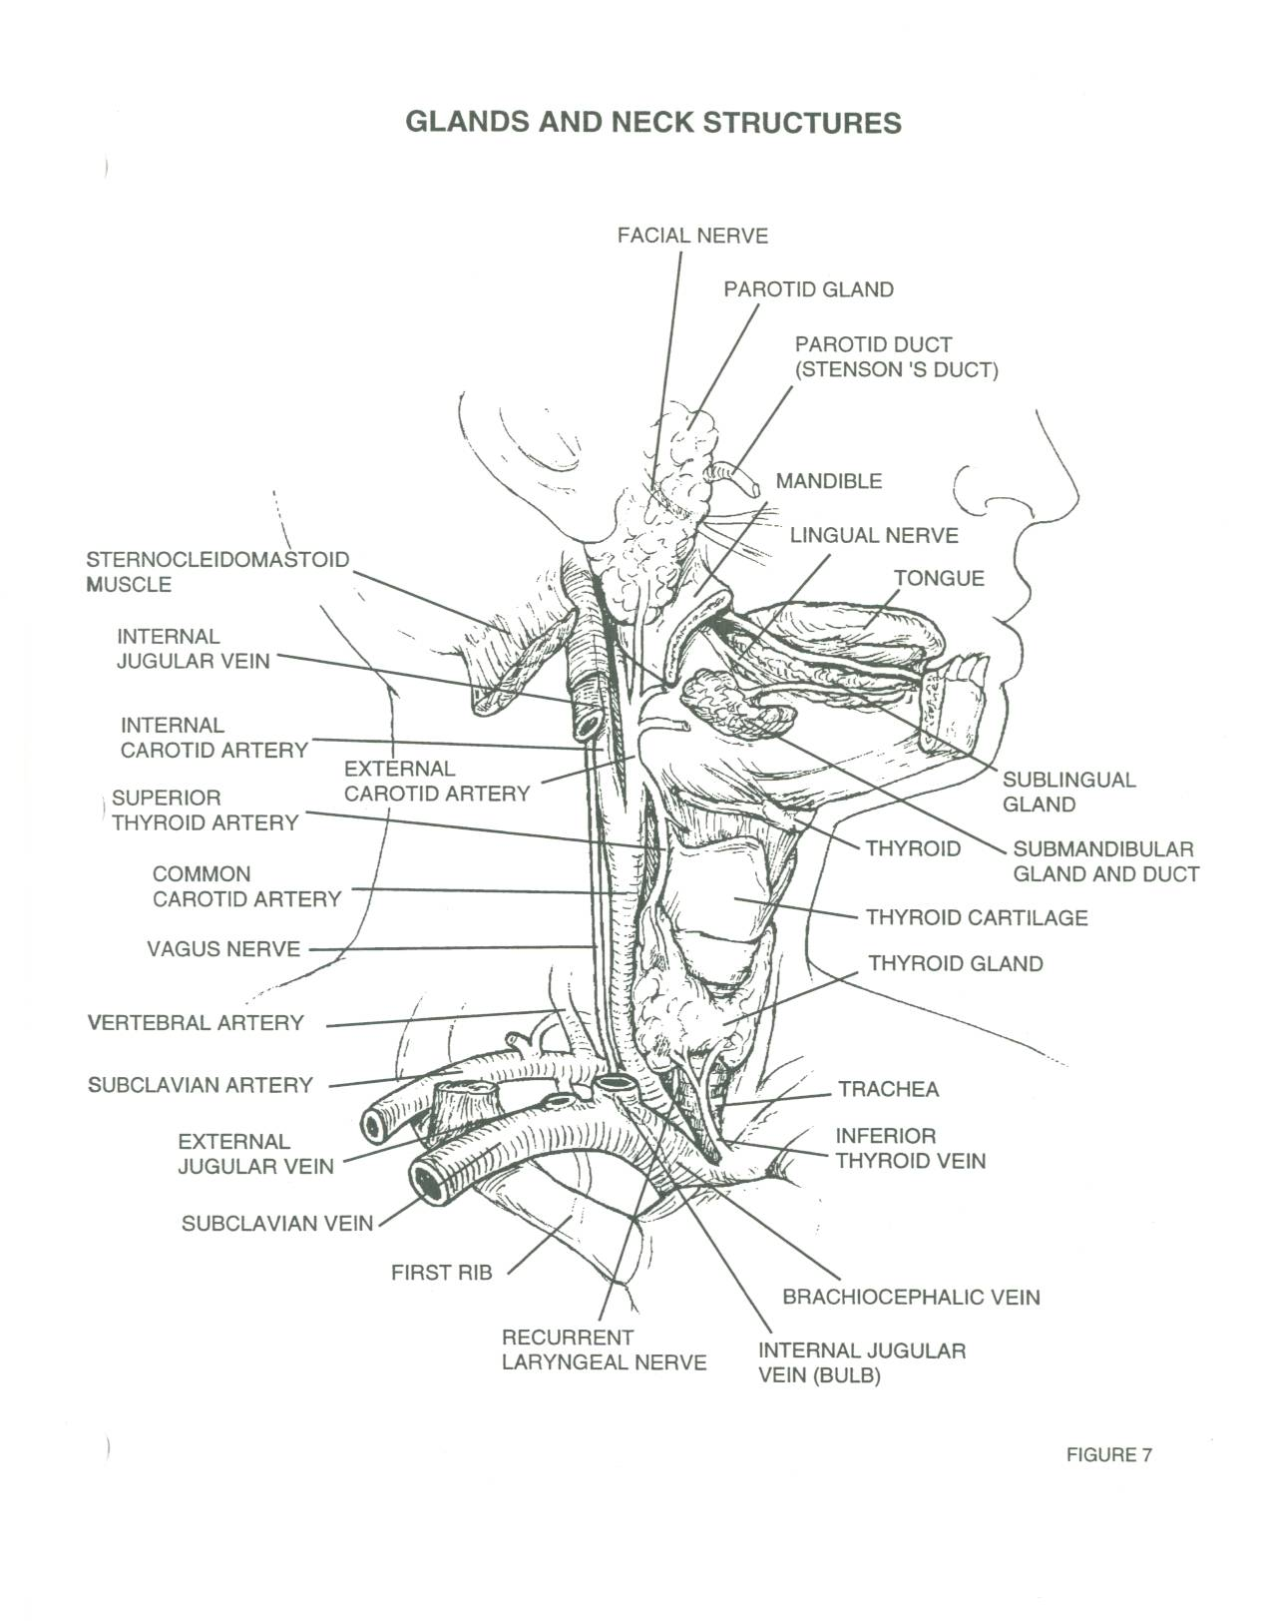

Slide 27
Abdominal Aorta
Supplies oxygenated blood to the abdominal wall and abdominal organs/viscera

Slide 28
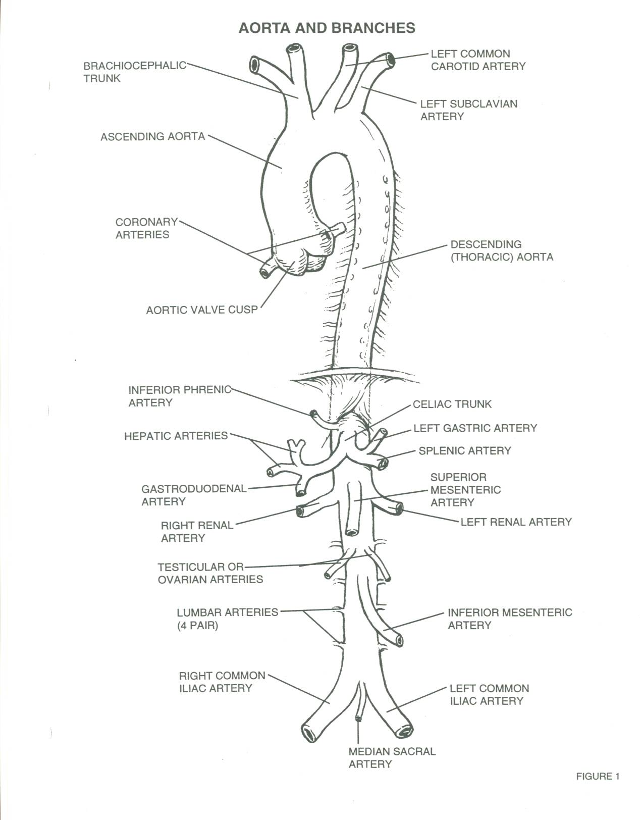

Slide 29
Lower Extremities (arterial)
Aorta bifurcates to form right and left common iliac arteries
Common iliacs bifurcate to form internal and external iliacs
Internal iliacs supply pelvis and perineum
External iliacs become femoral arteries>popliteal>bifurcates to form anterior tibial and posterior tibial
Anterior tibial becomes dorsalis pedis>plantar arch arteries
Posterior tibial>peroneal artery>joins dorsalis pedis to form plantar arch arteries

Slide 30
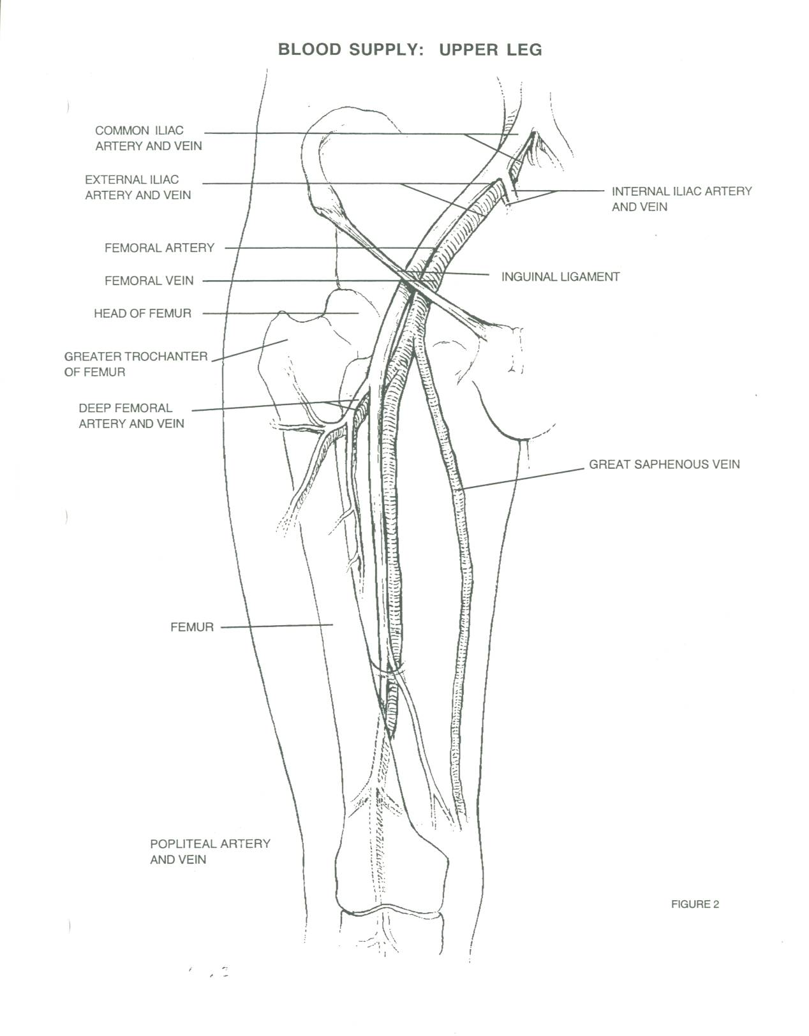

Slide 31
Venous System
Internal jugular veins drain the brain, head, face, and neck> subclavian veins> this union is called the innominate or brachiocephalic vein
Leads to the Superior Vena Cava which empties into the right atrium
External jugulars drain parotid glands and the superficial face and scalp> subclavian veins>SVC
Vertebral veins drain neck and vertebrae>subclavian veins>SVC

Slide 32
Venous System Continued
Upper Extremities (superficially)are drained by the basilic and cephalic veins that empty into axillary vein>the subclavians>SVC
Upper Extremities (deep) are drained by the radial, ulnar, and brachial veins>axillary vein>subclavians>SVC

Slide 33
Venous System Continued
Lower Body drains via those veins into the Inferior Vena Cava which also empties into the right atrium
See Overhead

Slide 34
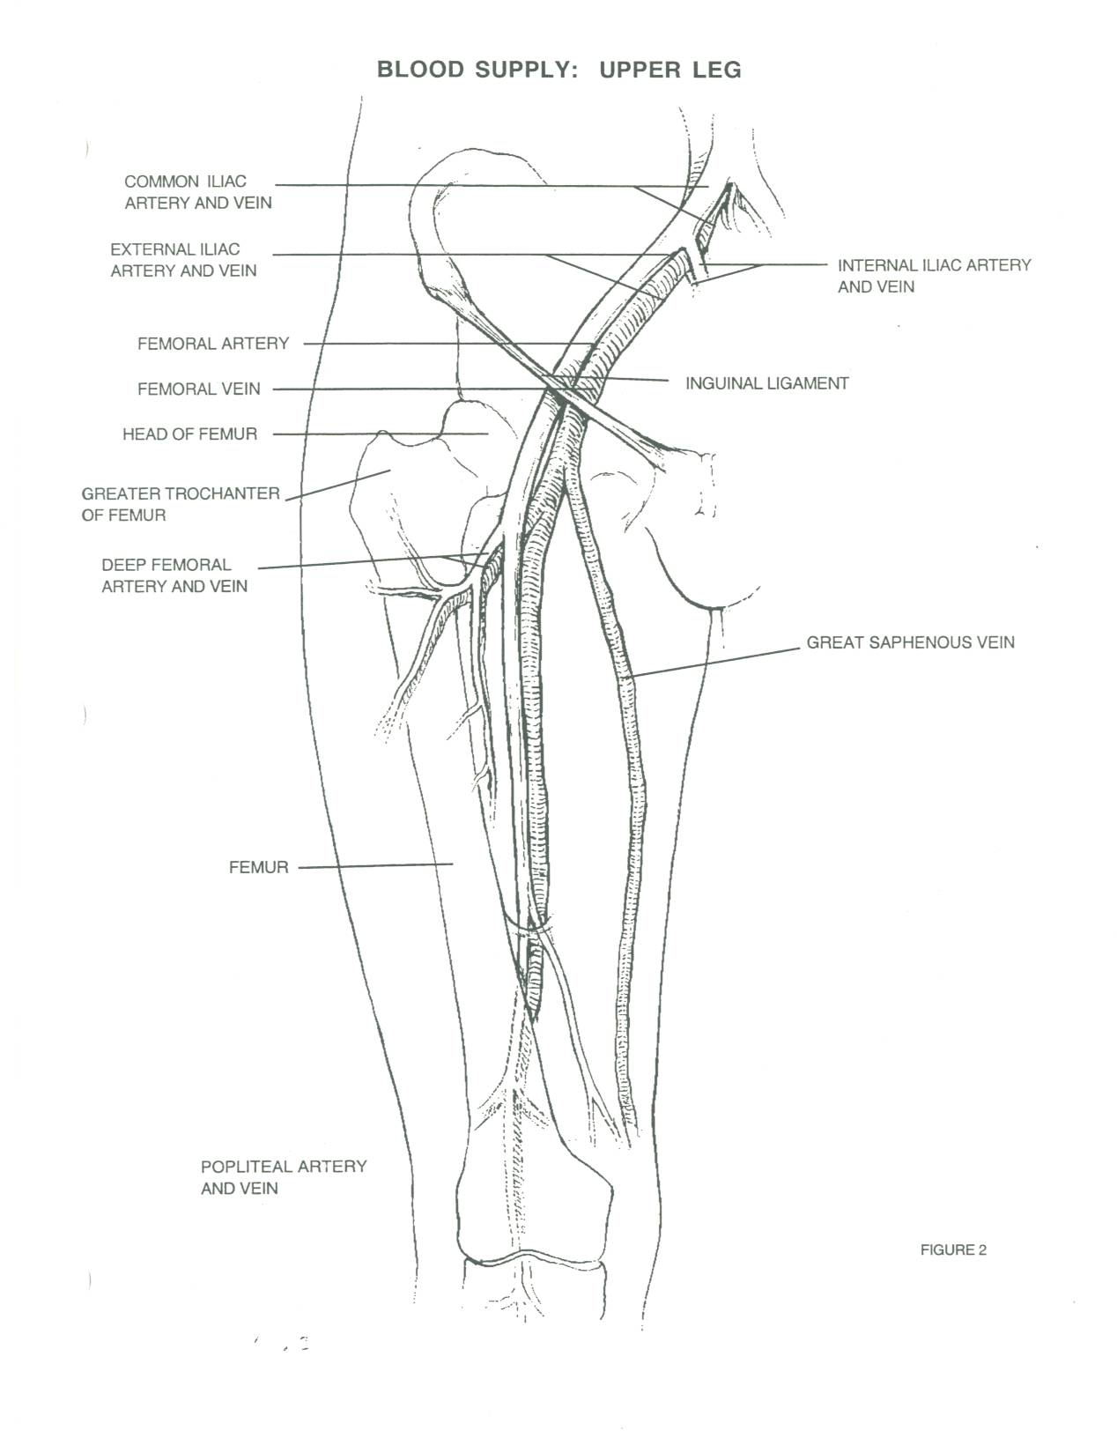

Slide 35
Pathology

Slide 36
Arterial Disease
Arterial Insufficiency (2 types):
1. Acute
Embolic or an unstable atherosclerotic plaque rupturing and creating a thrombosis or clot
80% in lower extremities
Definition/Clarification:
Embolus is a foreign substance or blood clot (liquid, solid, or gas) transported by the blood or lymphatic system ex. clot, air, fat, tumor parts
Thrombosis is a blood clot that occludes a vessel
If detached it becomes an embolus
Emboli usually come from the heart during an MI or A-Fib, can come from other areas and attach itself (usually attaches at bifurcations or narrowing areas)
Creates loss of circulation to areas below it
S/SX:5 Ps (pulselessness, pallor, pain, parethesia, and paralysis)

Slide 37
Acute Arterial Insufficiency Continued
Can patient tolerate arteriograms and anesthesia
Medical intervention is choice with unstable patient (thrombolytics)
Surgical intervention when stable=arterial embolectomy
Limb not salvageable=amputation

Slide 38
Arterial Insufficiency
2. Chronic = Ischemia
Results in inhibited or total blockage of flow
2 types:
a. Arteriosclerosis
Arteriosclerosis is part of the aging process creates hardening of the arteries= less elastic
Atheroma=thickening of tunica intima seen with arteriosclerosis
b. Atherosclerosis
Atherosclerosis is this build-up of plaque
Result of calcium or cholesterol deposits (plaque) inside the tunica intima

Slide 39
Atherosclerosis
Gradual process
Body develops collateral circulation as a compensatory mechanism
Causes speculated as intimal damage from smoking, hypertension, diabetes, etc.
Often referred to as atherosclerosis obliterens

Slide 40
Atherosclerosis
Generally is segmental in occurrence which allows for surgical intervention to correct it
If not corrected, can lead to gangrene or tissue death below the blockage in extremities
In the carotid arteries can lead to stroke
Surgical intervention involves bypass grafting (native vein or graft material) or endarterectomy (removal of plaque)

Slide 41
Aneurysms (peripheral)
True aneurysm=dilation of all layers of the arterial wall
May find atherosclerosis along with true aneurysm/is not the cause of
False Aneurysm (pseudoaneurysm)=not an aneurysm, but a tear that allows blood between the layers of the artery
Results from trauma, infection or post-arterial surgery where suture has been disrupted

Slide 42
Venous Insufficiency
Caused by deep venous thrombosis
Results from injury to the endothelium of the vein, stasis (immobility), coagulapathy problems, orthopedic trauma
Usually lower extremity clot
Urgent situation as clot can dislodge and move into the right atrium and make its way to the pulmonary artery resulting in death (PE=pulmonary embolus)
Medical treatment= anticoagulants
Can do a thrombectomy if isolated
Long term=vena cava filter

Slide 43
Diagnostic Exams
Angiography = Gold Standard for diagnosis with peripheral vascular disease
Ultrasound-detection by sound waves
Doppler-Measures blood flow
Computed Axial Tomography (CAT/CT Scan)-x-ray pictures in slices
Magnetic Resonance Imaging (MRI)-uses radio waves and a magnetic field to provide the 3-D views (can move in any direction unlike CT and is nonradioactive)

Slide 44
Anesthesia
Patient dependent: general, spinal, epidural, or local
All spinal/epidural patients get a foley catheter
CAE: will use an EEG to monitor brain activity and determine if a shunt is needed during the procedure. Can be done by CRNA or an EEG technician

Slide 45
Medications
Saline with antibiotic irrigant of surgeon choice or one patient is not allergic to
Heparin saline or lactated ringer’s irrigation for washing out inside artery to prevent clot during surgery (usually 250ml NS to 1,000units Heparin)
Papaverine antispasmodic/smooth muscle relaxant 120mg to 250ml NS (distention, prep, storage of vein grafts)
Topical Hemostatic Agents: Surgicel, Gelfoam with Thrombin, Avitene, other fibrins (floseal, tisseal)
(Surgeon choice)

Slide 46
Positioning
Extreme Care Taken with Positioning due to limited Circulation of these Patients
Try to position while awake to get feedback from patient
Pay attention to anatomical alignment
Padding bony prominences
DO NOT lay heavy instruments on patient
Supine with arms tucked or on armboards
Pillow under knees
Pads under heels and arms
Pillow, headrest, or donut under head (avoid neck hyperextension)
Shoulder roll for neck extension needed for carotid endarterectomy

Slide 47
Prep (Considerations)
Doctor preference/Patient allergy: Hibiclens, Betadine
Non-open wounds an Ioban is preferred due to fact that are operating on vasculature which is a potential opening to septicemia
If scrubbing a carotid or aneurysm BE GENTLE! You could loosen plaque or rupture an already ready to rupture artery!

Slide 48
Preps
Extensive/Circumferential
Nipples to knees for AAA (flat)
Pubis to ankle or whole foot (lower extremity)
May be from the waist down if using vein graft from one leg to the other
CAE ear lobe of affected side to clavicle/maybe to nipple and well across the chest. Head should be turned to expose affected side and a shoulder roll may be needed to provide a smooth surface

Slide 49
Drapes
IMPERVIOUS DRAPES
Extremity drapes
Universal drapes
Pediatric Laparotomy sheet
U-sheet

Slide 50
Basic Supplies, Equipment, Instrumentation
Drape Pack Clips
Minor or Major basin Rubber shods
Specialty Trays (CV or PV) Contrast
Vessel loops/umbilical tapes Kittner/peanut
Heparin needle or angiocath Tunneler
Silk ties or reels Introducer kit (prn)
Vessel suture: Prolene or Surgilene
Drain suture: nylon or Ethilon
Subcuticular suture: Vicryl or Dexon
Subcutaneous layer: staples, Ethilon, Monocryl, Vicryl, or Dexon
Notes:
Name things on a specialty tray like at the VA/No specialty trays Loops, heparin needle, umbilical tapes,

Slide 51
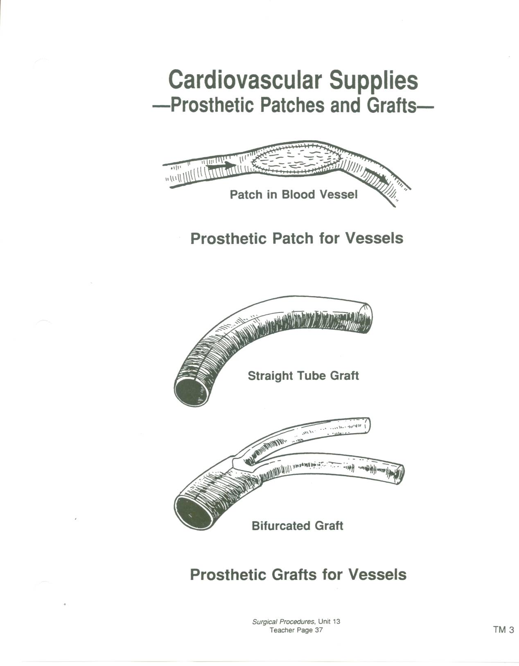

Slide 53
Basic Supplies, Equipment, and Instrumentation
Bovie
Suction (Cell Saver with trauma or AAA)
Harmonic Scalpel (surgeon preference)
EEG
X-ray OR table, place for C-Arm use
Simpulse (trauma/debridement)
C-Arm
Doppler Probe and box (conduction gel)
Headlight for the surgeon

Slide 54
Basic Supplies, Equipment, Instrumentation
Cardiovascular or peripheral vascular instrument tray
Carotid Tray
If above not available→ Basic Laparotomy Tray and add following:
Vascular clamps of surgeon choice (peripheral debakeys, fogarty clamps, satinskys, cooleys, henleys, etc.)

Slide 55
Fine needle holders of surgeon choice (castros, ryders, or other fine NH)
Fine forceps of surgeon choice (dietrich debakeys or fine debakeys, potts or geralds, etc.)
Micro/delicate Scissors (potts, tenotomy)
Bulldogs/small vessel clamps
Surgeon preferred self-retaining retractor (Omni, Henley, Myerding, Gelpi, Weitlander, Cerebellar, Beckman, etc.)
Freer or Penfield for endarterectomies
Beaver handle (Surgeon Preference)

Slide 56
Vascular Access Procedures

Slide 57
Vascular Access Procedures
Hickman: Single lumen catheter for IVs, antibiotics, parenteral nutrition solutions, and blood samples
Portacath: single or dual lumen with a silicone portal for IVs, antibiotics, parenteral nutrition sol., and blood samples
Perma-Cath: dual lumen catheter for hemodialysis (Can be permanent or temporary) Have a high thrombosis and infection rate.
C-Arm is used for placement and requires lead aprons
X-rays are always done post placement of these to r/o pneumothorax or hemothorax (Placed in subclavian or internal jugular vein=close proximity to parietal pleura)

Slide 58
Vascular Access Procedures
Arteriovenous (AV) Fistula
Direct fistula between the radial artery and the cephalic vein (Brescia-cimino)
Used for hemodialysis
Can be vein graft, prosthetic graft (PTFE), or brecia-cimino
Prosthetic grafts are looped and join brachial artery to median cubital vein
Long term dialysis
Move proximally with subsequent fistulas
Ciminos have the longest patency rate
Idea to provide area of venous and arterial mixture so that waste products can be removed from circulation by dialysate and dialysis machine (artificial kidney)

Slide 59
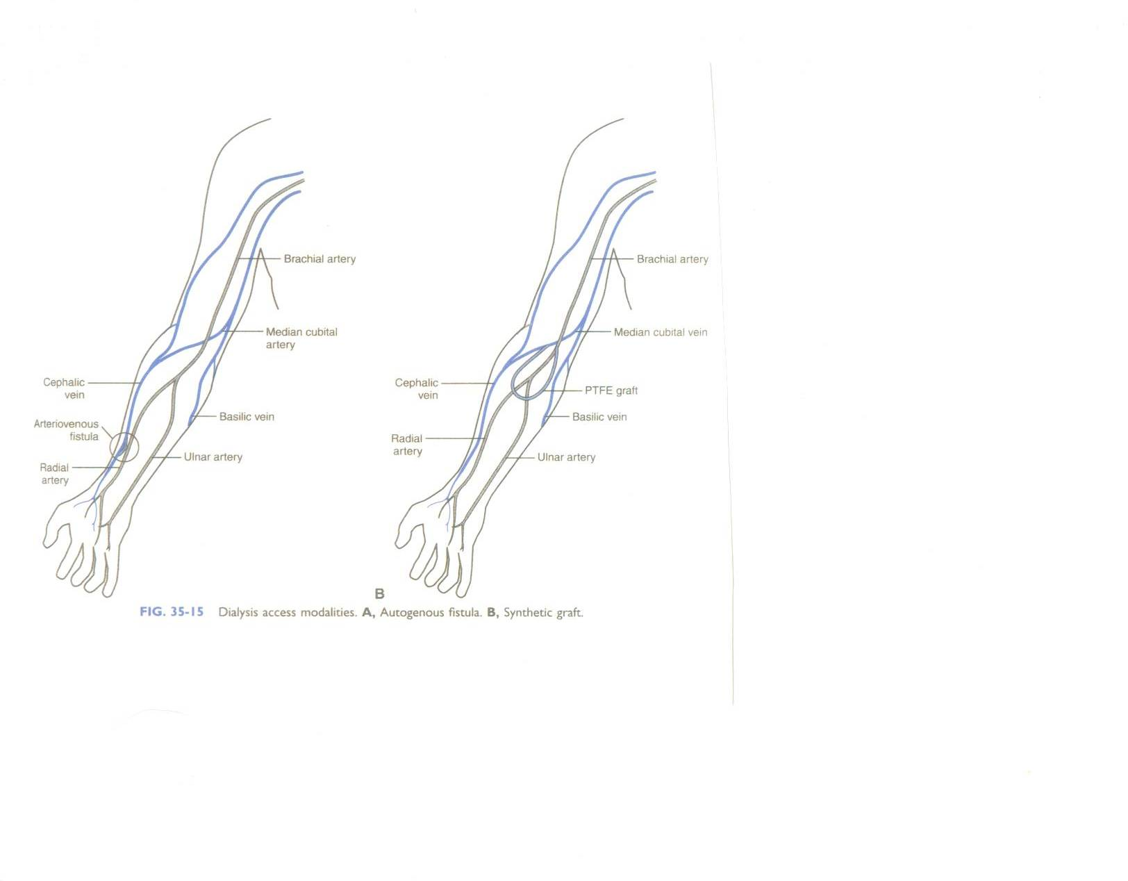
See Procedure Sheet Overhead

Slide 60
Carotid Endarterectomy
Two types:
1. Asymptomatic
2. Symptomatic
50% of patients with carotid stenosis have a bruit
50% of patients with carotid stenosis do not have a bruit
If have a bruit, should be sent for ultrasound

Slide 61
CAE Procedure
Incision (raytex up)
Cautery/Debakey forceps
Wietlander
Cautery/Metz/Debakeys
3-0 silk ties and clips available
exposure of internal, external, and common carotid arteries by Metz dissection
Isolate right angle, vessel loops or umbilical tapes, hemostat to clamp
May use a 2-0 or 0 silk tie on vertebral artery with a hemostat to occlude
Patient heparinized by CRNA
Vascular clamps ready X three (internal, external and common clamped)
#11 blade arteriotomy, potts to extend, freer or #4 penfield
Wet lap ready for wiping plaque debris
Likely want fine forceps to handle plaque and artery wall
Tenotomies ready, fine right angle, Mills forceps or carotid forceps
Heparin saline on heparin needle or angiocath
Patch material ready with appropriate size Prolene (7-0 or 6-0) x 2
Rubber shod
Before tying down, will bleed to prevent air being enclosed
May like hands wet to tie prolene
Save long pieces for tacks prn
Once artery closed will remove clamps common, external and internal)
May apply topical hemostatic (cut to size) and raytex
#7 JP drain placed with 15 blade, tonsil, mayos ready to trim tubing, sewn in with 3-0 nylon or ethilon stitch
Irrigate with antibiotic sol.
3-0 vicryl taper (CT-1) subcutaneous
4-0 vicryl cutting (PS-1) subcuticular
Steristrips cut to size pressure dressing
Do not breakdown set up (be aware of BP)
Notes:
May use smaller vascular clamps for internal and external/peripheral debakey likely used on common carotid

Slide 62
PVD Surgical Options
Embolectomy/Thrombectomy
Angioplasty
Percutaneous transluminal
Patch angioplasty (vein or synthetic patch)
Stent
Bypass
Autogenous(reverse, non-reverse,
in-situ)
Synthetic
Endarterectomy (not below hypogastric level)
Notes:
Angioplasty and stents are for short occlusions with good distal run-off

Slide 63
Synthetic Grafts
1. Dacron (not used below the knee)
Knitted polyester (requires pre-clotting)
Knitted velour polyester
Woven polyester
2. PTFE (below the knee)
Gortex and Impra
(Come in ringed, stretch, standard-wall, and thin-walled)

Slide 64
Femoral-Popliteal Bypass Graft
Extensive femoral artery obstruction
Autogenous saphenous vein preferred
Requires 2 incisions
Isolation of femoral and popliteal arteries
Passage of tunneling device and graft prior to clamping of arteries
Full preparation (trimming of graft, etc.)
Patient heparinized by CRNA
Will perform femoral anastamosis first
Have clamp ready to clamp off graft
Will bleed through (have bowl ready) prior to distal anastamosis) to prevent air retention

Slide 65
Femoral Femoral Bypass Graft
Unilateral iliac obstruction
Requires 2 incisions
Will isolate both femoral arteries
Will pass graft with tunneler and prepare graft
Patient heparinized by CRNA
Clamps applied, anastamosis ensues
Will bleed through before attaching to other end

Slide 66
Axillo-Femoral Bypass Graft
Done when Aorto-iliac Bypass Graft is contraindicated usually due to diffuse aortic disease
Requires 2 incisions
Likely expose and isolate femoral first, then move to axilla
Will tunnel and prepare graft
Patient heparinized by CRNA
Vascular clamps applied
Will perform axillary anastamosis first

Slide 67
Embolectomy/Thrombectomy
Area of embolus or thrombus incised, dissected, and isolated with vessel loops
Vessel loops tightened with hemostats
Patient heparinized by CRNA
Will perform arteriotomy with #11 blade have fogarty balloon ready (you will have checked the balloon prior to passing it up/have proper amount of heparin saline in the balloon)
Balloons come in 2F-6F (irrigating and non-irrigating) 2F is the smallest
Will release vessel loops as pass balloon into artery
Be prepared for clot that will come out/have a vascular clamp ready as blood will shoot out like a water hose once obstruction is cleared (stand back)
Will pass balloon proximally, then distally
Will close artery with 6-0 or 7-0 prolene

Slide 68
Aneurysm Repair (Peripheral)
Area over aneurysm incised, dissected, and isolated
Heparin given by CRNA
Be prepared for possible gush of blood especially in a false aneurysm
Have vascular clamps ready
Will bypass aneurysm with synthetic graft or perform patch angioplasty with synthetic or autogenous graft if aneurysmal involvement is not diffuse

Slide 69
Summary
Anatomy & Physiology
Pathology
Diagnostic Exams
Preparation Prep/Positioning
Basic Supplies, Equipment, Instrumentation
Peripheral Vascular Procedures:
Vascular access
Carotid endarterectomy
Bypass procedures

