Slide 1
ENT Procedures Operative Sequence
Myringotomy
with Ear Tubes

Slide 2
Myringotomy
Define the procedure:
A small incision is made in the tympanic membrane to allow the drainage of fluid from the middle ear and the placement of ear tubes.

Slide 3
Myringotomy
Overall Purpose of Procedure:
Relieve effusion.
Effusion = ‘s fluid in the middle ear causing painful ear infections (a.k.a. acute otitis media)
Acute otitis media - Inflammation of the middle ear in which there is fluid in the middle ear accompanied by signs or symptoms of ear infection: a bulging eardrum usually accompanied by pain; or a perforated eardrum, often with drainage of purulent material (pus).

Slide 4
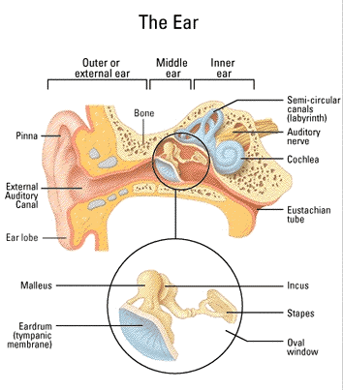

Slide 5
Ear Tubes
Ear tubes are tiny cylinders placed through the ear drum (tympanic membrane) to allow air into the middle ear. They also may be called tympanostomy tubes, myringotomy tubes, ventilation tubes, or PE (pressure equalization) tubes.
These tubes can be made out of plastic, metal, or Teflon and may have a coating intended to reduce the possibility of infection.
There are two basic types of ear tubes: short-term and long-term.

Slide 6
Ear Tubes cont.
Short-term tubes are smaller and typically stay in place for six months to a year before falling out on their own.
Long-term tubes are larger and have flanges that secure them in place for a longer period of time. Long term tubes may fall out on their own, but removal by an ENT surgeon is often necessary.

Slide 7
Myringotomy
Wound Classification: 2

Slide 8
Operative Sequence
1- Incision
2- Hemostasis
3- Dissection
4- Exposure
5- Procedure (Specimen Collection possible)
6- Hemostasis
7- Irrigation
8- Closure
9- Dressing Application

Slide 9
Myringotomy
Instrumentation: Myringotomy tray, microscope, speculum holder, micro-instruments.
Positioning: The patient is in supine position arms tucked. MD will sit for procedure.
Prepping: Surgeon preference. Hibiclense or a Betadine Prep Kit. Betadine can be placed on cotton ball to swab the ear if MD prefers. Some use no prep at all...always ask
Draping: 4 towels and a head drape. Ask about towel clips. Ask about clear incise drape.

Slide 10
Myringotomy Begin your Operative Sequence
Incision: made into the tympanic membrane with myringotomy blade (this step is out of order in this surgery due to the fact that we already have an opening to work through – the ear canal)

Slide 11
Myringotomy cont. Operative Sequence
Hemostasis: none
Dissection and Exposure: ear spec and microscope
Exploration and Isolation: MD will remove ear wax (cerumen) with ear curettes and visualize the TM.

Slide 12
Myringotomy cont. Operative Sequence
Surgical Repair/Removal/Specimen Collection:
Will make a 2mm to 3mm incision into the TM.
Fluid is suctioned out with micro-Frasier suction, #3 or #5.

Slide 13
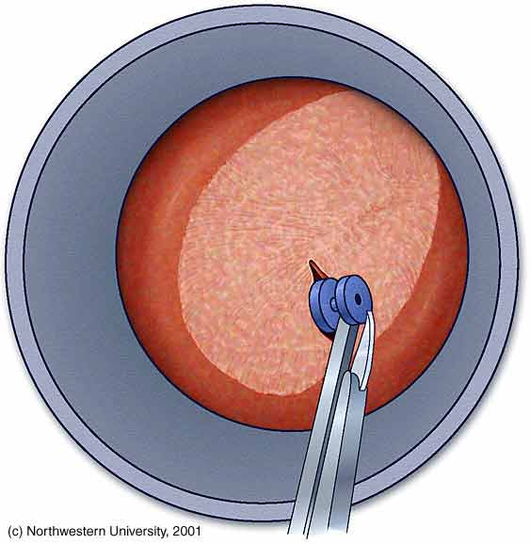
Myringotomy cont. Operative Sequence
Surgical Repair/Removal/Specimen Collection:
PE tube is grasped either by the MD or scrub with alligator forceps.
Placed into the incision.
Rosen needle (actually a pick) used to manipulate PE tube into correct position.
Video
http://www.youtube.com/watch?v=j_Z-ylTtRts

Slide 14
Myringotomy cont. Operative Sequence
Hemostasis and Irrigation:
none
Closure:
Places antibiotic drops into ear canal.
Places cotton ball in ear canal.

Slide 15
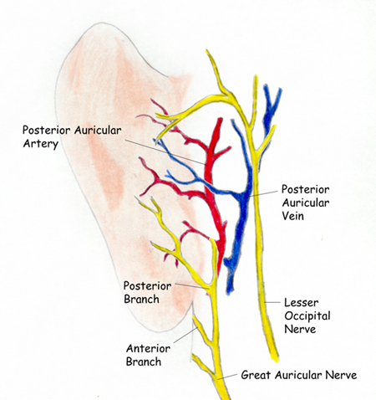
Myringotomy
Major Arteries:
Posterior auricular artery
Labyrinthine artery
Major Veins:
Posterior auricular vein

Slide 16
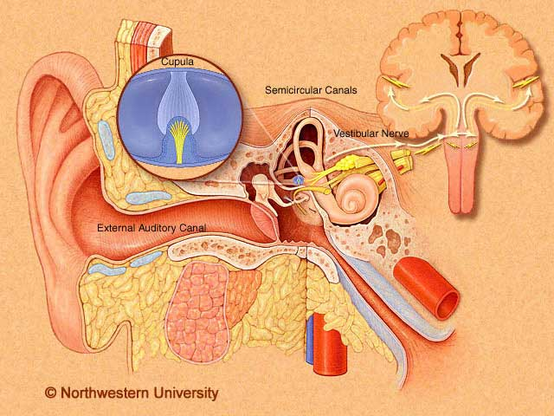
Myringotomy
Major Nerves:
Vestibular nerve: The vestibular nerve is one of the two branches of the Vestibulocochlear nerve (the cochlear nerve being the other). It goes to the semicircular canals via the vestibular ganglion. It receives positional information.

Slide 17
ENT Procedures Operative Sequence
Tonsillectomy
& Adenoidectomy

Slide 18
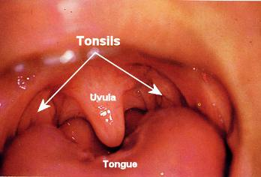
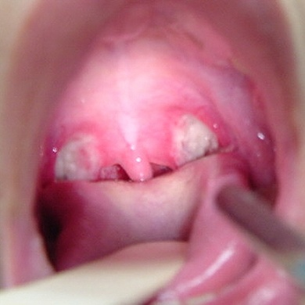
Tonsillectomy and Adenoidectomy
Tonsils are small, round pieces of tissue that are located in the back of the mouth on the side of the throat. Tonsils are thought to help fight infections by producing antibodies.

Slide 19
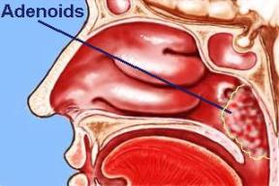
Adenoid - Lymph-like areas of tissue, or glands, that are similar to the tonsils, but they are located very high in the throat, behind the nose. They trap and filter out germs that enter the body. The adenoids also help your body fight off infection by making antibodies.

Slide 20
Types of Tonsils
Palatine tonsils--located on each side of the throat.
Pharyngeal tonsils--also known as adenoids are near the posterior openings of the nasal cavity.
Lingual tonsils--near the base of the tongue

Slide 21
You have your adenoids when you are born and they continue to grow until you are 5 to 7 years old. By school age, the adenoids begin to shrink in size, and, by the time children reach their pre-teen or teenage years, the adenoids are usually small enough to not cause any symptoms.

Slide 22
What Are the Symptoms of Enlarged Adenoids
A child may complain of:
difficulty breathing through the nose
is breathing through the mouth
talks as if his or her nostrils are pinched
breathes noisily
snores while sleeping
stops breathing for a few seconds while sleeping (called sleep apnea)

Slide 23
Tonsillectomy and Adenoidectomy
Define the procedure: removal of tissue to eradicate infection, improve the airway or remove cancer.

Slide 24
Tonsillectomy and Adenoidectomy
Overall Purpose of Procedure:
3 pathological indications for removal of the tonsils and adnoids:
Infection
Hypertrophy- enlargement via cellular growth
Cancer
Pt. may suffer from tonsillitis, peritonsillar abscess, strep throat, irr. sleep patterns, difficulty swallowing.
Adenoids can become hypertrophic to the point of blocking the Eustachian tube, causing otitis media.

Slide 25
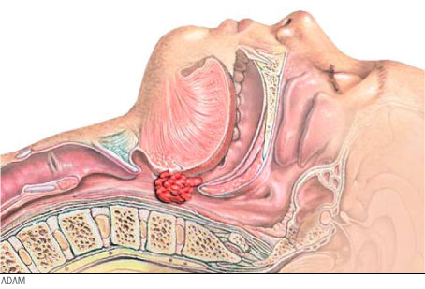

Slide 26
Tonsillectomy and Adenoidectomy
Wound Classification: 2

Slide 27
Operative Sequence
1- Incision
2- Hemostasis
3- Dissection
4- Exposure
5- Procedure (Specimen Collection possible)
6- Hemostasis
7- Irrigation
8- Closure
9- Dressing Application

Slide 28
Tonsillectomy and Adenoidectomy
Instrumentation: T&A tray
Positioning: The patient is in supine position arms tucked. MD will sit for procedure. Spin bed 90 degrees for some Md’s.
Prepping: NONE!
Draping: 4 towels and a head drape (depends on MD). Ask about towel clips. Down sheet.

Slide 29
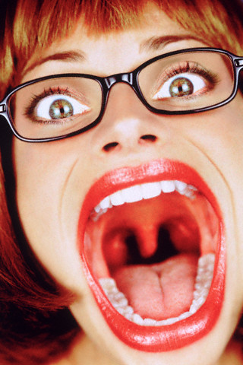
Tonsillectomy and Adenoidectomy Begin your Operative Sequence
Incision: This step comes later in the procedure.
Hemostasis: none at this point in the procedure.

Slide 30
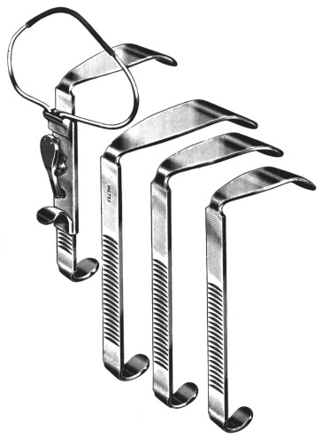
Tonsillectomy and Adenoidectomy cont. Operative Sequence
Dissection and Exposure:
Mouth Gag of Md choice is placed into pt’s mouth. Mouth gag WILL REST on mayo stand.

Slide 31
Tonsillectomy and Adenoidectomy cont. Operative Sequence
Exploration and Isolation:
MD might have headlight for visualization purposes.
Tonsil is grasped with Allis clamp, possible Allis Adair.
Have FRED on mayo for dental mirror.

Slide 32
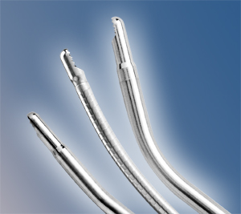
Tonsillectomy and Adenoidectomy cont. Operative Sequence
Surgical Repair/Removal/Specimen Collection:
An incision is made in the grasped tonsil.
Incision can be made with a Snare, Laser, Curette, or Coblation Wand.
Tonsil is removed with the device of choice.
Scrub needs to have a chromic suture ready on the table for heavy bleeding.

Slide 33
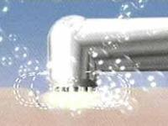
Tonsillectomy and Adenoidectomy cont. Operative Sequence
Surgical Repair/Removal/Specimen Collection:
Coblation wand uses radiofrequency waves, instead of cautery (heat) techniques, to remove tonsils and adenoids.
Coblation Tonsillectomy: http://www.youtube.com/watch?v=KizSZuqkyBc

Slide 34
Tonsillectomy and Adenoidectomy cont. Operative Sequence
Surgical Repair/Removal/Specimen Collection:
You will repeat the same process for the other tonsil.
Adenoid – MD will retract the palate with a red rubber catheter inserted transnasally.
Clamp end of red rubber with Kelly.
MD will use dental mirror to view adenoid tissue.
Removal with same procedure as Tonsils.
You will have specimens – ask then pass off.
May need sterile safety pin to mark specimen. (usually the safety pin will go into the right tonsil. Be sure not to put the pin into your hand – Tonsils are very dirty)

Slide 35
Tonsillectomy and Adenoidectomy cont. Operative Sequence
Hemostasis and Irrigation:
Heavy bleeding is a possibility. Always have NACL ready on back table or mayo.
Closure: packed with strung gauze. May be soaked in viscous Lidocaine.
T and A vid
Child and Adult T&A EESEDU
NEVER BREAK YOUR TABLE DOWN

Slide 36
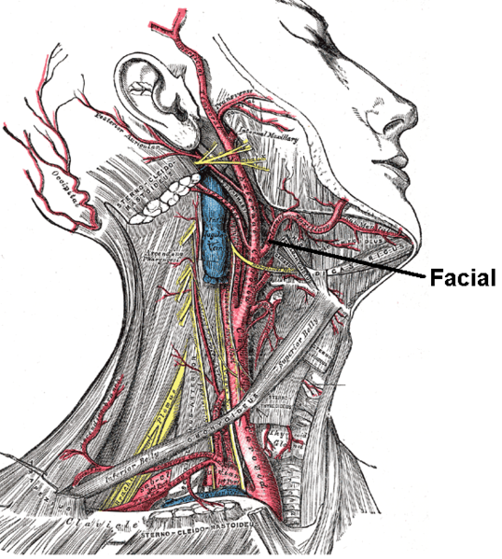
Tonsillectomy and Adenoidectomy
Major Arteries:
tonsillar and ascending palatine branches of the facial artery
Major Veins:
tonsillar veins

Slide 37
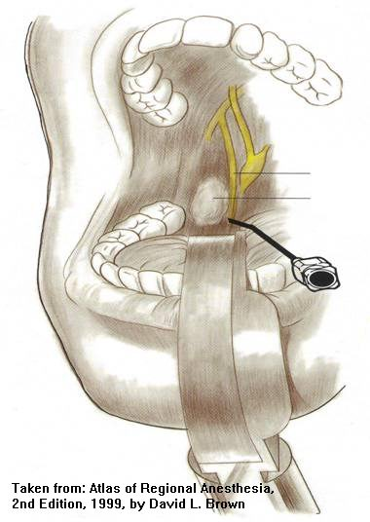
Tonsillectomy and Adenoidectomy
Major Nerves:
tonsillar branches of glossopharyngeal nerve

Slide 38
SUR 122
Tracheotomy/Tracheostomy

Slide 39
Tracheostomy is indicated for a patient who requires emergent or elective airway management for:
prolonged ventilator dependence
acute upper airway obstruction
chronic upper airway obstruction

Slide 40
Pathology for Tracheotomy or Tracheostomy
Vocal cord paralysis
Neck surgery
Trauma
Prolonged intubation
Secretion management
Cannot intubate
Stridor due to tracheal blockage
Sleep apnea

Slide 41
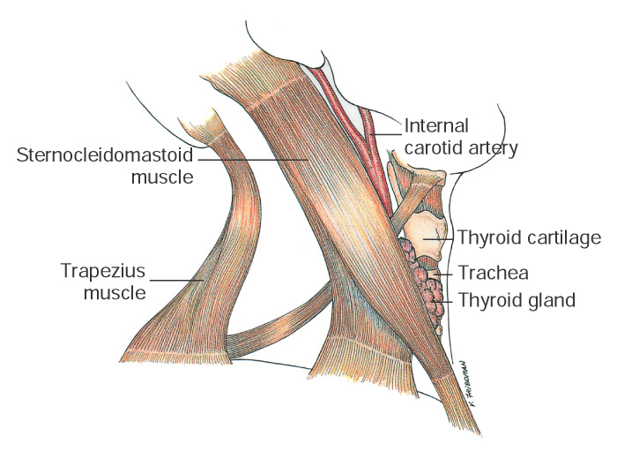
Anatomy of the Neck
(From Potter PA and Perry AG: Fundamentals of nursing, ed 5, St Louis, 2001, Mosby.)
Notes:
The neck is traditionally organized into triangles; each side is divided into two large triangles separated by the sternocleidomastoid muscle.
The neck has many significant structures, including
The carotid artery
The jugular vein
The vagus nerve
The recurrent laryngeal nerve
The esophagus
The trachea
The spinal accessory nerve (cranial nerve XI)
The digastric muscle
The hypoglossal nerve (cranial nerve XII)
The larynx
The pharynx
The thyroid
The parathyroid
The ansa cervicalis
Lymph nodes

Slide 42
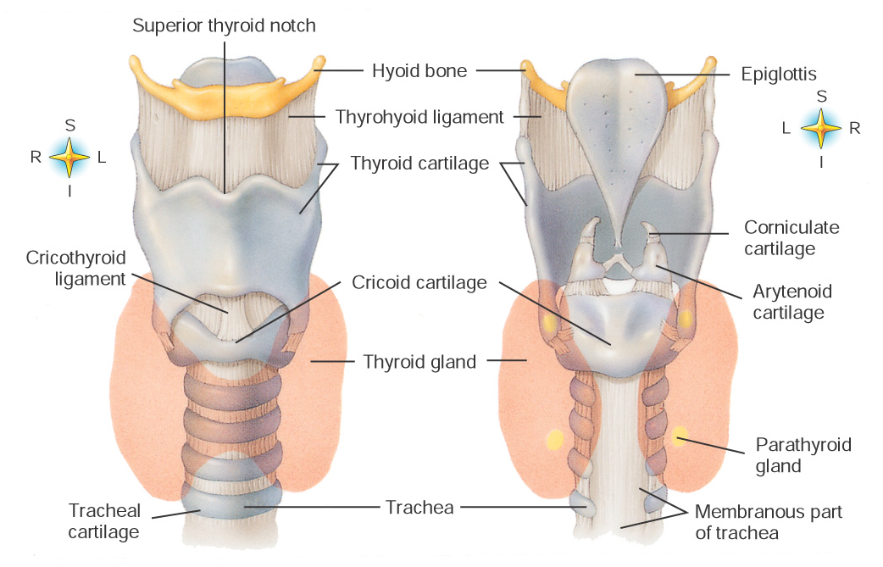
Anatomy of the Larynx
Anterior view of the pharynx
Posterior view of the pharynx
(From Thibodeau GA and Patton KT: Anthony's textbook of anatomy and physiology, ed 17, St Louis, 2003, Mosby.)
Notes:
The larynx is composed of nine segments of cartilage, three paired sets and three unpaired segments as illustrated in Figure 25–18.

Slide 43
Tracheotomy/Tracheostomy
Tracheotomy temporary opening into the trachea to facilitate breathing
Tracheostomy permanent opening of the trachea and creation of a tracheal stoma
Must place tracheal tube with either
Patient will be hooked up to a ventilator
Long term tracheostomy may eventually be able to wean off ventilator, but maintain stoma that will function as their nose did prior to surgery

Slide 44
Anesthesia
General
Local

Slide 45
Medications
Local anesthetic: Lidocaine or bupivicaine with or without epinephrine
Antibiotic irrigation

Slide 46
Positioning
Supine
Shoulder roll
Donut headrest
Pillow under knees
Safety strap

Slide 47
Prep
End of chin to midchest and bedsheet to bedsheet
Prep of choice: Duraprep, betadine scrub and/or paint

Slide 48
Draping
Towels
Small fenestrated sheet (Pediatric lap sheet)

Slide 49
Supplies, Equipment, Instruments
Minor basin
Basic pack
Pediatric lap sheet
Other small fenestrated sheet
Blades
Suture or ties of surgeon’s choice (prn)
Tracheotomy tray
Tracheotomy tube (Shiley)
Twill tape

Slide 50
Operative Sequence
Discussion

Slide 51
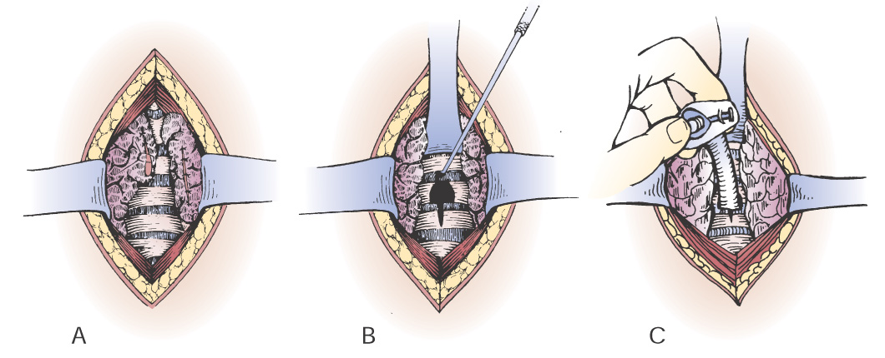
Surgical Procedures
Tracheotomy/Tracheostomy
Isthmus of thyroid is divided to expose the trachea
Two tracheal rings are cut, and the upper ring is partially resected. Tracheal hook pulls the trachea from the depth of the wound toward the surface
Tube is inserted
(Modified from DeWeese DD: Textbook of otolaryngology, ed 6, St Louis, 1982, Mosby.)
Notes:
Tracheostomy is indicated for patient who require emergent or elective airway management of prolonged ventilator dependence or acute or chronic upper airway obstruction.
Technique:
An incision is made over the anterior tracheal wall.
The surgeon visualizes the tracheal wall.
The tracheal incision is made, usually between the third and fourth tracheal rings.
The endotracheal tube is partially removed to the point superior to the tracheal incision.
The tracheostomy tube is inserted.
Hemostasis is achieved.
Tracheostomy tube is secured.
Dressings are applied.
The obturator from the endotracheal tube is sent with the patient.

Slide 52
Considerations
Will make sure obturator goes with patient to PACU or ICU
Complications: hemorrhage, infection, damage to other structures
TRACHEOSTOMY Video

Slide 53
ENT Procedures Operative Sequence
Septoplasty

Slide 54
Septum anatomy
The nasal septum separates the left and right nasal airway. The yellow portion is made of flexible cartilage, the quadrangular cartilage. The blue portion is thin bone, the perpendicular plate of the ethmoid bone. The purple portion is thicker bone, the vomer bone.

Slide 55
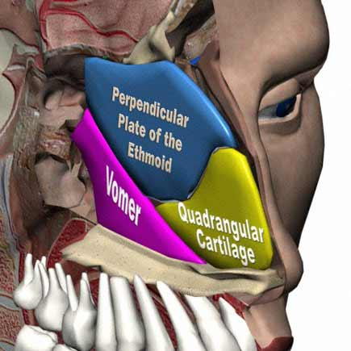

Slide 56
Septoplasty
Overall Purpose of Procedure:
To produce a patent nasal airway

Slide 57
Septoplasty
Define the procedure:
A surgical procedure done to improve the flow of air to your nose by repairing malformed cartilage and/or the bony portion.

Slide 58
Indications
1. Mouth breathing,
2· Snoring,
3· Drooling during sleep,
4· Change in voice,
5· Decrease sense of smell and taste
6· Sometimes sleep disturbances.
7· The symptoms are usually worse on one side, and sometimes occur on the side opposite the bend.
In some cases the crooked septum can interfere with the drainage of the sinuses, resulting in repeated sinus infections.
The septum may also need to be straightened in individuals undergoing sinus surgery just so that the instruments needed for this operation can be fit into the nasal cavity.

Slide 59
Septoplasty
This procedure may be performed in conjunction with:
Rhinoplasty –a facial cosmetic procedure, usually performed to enhance the appearance of the nose. During rhinoplasty, the nasal cartilages and bones are modified, or tissue is added. The aim is to improve the visual appeal of the nose.
Rhinoplasty is also frequently performed to repair nasal fractures. When rhinoplasty is used to repair nasal fractures, the goal is to restore pre-injury appearance of the nose.
Sinus surgery

Slide 60
Septoplasty
Septoplasty is rarely performed in children because the septum is is the major growth center of the midface; disrupting it may lead to maxillary hyperplasia (enlarged upper jaw)
Wound Classification: 2

Slide 61
Operative Sequence
1- Incision
2- Hemostasis
3- Dissection
4- Exposure
5- Procedure (Specimen Collection possible)
6- Hemostasis
7- Irrigation
8- Closure
9- Dressing Application

Slide 62
Septoplasty
Instrumentation: Septoplasty tray
Positioning: The patient is in supine position arms tucked. MD will sit for procedure. Spin bed 90 degrees for some MD’s.
Prepping: NONE!
Draping: 4 towels and a head drape (depends on MD). Ask about towel clips. Down sheet.

Slide 63
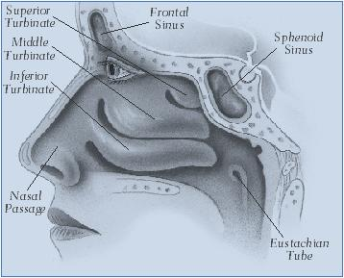
Septoplasty Begin your Operative Sequence
Incision: before this step comes the MD will inject the nose and turbinates with 1% Lidocaine with Epi. Then MD will pack the nose nasal packing soaked in vasoconstrictor of choice. (Afrin, Cocaine, Adrenaline)
Hemostasis: epi

Slide 64
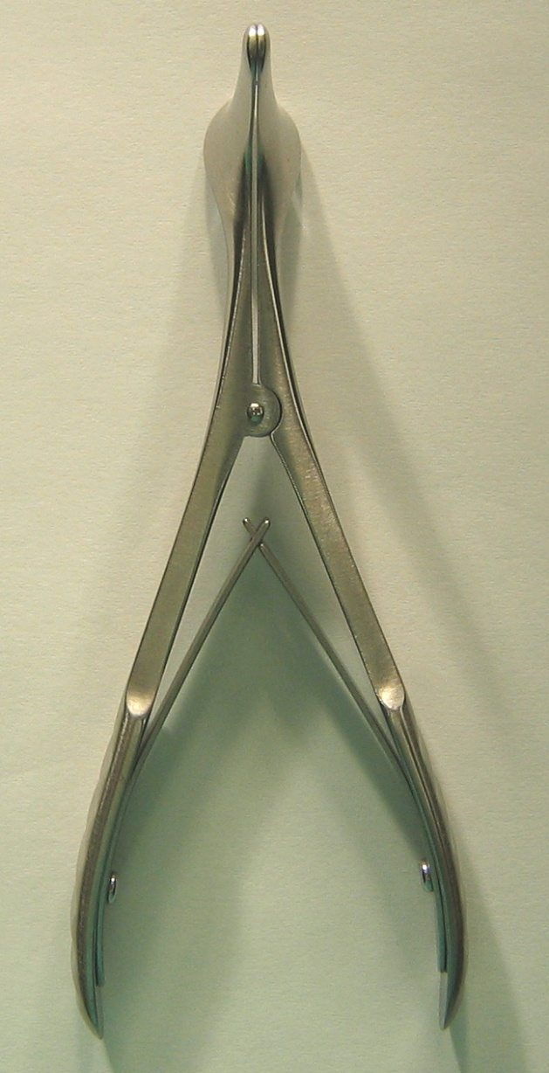
Septoplasty cont. Operative Sequence
Dissection and Exposure:
Placement of nasal speculum

Slide 65
Septoplasty cont. Operative Sequence
Exploration and Isolation:
MD might have headlight for visualization purposes.
May perform with the aid of a scope

Slide 66
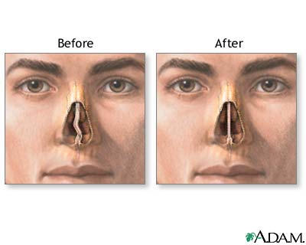
Septoplasty cont. Operative Sequence
Surgical Repair/Removal/Specimen Collection:
Incision is made into the septum below the obstruction.
Small Tenotomy scissors are used to dissect the membranous nasal septum and expose the cartilage.

Slide 67
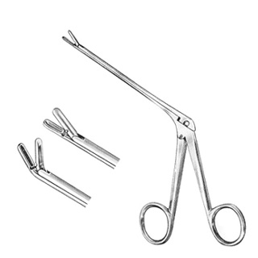
Septoplasty cont. Operative Sequence
Surgical Repair:
A Freer or Cottle elevator is then used to elevate the septum off the underlying tissue.
MD removes the deviated bone using a small chisel and mallet.
Pieces are then removed with a Takahashi forcep
Incision repair with 4-0 Chromic suture

Slide 68
Septoplasty cont. Operative Sequence
Hemostasis and Irrigation:
NACL
Suction-Bovie if needed.
Closure: internal nasal splints are placed bilat. to stabilize the septum and are stitched to the membranous septum with a 3-0 Chromic.
Video: http://www.youtube.com/watch?v=2x72UTHVKEI
NEVER BREAK YOUR TABLE DOWN

Slide 69
Septoplasty
Major Arteries:
Facial Artery (exterior of nose)
branches from the internal carotid, namely the branches of the anterior and posterior ethmoid arteries from the ophthalmic artery, and (2) branches from the external carotid, namely the sphenopalatine, greater palatine, superior labial, and angular arteries.
Major Veins: essentially follow the arterial pattern

Slide 70
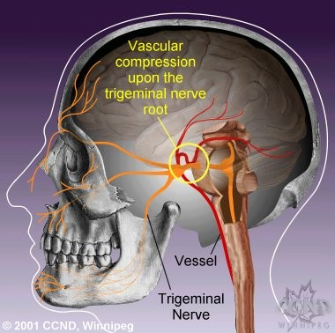
Septoplasty
Major Nerves:
sensation of the nose is derived from the first 2 branches of the trigeminal nerve.

Slide 71
ENT Procedures Operative Sequence
Thyroidectomy

Slide 72
Thyroid Functions
The thyroid gland functions in maintaining the body’s metabolic rate. One of the main functions is iodine metabolism.
Thyroid - A gland located beneath the voice box (larynx) that produces thyroid hormone. The thyroid has 2 lobes and an isthmus.
Isthmus – lies over the upper portion of the trachea, below the larynx.

Slide 73
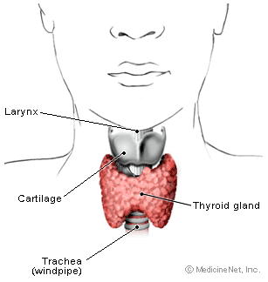
Thyroid anatomy
The thyroid gland is enclosed by pretracheal fascia.
The parathyroid glands (4) lies behind or within the thyroid gland.

Slide 74
Thyroidectomy
Overall Purpose of Procedure:
The surgical removal of one or both lobes of the Thyroid gland.
Total Thyroidectomy – removal of the entire thyroid gland.
Subtotal Thyroidectomy – removal of all but the posterior portions of each lobe in order to preserve the parathyroid glands and the recurrent laryngeal nerves.
Thyroid Lobectomy – removal of a thyroid gland lobe.

Slide 75
Thyroidectomy
Total Thyroidectomy may be done for malignancies – patient will have to take thyroid hormones for the rest of their life.
Hyperthyroidism may be treated with a subtotal approach.

Slide 76
Thyroidectomy
Define the procedure:
A surgical procedure to treat various diseases of the thyroid such as hyperthyroidism and cancer that can not be treated with chemotherapy.
Hyperthyroidism - excessive functionality of the thyroid gland marked by increased metabolic rate, enlargement of the thyroid gland, rapid heart rate, high blood pressure, and various secondary symptoms

Slide 77
Symptoms of Hyperthyroidism
goiter (enlarged thyroid gland)
nervousness
mental impairment, memory lapses, diminished attention span
irritability
trembling hands
fatigue
insomnia
eye irritation
protruding eyeballs (Grave's disease only)
diarrhea
itchy skin
unexplained weight loss despite increased appetite
heart palpitations
heat intolerance
increased sweating
muscle weakness
hair loss
increase in bowel movements
decrease in menstrual periods

Slide 78
Thyroidectomy
Wound Classification: 1

Slide 79
Operative Sequence
1- Incision
2- Hemostasis
3- Dissection
4- Exposure
5- Procedure (Specimen Collection possible)
6- Hemostasis
7- Irrigation
8- Closure
9- Dressing Application

Slide 80
Thyroidectomy
Instrumentation: Thyroid tray, Major Head and Neck Tray if your facility has one. Have Bipolar cautery available. Have Nerve Stimulator available.
Positioning: The patient is in supine position arms tucked, neck hyper extended. Roll placed under pt shoulders.
Prepping: Surgeon preference. Duraprep, Hibiclense or a Betadine Prep Kit. Prep from chin to top of chest, far lateral on both sides.
Draping: 4 towels and a lap drape. Ask about towel clips. Down sheet if needed.

Slide 81
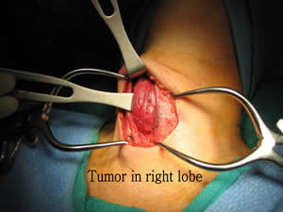
Thyroidectomy Begin your Operative Sequence
Incision:
Made with 10kb in midline of neck. Preferably in the normal skin crease.
Hemostasis:
Bovie, hemoclips, ties

Slide 82
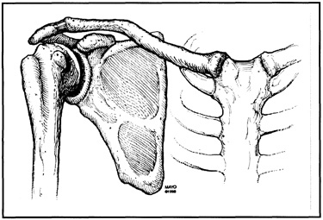
Thyroidectomy cont. Operative Sequence
Dissection and Exposure: Must raise the skin flaps. Have double pronged skin hooks available, Army-Navy’s, Volkmans etc.
Metz scissors, skin flaps are dissected superiorly to the level of the cricoid cartilage and post. to the sternoclavicular joint

Slide 83
Thyroidectomy cont. Operative Sequence
Exploration and Isolation:
Fascia in the midline is incised (15 kb).
Strap muscles are identified and divided.
Divide the inferior and middle thyroid veins (will need clips or silk sutures).
Divide the superior and inferior thyroid arteries (will need clips or silk sutures again).
Next we will dissect the recurrent laryngeal nerves.

Slide 84
Thyroidectomy cont. Operative Sequence
Surgical Repair/Removal/Specimen Collection:
Pass Lahey or Allis clamps, Metz and smooth forceps for grasping the body of the thyroid gland.
The thyroid lobe is elevated and freed from the trachea (Metz and smooth forceps like Gerald's or Dekakeys)

Slide 85
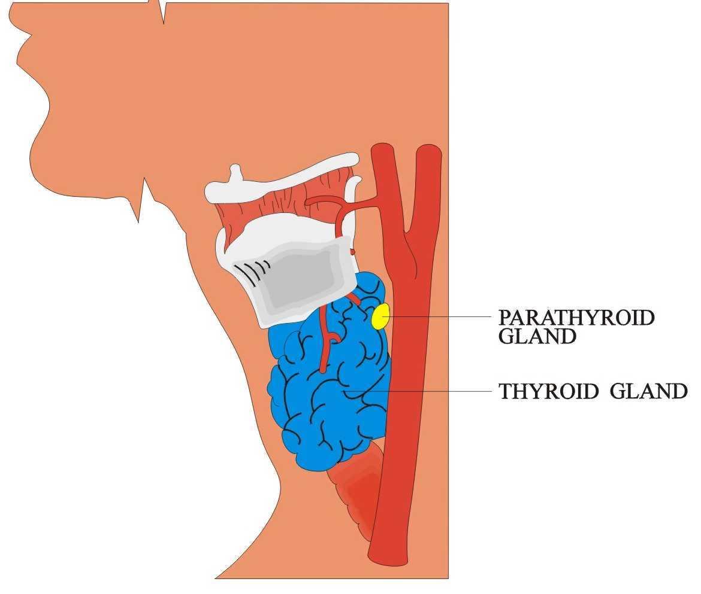
Thyroidectomy cont. Operative Sequence
Surgical Repair:
Now we have to divide and isolate the thyroid isthmus from the trachea.
Provide Metz and be ready for a specimen.

Slide 86
Thyroidectomy cont. Operative Sequence
Hemostasis and Irrigation:
NACL and bovie. A closed drain system might be required.
Closure: Vicryl and Nylon on cutting needle for drain stitch.
Thyroidectomy Video - eesedu

Slide 87
Parathyroidectomy
The parathyroid glands are four, small, pea-shaped glands that are located in the neck on either side of the trachea (the main airway) and next to the thyroid gland. In most cases there are two glands on each side of the trachea, an inferior and a superior gland. Fewer than four or more than four glands may be present, and sometimes a gland(s) may be in an unusual location.

Slide 88
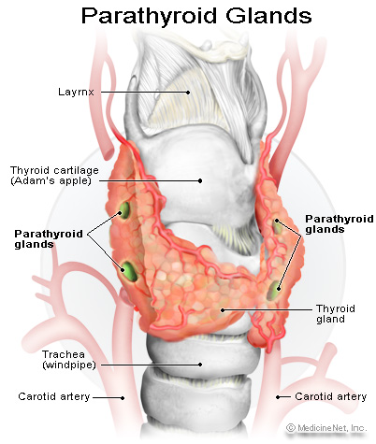

Slide 89
Parathyroid Functions
The function of the parathyroid glands is to produce parathyroid hormone (PTH), a hormone that helps regulate calcium within the body.

Slide 90
Parathyroidectomy
Overall Purpose of Procedure:
The surgical removal of one or all of the parathyroid gland(s).
It is used to treat hyperparathyroidism.

Slide 91
Symptoms of Hyperparathyroidism
Hyperparathyroidism is a condition in which the parathyroid glands produce too much PTH. If there is too much PTH, calcium is removed from the bones and goes into the blood. This results in increased levels of calcium in the blood and an excess of calcium in the urine. (If there is too little PTH, the blood calcium level can fall to dangerously low levels.) In more serious cases, the bone density will diminish and kidney stones can form. Other non-specific symptoms of hyperparathyroidism include depression, muscle weakness, and fatigue. Every effort is made to medically treat or control these conditions prior to surgery. These efforts include avoiding calcium rich foods, proper hydration (intake of fluids), and medications to avoid osteoporosis.

Slide 92
Causes of Hyperparathyroidism
There are two types of hyperparathyroidism, primary and secondary. The most common disorder of the parathyroid glands and one that causes primary hyperparathyroidism, is a small, tumor called a parathyroid adenoma. A parathyroid adenoma is a benign condition in which one parathyroid gland increases in size and produces PTH in excess. (As opposed to parathyroid adenoma, it should be noted that malignant tumors of the parathyroid glands, that is, cancer, is very rare.) In most situations patients are unaware of the adenoma, and they are found when routine blood test results show an elevated blood calcium and PTH level. Less commonly, primary hyperparathyroidism may be caused by over activity of all of the parathyroid glands, referred to as parathyroid hyperplasia.
With secondary hyperparathyroidism, the secretion of PTH is caused by a nonparathyroid disease, usually kidney failure.

Slide 93
Parathyroidectomy
Define the procedure:
Parathyroidectomy is the removal of one or more of the parathyroid glands.

Slide 94
Parathyroidectomy
Wound Classification: 1

Slide 95
Operative Sequence
1- Incision
2- Hemostasis
3- Dissection
4- Exposure
5- Procedure (Specimen Collection possible)
6- Hemostasis
7- Irrigation
8- Closure
9- Dressing Application

Slide 96
Parathyroidectomy
Instrumentation: Thyroid tray, Major Head and Neck Tray if your facility has one. Have Bipolar cautery available. Have Nerve Stimulator available.
Positioning: The patient is in supine position arms tucked, neck hyper extended. Roll placed under pt shoulders.
Prepping: Surgeon preference. Duraprep, Hibiclense or a Betadine Prep Kit. Prep from chin to top of chest, far lateral on both sides.
Draping: 4 towels and a lap drape (depends on MD). Ask about towel clips. Down sheet if needed.

Slide 97
Parathyroidectomy Begin your Operative Sequence
Incision:
Made with 10kb in midline of neck. Preferably in the normal skin crease.
Hemostasis:
Bovie, hemoclips, ties

Slide 98
Parathyroidectomy cont. Operative Sequence
Dissection and Exposure: Must raise the skin flaps. Have double pronged skin hooks available, Army-Navy’s, Volkmans etc.
Metz scissors, skin flaps are dissected superiorly to the level of the cricoid cartilage and post. to the sternoclavicular joint

Slide 99
Parathyroidectomy cont. Operative Sequence
Exploration and Isolation:
Fascia in the midline is incised (15 kb).
Strap muscles are identified and divided.
Parathyroid glands are searched and dissected for.

Slide 100
Parathyroidectomy cont. Operative Sequence
Surgical Repair/Removal/Specimen Collection:
The parathyroid gland is elevated and freed from the throid (Metz and smooth forceps like Gerald's or Dekakeys)

Slide 101
Parathyroidectomy cont. Operative Sequence
Surgical Repair:
Provide Metz and be ready for a specimen.
Minimally Invasive Parathyroidectomy
PTH levels obtained during parathyroidectomy help to guarantee the successful resection of the abnormal gland by demonstrating a return of the PTH levels to normal after the suspected parathyroid adenoma is removed. Using this method, a PTH determination is obtained immediately prior to the resection and compared to a PTH determination done ten minutes after the resection.

Slide 102
Parathyroidectomy cont. Operative Sequence
A portion of a gland may be transplanted to another site in the neck or the arm to preserve parathyroid function.
This is a very important step that you need to be ready for.
Although this is a separate procedure with a separate incision, most surgeons will NOT require a separate setup.

Slide 103
Parathyroidectomy cont. Operative Sequence
In most situations, you only need one functioning gland to have normal calcium levels.
In the rare event that all glands are removed, blood calcium levels may fall, and patients may need to take calcium supplementation for the rest of their lives.

Slide 104
Parathyroidectomy cont. Operative Sequence
Hemostasis and Irrigation:
NACL and bovie. A closed drain system might be required.
Closure: Vicryl and Nylon on cutting needle for drain stitch.

Slide 105
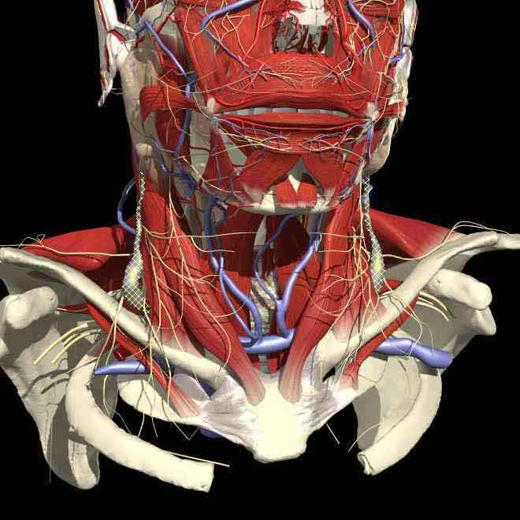
Thyroidectomy and Parathyroidectomy
Major Arteries:
Superior and Inferior thyroid artery
Major Veins:
Internal Jugular Vein

Slide 107
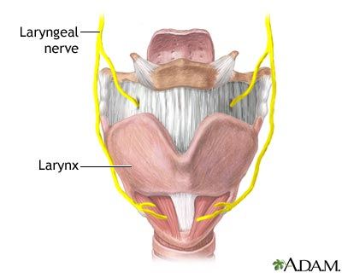
Thyroidectomy and Parathyroidectomy
Major Nerves:
Recurrent Laryngeal Nerve
Damage to the recurrent laryngeal nerve with resultant weakness or paralysis of the vocal cord or cords

