Slide 1
CARDIAC SURGERY I

Slide 2
Outline
Heart A & P
CAD
Open Heart Diagnostics
Anesthesia and Medications on Field
Open Heart Patient Preparation
Supplies, Instrumentation, and Equipment
CABG
Complications of CABG
Congenital Pathologies of the Heart
Cardiac Arrhythmias: Pacemakers and AICDs

Slide 3
Anatomy of the Heart
Four chambers:
Upper atria x 2
Lower ventricles x 2
Four valves:
Atrioventricular valves x 2
Semilunar valves x 2
Divisions:
ventricular and atrial septum separate each atria and ventricle
Coronary sulcus separates atria from ventricles

Slide 4
Heart Anatomy
Beneath the sternum is a layer of fat or subcutaneous tissue that must be dissected to get to the mediastinum (cavity between the pleural cavities)
Through the mediastinum is a shiny sac that will be opened to expose the heart
This is the “PERICARDIUM”
In the pericardium is a serous lubricating fluid that protects the outer layer of the heart (as it is constantly moving) called the “EPICARDIUM”

Slide 5
Heart Anatomy
The muscle layer or middle layer of the heart is the MYOCARDIUM
The inner layer or lining of the heart is called the ENDOCARDIUM
Endocardium is a continuous layer with the blood vessels

Slide 6
Normal Circulation
Blood comes back to heart for reoxygenation via SVC and IVC entering the RA>tricuspid valve>RV> pulmonic valve into the pulmonary trunk>R/L pulmonary arteries>Lungs (reoxygenated)>returns to heart via the pulmonic veins (two per side/four total) into the LA>mitral (bicuspid)valve LV through the aortic valve pushing oxygenated blood into the aorta and coronary ostia as it passes them through the aortic arch and throughout the rest of the body where oxygen is needed by all the organs and tissues

Slide 7
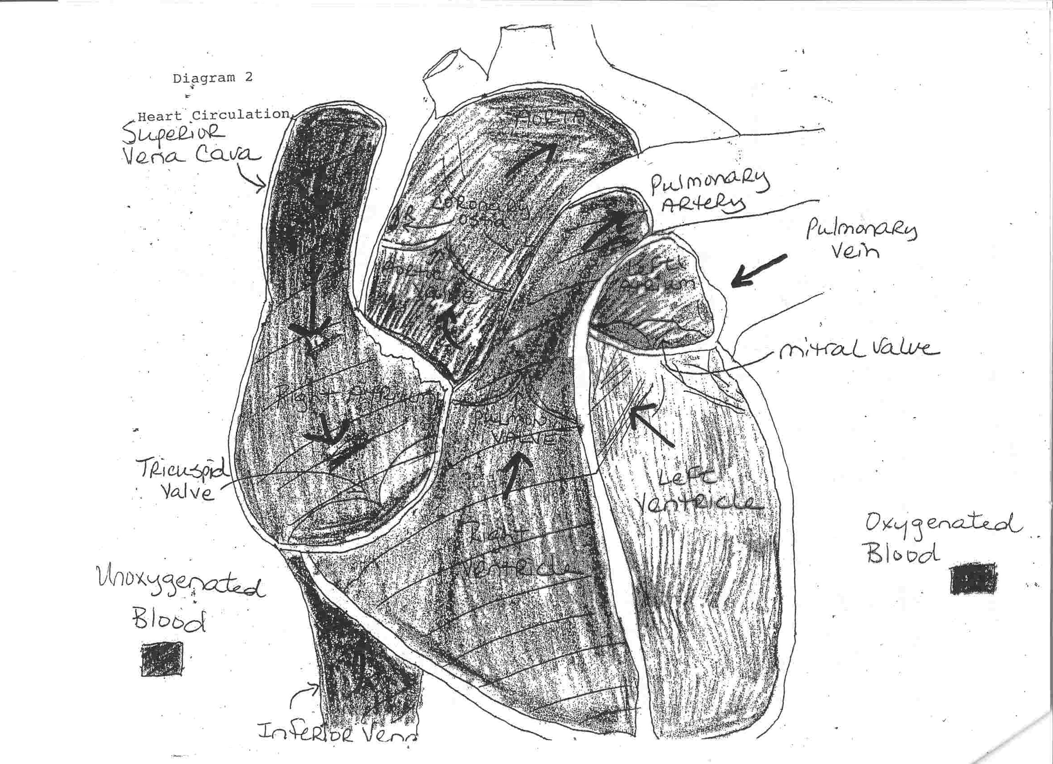

Slide 8
Coronary Anatomy and Circulation
Coronary Ostia are the origin points of coronary (heart) circulation
Right and Left on either side of the aorta just above the aortic valve
Left coronary “left main” bifurcates into the LAD (left anterior descending) and the Cx (circumflex)
Diagonal branches come off the LAD
OM (obtuse marginals) come off the circumflex

Slide 9
LAD and circumflex branches supply oxygen to the anterior and posterior portion of the heart which involves important structures such as bundle branches, papillary muscles of the mitral valve, and in 50% of patients, the SA (sinoatrial node)

Slide 10
Right coronary artery bifurcates into the right coronary artery and posterior descending coronary artery (PDA)
The right coronary artery can have branches called marginals
The right coronary artery supplies blood to the right atrium and in 50-60% of patients, the SA node
The PDA supplies blood to the posterior ventricular septum, half the inferior wall of the left ventricle, papillary muscles of the mitral valve and the AV (atrioventricular) node

Slide 11
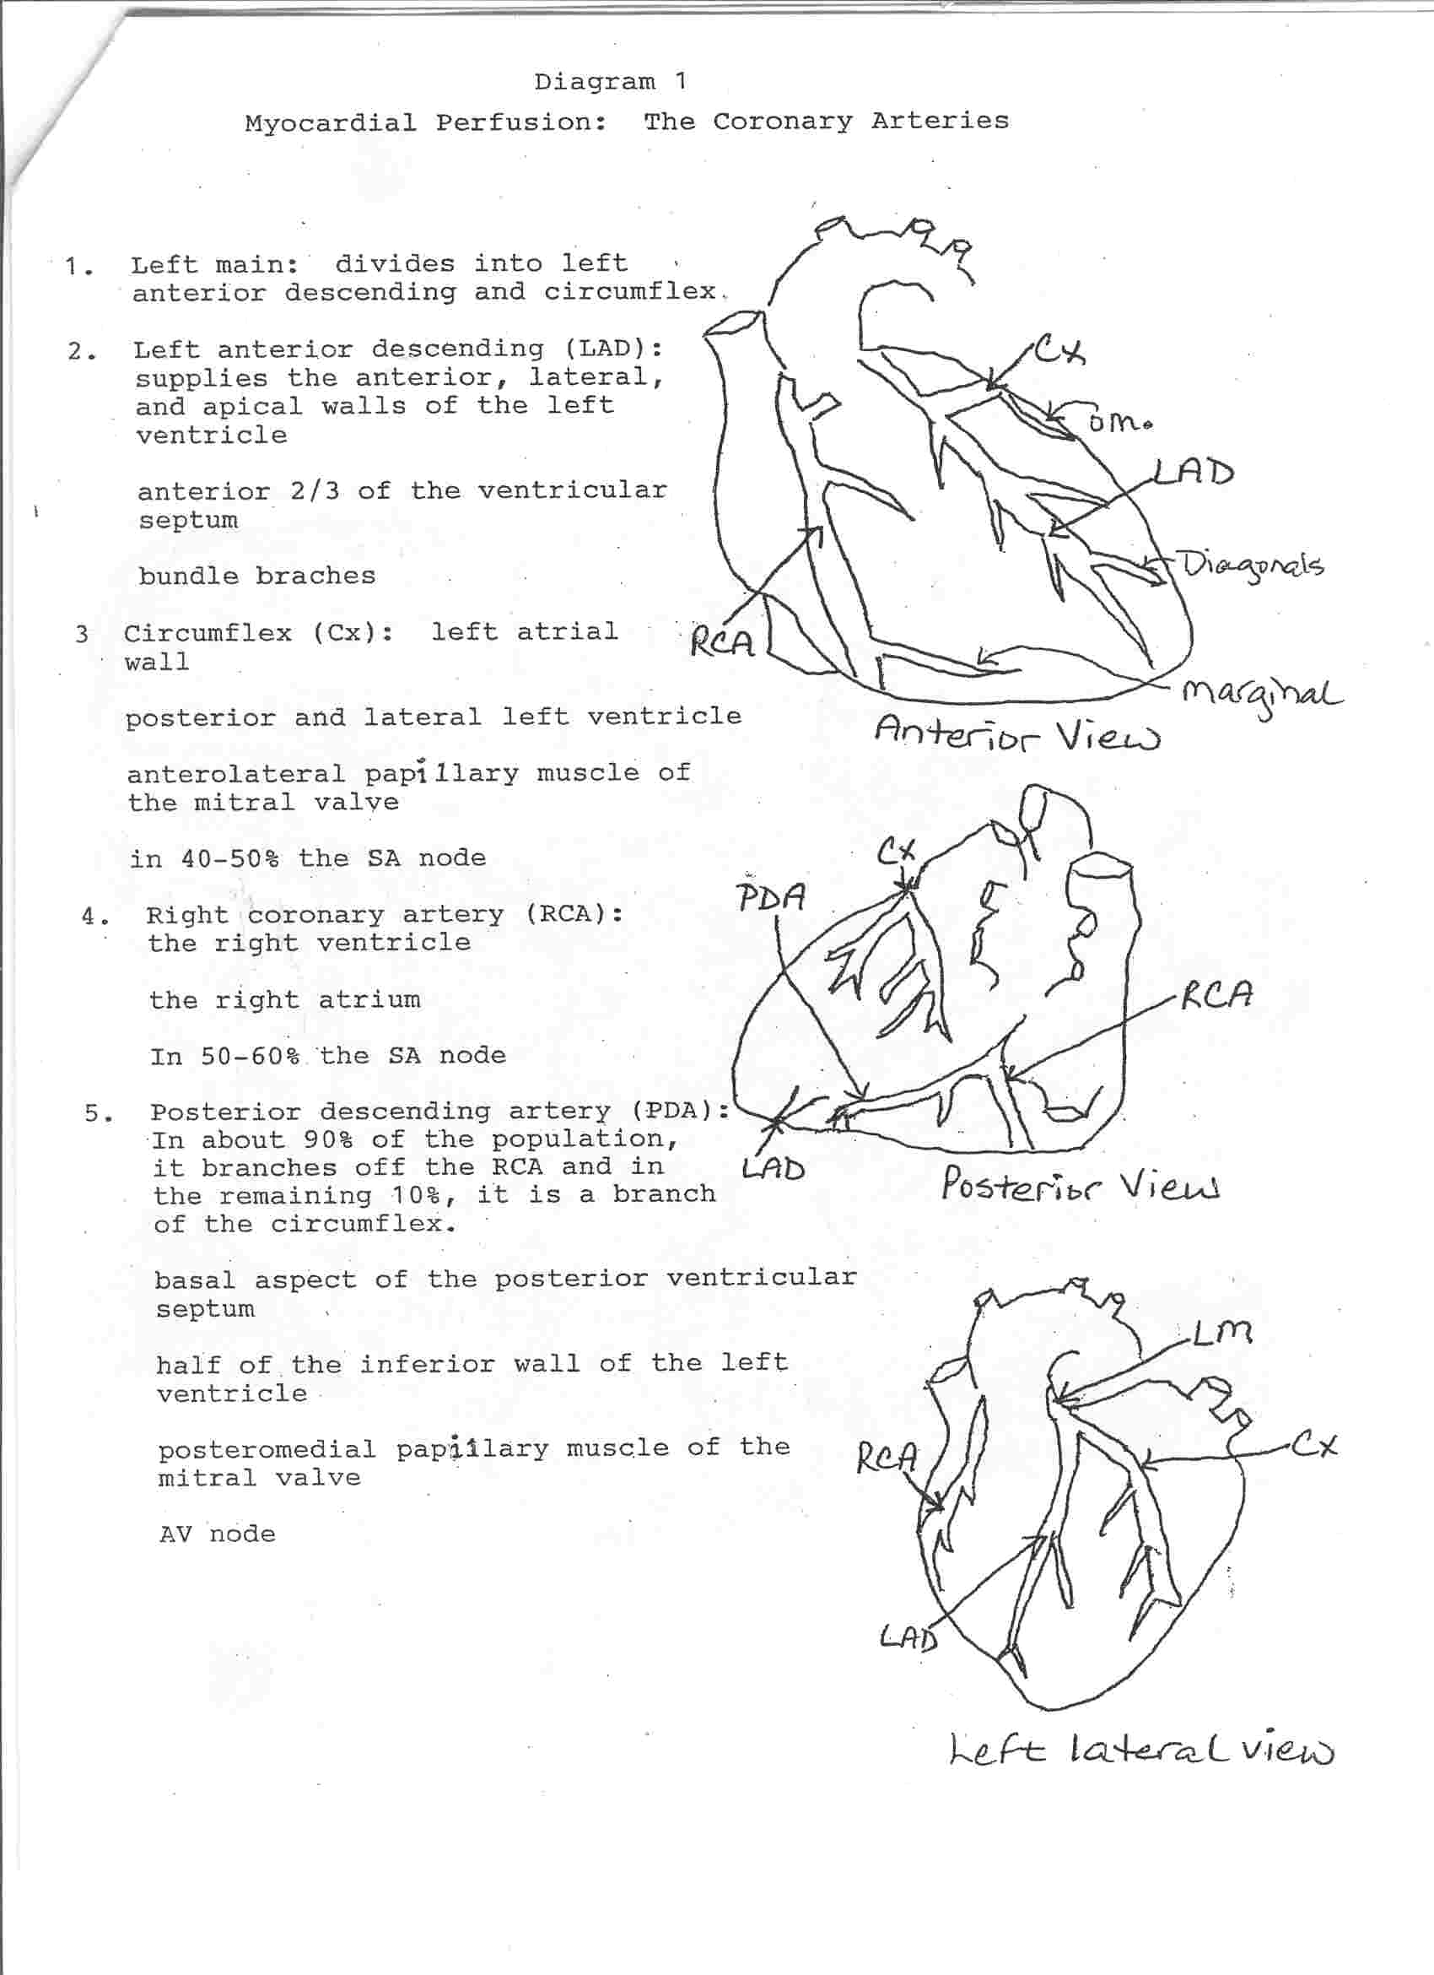

Slide 12
Coronary arteries ultimately drain (as coronary veins) into the coronary sinus, located in the right atrium where the vena cava also empty after oxygen has been used by its respective organs so that the reoxygenation process may start all over again

Slide 13
Cardiac Conduction
Coordinates cardiac conduction
SA Node (sinoatrial) “the pacemaker”
AV Node (atrioventricular)
Bundle of HIS or AV Bundle
Down R/L insulated branched bundles in ventricular septum
Purkinge Fibers non-insulated and feed into R/L ventricles

Slide 14
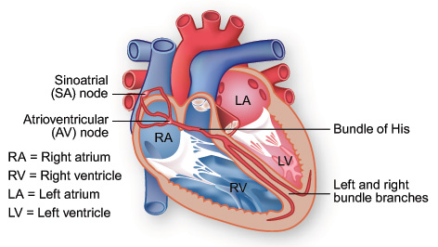

Slide 15
Cardiac Conduction
SA node initiates impulse > atria contract (blood forced into ventricles through atrioventricular valves and semi-lunar valves close)> stimulus picked up by AV node > AV Bundle (signal slightly delayed) > bundle branches > purkinge fibers > ventricles stimulated and contract (blood forces atrioventricular valves to close and semilunar valves to open)
These valves should go one-way

Slide 16
Cardiac Cycle
Two phases:
Diastole
Systole

Slide 17
Cardiac Cycle
Systole
1/3 cardiac cycle
Atrial contraction
Blood pumped to ventricles filling pulmonary and systemic arteries
With volume of blood in ventricles, ventricular pressure greater than atrial
Mitral and tricuspid valves shut
Ventricles contract, blood pushed into pulmonic and aortic valves

Slide 18
Cardiac Cycle
Diastole
2/3 cardiac cycle
Ventricular relaxation
Ventricles fill with blood
AV valves open (tricuspid and mitral)
Pressure higher in atria creating ventricular filling

Slide 19
Cardiac Cycle
4-6L of blood pumped throughout body per minute
This total volume = cardiac output
CO=SV (volume of blood in each systole) x R (number of beats per minute)

Slide 20
Heart Sounds
Closure of the AV valves (tricuspid and mitral) = 1st heart sound S₁ = start of systole
Closure of semi-lunar valves = second heart sound S₂ = start of diastole

Slide 21
Parasympathetic and Sympathetic Nervous System
Nerve fibers from PSNS and SNS originate in medulla oblongata end in SA and AV nodes
PSNS fibers slow heart using acetylcholine
SNS fibers raise heart rate using norepinephrine

Slide 22
Coronary Artery Disease
Coronary Heart Disease is the number one cause of death in the United States
Risk factors for coronary heart disease include: cigarette smoking, hypertension, elevated cholesterol, lack of physical activity, diabetes, obesity, reproductive hormones, type A personality traits, and heredity

Slide 23
Coronary Heart Disease (CHD) is defined as “myocardial impairment due to an imbalance between coronary blood flow and myocardial oxygen requirements”
CHD is primarily caused by atherosclerosis, a narrowing or occlusion of the coronary arteries=Coronary Artery Disease (CAD)
CHD can be related to blood clots or arterial spasm

Slide 24
Atherosclerosis most often occurs in the proximal segments of the coronary arteries
This is a fortunate circumstance as it makes surgical revascularization techniques possible and effective
Without myocardial blood supply, myocardial infarction (MI) or heart attack occurs, and life is threatened

Slide 25
Coronary Artery Bypass Grafting CABG
Surgical revascularization technique
Other options depending on the severity of disease are coronary balloon angioplasty (PTCA), atherectomy, ablation, and stent placement (These procedures are done in the cardiac catheterization lab)
CABG is literally providing the patient with a “new” coronary artery which bypasses or goes around the existing stenosis creating a new origin point on the aorta for that artery, resupplying an area of the heart with blood that is otherwise limited

Slide 26
Diagnosis
NONINVASIVE
H & P
ECG/EKG
Exercise EKG or Stress Test
Chest X-ray

Slide 27
Diagnosis
INVASIVE
Aortography
Electrophysiology (EP) studies
Cardiac catheterization-provides definitive information for ischemic or coronary artery disease
Endomyocardial biopsy

Slide 28
Sequence of Events
Room set-up
Furniture
Equipment
Personnel in the room
Anesthesia
Graft Harvesting by the PA
Greater Saphenous vein
Radial Artery

Slide 29
Equipment
Two large tables (back table and Mayfield)
Mayo stand (for saw)
Double ring
Prep tables x 2
Slush machine/warmer
ECU x 2
Cell saver
CPB machine
Off-table suction
Video tower if doing ESVH (insufflator, camera, light source, video monitor)
External pacing box to CRNA

Slide 30
Instrumentation
Open heart trays
IMA Retractor
Delicate Tray if doing radial harvest and an (extra) smaller back table like we use in lab
Micro instrument set
Doctor specials micro instrument set
Sternal retractor (Ankinney)
Finochetti
Sternal saw
Internal defibrillator paddles (size is surgeon preference) standard size is 6.0
ESVH Tray

Slide 31
Supplies
CV Drape pack
Coronary custom pack
Three quarter sheets x 3
Gloves for all involved in surgery
Miscellaneous suture (silk ties (4-0, 3-0, 2-0, 0, 1, 2), pericardial, cannulation, distal anastamoses, proximal anastamoses, pacing wires, suture to sew in pacing wires (surgeon dependant), cutting needles to sew in chest tubes and pacing wires to skin, sternal wires, fascia, subcutaneous, subcuticular
Will also need closing suture for the PA to close the leg incision or radial incision on the arm (subcutaneous and subcuticular)
If using the femoral artery or vein may need appropriate sized prolene to close the vessel after cannuli are removed
If using same saphenous vein that goes to the femoral vein cannulated, will simply tie off that femoral vein after cannula is removed

Slide 32
Supplies continued
Chest tubes of surgeon choice (need chest tube for side that IMA is being harvested, a mediastinal chest tube, and a substernal chest tube)
Aortic punch
Graft markers
Clips (small, medium, and large)
Small suction to suction the chest tubes before hooking up (10F)
Arterial cannula, venous cannula, antegrade cannula, medusa, vessel cannulas, retrograde cannula
Y-connectors for chest tubes
Straight connector for venous if it is not on it (must know size of pump tubing and cannula end
Coronary suction or blower mister
Intracoronary shunts if “beating” or OPCAB

Slide 33
Supplies
Special retractor for OPCAB or “Beating” (called Guidant stabilizer system or Medtronic’s: octopus, starfish, or urchin stabilizing systems (surgeon choice)
Temperature probe/Foley
Myocardial temperature probe (optional)
Cardiac insulation pad

Slide 34
Drugs on Field
Warm Saline with antibiotic if surgeon preference (Ancef)
Cold Saline
Cardioplegia Solution
Papaverine 60mg/2ml + 30ml of PF NS
Sternal hemostatic (bonewax or combination of gelfoam powder and thrombin or saline)
Gelfoam sponge (may cut to anastamosis size)
Avitene
Surgicel
Heparinized LR or NS for the vein soak/prep
Combination of albumin, 10ml of papaverine mix, and 30cc of heparin saline for radial artery soak

Slide 35
Patient Positioning
Supine
Arms tucked/padded (esp. side IMA bar will be on) aware of arterial line impediment
Headrest
May use pillow under knees or gel pads for heals

Slide 36
Prep
Betadine soap followed by betadine paint
Some places use spray or gel betadine
Begin at sternum and work your way out to groins, then pubis last
May proceed from groins to lower legs
Proper procedure is to do the upper body separate then wash each leg individually beginning at the leg incision site and working your way out circumferentially, always prepping the pubis last
Will do at least two coats of paint after the soap has been done by the circulator
May or may not do feet depending on the institution (if do not prep as far to lower ankle as possible and get under the lower legs to lower buttock

Slide 37
Draping
Groin Towel (tri-folded, long way)
Towels x 2 on either side, neck towel (secure with towel clips or staples)
Lower leg drape, should have adhesive strip
Wrap feet with towels x 2 and kerlix or booties if have been prepped
Drying towels
X-large IOBAN
CV Drape

Slide 38
Sequence of Events
Greater Saphenous vein harvest simultaneous with mediansternotomy
Mediansternotomy
Internal Mammary Artery Harvest (IMA)
Cannulation for CPB
Aortic cross clamp applied
Cardioplegia administered
Temp reduced
Heart stopped

Slide 39
Cardiopulmonary Bypass CPB
Procedure done to stop the heart and empty the heart of blood temporarily so that the heart is protected and a bloodless field is provided for optimal visibility by the surgeon
Are newer methods available to not stop the heart (OPCAB)
An example of someone who would not be receptive to CPB would be someone at risk of a stroke (existing carotid stenosis)

Slide 40
CPB
Heparin given before CPB to prevent coagulation
Hemodilution done by anesthesia to decrease blood viscosity and prevent clotting
See diagram: purse string sutures are placed on the aorta x 2, on the right atrium x 2, and later on the aorta x one below where the aortic cannula is placed
An aortic cannula is placed into the aorta and attached to the arterial CPB tubing
A Venous cannula is placed in the right atrium into the inferior vena cava and attached to the venous CPB tubing
A retrograde cannula is placed into the coronary sinus via the right atrium attached to a pressure line which is monitored by anesthesia and a cardioplegia line which goes to the perfusionist
An antegrade cannula/vent is placed into the aorta below the arterial cannula which is attached to the cardioplegia line and a vent line going to the perfusionist

Slide 41
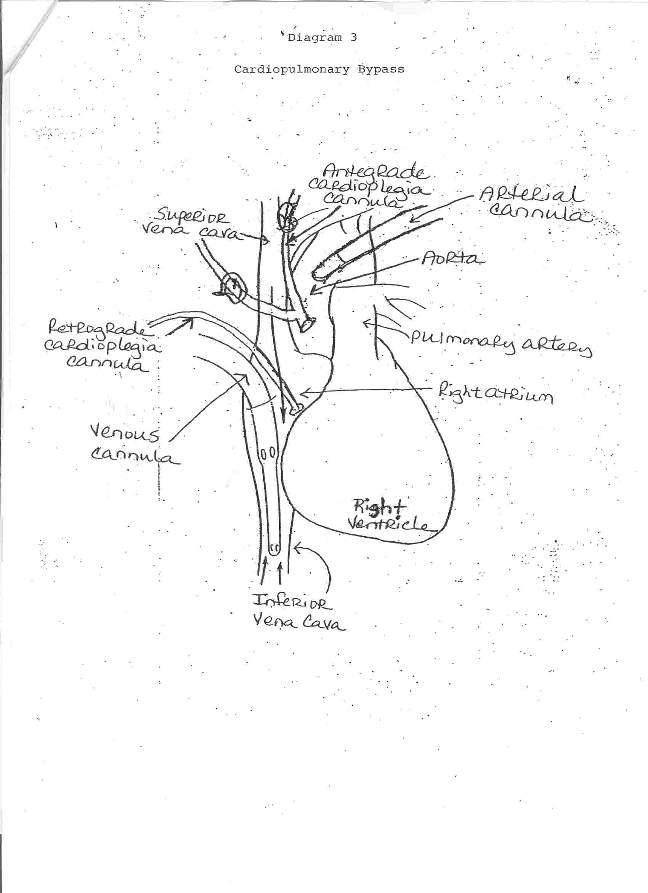

Slide 42
Protecting the Heart
Patient core body temperature is reduced ≤ 30°
Heart temp is reduced ≤ 12°
Cardioplegia is a high potassium solution that stops and protects the heart
The antegrade and retrograde lines allow for cardioplegia to be administered by the perfusionist directly into the heart
Antegrade sends cardioplegia directly into the coronary ostia protecting those areas of the heart above the coronary stenoses
Retrograde sends cardioplegia in reverse to protect the areas of the heart below the stenoses
Depending on severity of the disease as well as surgeon preference, retrograde may not be used

Slide 43
Protecting the Heart
Before cardioplegia is administered an aortic cross clamp is placed between the arterial cannula and antegrade cannula to prevent blood circulating through the arterial cannula from coming into the heart as well as prevent cardioplegia from going into the patient’s bloodstream
Blood that comes through the superior vena cava that may not be picked up by the venous cannula to go to the CPB machine can be sucked out of the heart through the vent attached to the antegrade line so that it can be added to the CPB circuitry
Hence you have mechanical cardiopulmonary bypass of the patient’s normal cardiopulmonary bypass
We’re ready to GRAFT some new coronaries!

Slide 44
Distal anastamoses
Rewarming/Restarting the heart
Cardioplegia cessation
Warming Patient with CPB circuitry
Administration of Lidocaine (PRN)
Defibrillation (PRN)
Temporary Pacing (PRN)

Slide 45
Proximal anastamoses
Decannulation “Coming Off Bypass”
Pacing wires/Chest tubes
Drying up
Closure
May close the pericardium with pop-off neurolon or silk sutures especially if anticipating a re-operation or if patient is very young
Sternal wires
Fascia
Subcutaneous
Subcuticular
Dressing
Patient to CVICU

Slide 46
CABG animation

Slide 47
IABP
Intra-aortic balloon pump
Sometimes a patient’s heart does not regain its normal pumping ability after coming off bypass. In these instances, an IABP will be placed to assist the patient’s heart so that it may regain its normal pumping function gradually.
Patient’s requiring these can usually be anticipated by their poor cardiac function and disease at the beginning of the procedure

Slide 48
RE-DO Heart Surgeries
If this is a second heart procedure will need an oscillating saw and anticipate crashing on bypass if injury is sustained upon opening of the sternum
Scar formation/Adhesions of result in heart structures adhering to the sternum making them susceptible to being injured with mediansternotomy
Generally femoral cannulation for CPB is used in these circumstances to avoid such an event allowing patient to be ON BYPASS before the sternum is opened

Slide 49
Complications
Cardiogenic shock
PE (pulmonary embolus)
Myocardial contusion
Mechanical venous obstruction
Hypothermia
Cardiac tamponade (pericardial sac fills with blood = pressure on heart)
Arrythmias
Infection
Notes:
Tamponade occurs most frequently due to a bleeder or something is leaking and drainage of the mediastinum is inadequate. Requires “bring-back” to repair problem

Slide 50
Congenital Pathology
PDA
ASD
VSD
Tetrology of Fallot
Coarctation of the Aorta

Slide 51
PDA
Patent ductus arteriosus
Channel joining PA or pulmonary artery to aorta in utero remains patent
Normally closes within hours after birth
Asymptomatic in early childhood, growth and development are normal
Symptoms progress: Thrill palpable in upper left sternum and continuous murmur heard in systole and diastole (machine-like)

Slide 52
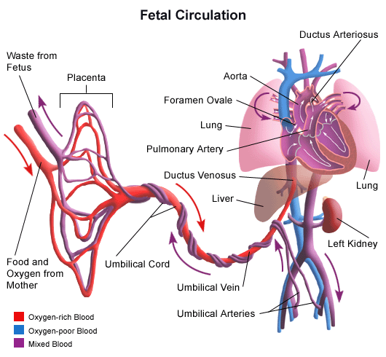

Slide 53
ASD
Atrial septal defect
Atrial septum opening
Results in shunting of blood from left to right atrium, increasing pulmonary blood flow
Tolerated
Symptoms rare in infants
Normal development
Symptoms in children and young adults are fatigued and DOE (dyspneic on exertion)

Slide 54
VSD
Ventricular septal defect
Ventricular septal opening
Primarily subaortic
Size and position vary
Small are asymptomatic
Large defects create slow birth weight and growth
Severe creates heart failure

Slide 55
Tetrology of Fallot
4 components:
Pulmonary valve stenosis
VSD
Hypertrophy of right ventricle
Over-riding aorta
Results in blood being shunted away from pulmonary system decreasing oxygenated blood delivery to systemic system
Symptoms: cyanosis with exertion (crying ) then at rest, delayed development
Repaired prior to school-age
Good prognosis

Slide 56
Coarctation of Aorta
Severe narrowing of descending aorta at ductus arteriosis junction and aortic arch below or distal to left subclavian artery
Result is left ventricle workload increase
May be concurrent with PDA and VSD
Diagnosed first months of birth with development of heart failure in infants with concurrent disorders
Asymptomatic , growth and development are normal
Diagnosed accidentally with BP findings
Teens may complain of lower extremity cramping that worsens with exercise

Slide 57
Cardiac Arrythmias or Dysrhythmias
Abnormal heart rhythm
Causes:
Heart disease, drugs, trauma
Heart block or sinus bradycardia are indications for a pacemaker insertion
Treatment:
Pacemaker insertion
Pacemaker consists of a generator (produces electrical impulses) and leads that carry electrical impulses to electrodes which are placed in the atrial or ventricular endocardium where ever impulse is lacking at SA or AV node (unipolar) or both (bipolar)
Impulse does not emit unless heart rate falls below pre-set level
Lithium battery in generator lasts several years (around ten)

Slide 58
Pacemakers
If surgical patients are know to have a pacemaker, avoid ECU
Creates electromagnetic interference
If must use, place dispersive electrode on thigh or as far away from generator as possible
EOL (end of life) of battery or generator most common reason for replacement
Newer models have a metallic shield that minimizes the original concern of household appliances affecting the device

Slide 59
AICD
Automatic implantable cardioverter- defibrillator
Recognizes life-threatening cardiac dysrhythmias such as ventricular tachycardia or ventricular fibrillation
Generator set to recognize and “shock” or convert arrhythmia to normal rhythm
Newer models can pace and defibrillate
ESU or MRI can deprogram AICDs or ICDs creating random electrical discharges onto the myocardium
“Magnets” or electromagnetic wands can be used to deactivate the device prior to surgical incision and be used to reactivate and reprogram the device
AICDs are not affected by household appliances

Slide 60
Summary
Heart A & P
CAD
Open Heart Diagnostics
Anesthesia and Medications on Field
Open Heart Patient Preparation
Supplies, Instrumentation, and Equipment
CABG
Complications of CABG
Congenital Pathologies of the Heart
Cardiac Arrhythmias: Pacemakers and AICDs

