Slide 1
Thoracic Surgery I

Slide 2
Outline
Terms
Anatomy & Physiology
Pathology
Diagnosis
Anesthesia
Medications
Supplies, Instruments, Equipment
Patient preparation
Prepping and Draping
Procedures: Bronchoscopy, Mediastinoscopy, & Thoracostomy
Post-operative Considerations/Complications

Slide 3
Purpose of Thoracic Surgery
Diagnose by endoscopic or open biopsy
Treat disease by resection or repair of tissue
Correct structural deformity
Traumatic injury repair

Slide 4
Terms
Bronchial washings-secretions obtained from bronchi by injection and aspiration of small amounts of NS for cell identification
Empyema-pus in the pleural cavity
Flail chest-rib fracture where are not attached creating paradoxic movement during inspiration and expiration
Hemothorax-blood in the pleural cavity from trauma, pneumonia, TB, or malignancy that has caused vessel rupture
Hypoxia-insufficient oxygen intake upon inspiration
Intercostal space-space between two ribs

Slide 5
Terms
Lobes-well defined portions (Lungs: 2 left and 3 right)
Pectus carinatum (pigeon-breast) -abnormal protrudence of the sternum (congenital)
Pectus excavatum-abnormal funnel-shaped depression of the lower sternum (congenital)
Pleural effusion-abnormal fluid accumulation in the pleural space
Pneumothorax-accumulation of air or gas in the pleural cavity resulting in collapse of the affected lung (may be closed or open)
Thoracentesis-aspiration of fluid from the pleura via the chest wall by inserting a needle

Slide 6
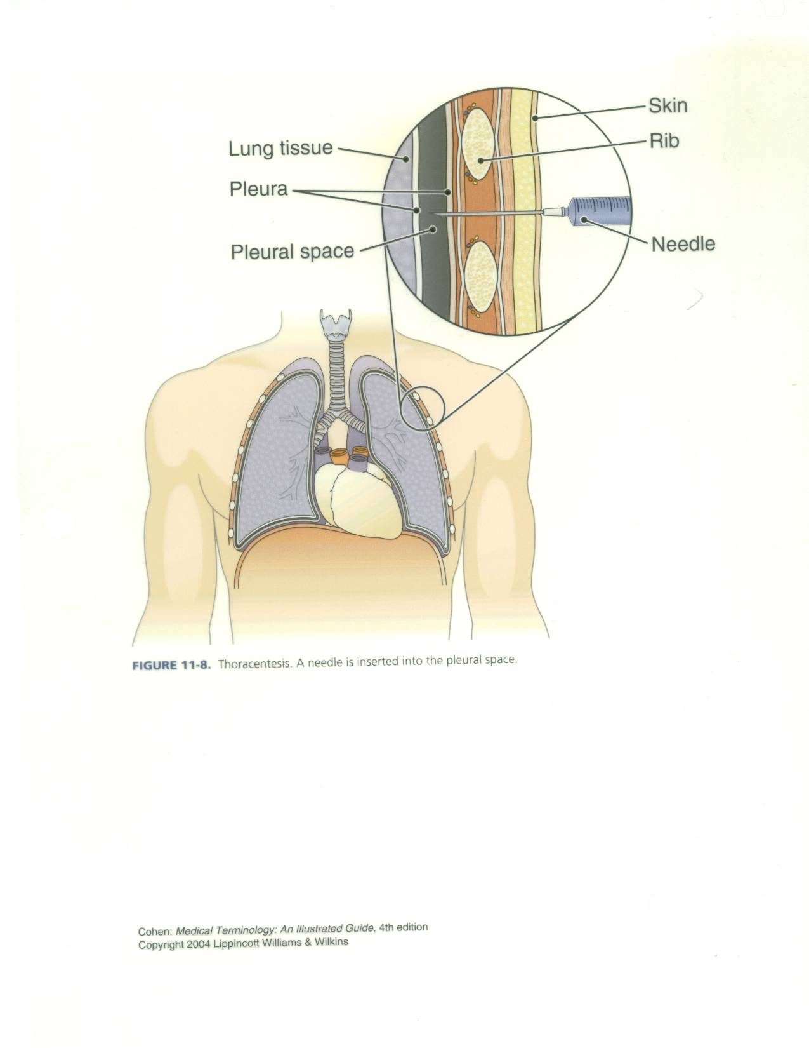

Slide 7
Anatomy & Physiology
of the
Respiratory System

Slide 8
Organs of Respiratory System
Nose
Pharynx
Larynx
Trachea
Lungs

Slide 9
Nose
Lined with goblet cells that produce mucous
Air hits conchae/turbinates and tumbles which allows warming, filtration, and moistening of the air
External nose from face out
Internal nose face back to sinuses
Upper posterior portion of nose lined with receptors for olfactory sense

Slide 10
Pharynx
Starts at back of sinuses to top of larynx
Hallway/Opening/Passageway: where nasal cavity, oral cavity, eustacian tubes, esophagus, and trachea open to
Three sections: Nasopharynx, Oropharynx, Laryngopharynx

Slide 11
Larynx
Voicebox
9 pieces of hyalin cartilage
On top flap called epiglottis
Epiglottis function to protect larynx when swallowing
Epiglottis closed when swallow and open when breath
Vocal cords: False are on top (superior) and True are on bottom (inferior)
Tissue folds made of elastic fibers that produce a sound and change pitch, loudness produced in the resonating chamber called the sinuses

Slide 12
Trachea
Anterior to esophagus
1” diameter and 4 ½” long
Outside of 16-20 C-shaped rings of hyalin cartilage which function to hold trachea open
Between the C’s opening and the esophagus is an open area with the trachealis muscle
This muscle tissue relaxes when swallowing
Passageway for oxygen into the lungs & carbon dioxide out of the lungs
Begins at larynx ends at bifurcation of the bronchi

Slide 13
Primary Bronchi
Trachea branches into right and left primary bronchi
Right larger, wider and shorter than left
Right more vertical than left
Result tend to aspirate things into right bronchi verses left
Right and left (each called a bronchus)
Also transport oxygen and carbon dioxide
Lined with goblet cells that secrete mucus to trap particles in the air we breath
Contain cilia that sweep these trapped particles up and out to be expelled or swallowed
Primary bronchi divide into secondary bronchi each of which goes to its own lobe

Slide 14
Secondary Bronchi/Lobar Bronchi
3 on right
2 on left
Go to respective lobes of lungs:
3 lobes on right and 2 lobes on left
Secondary bronchi divide into tertiary bronchi that supply the lung in segments

Slide 15
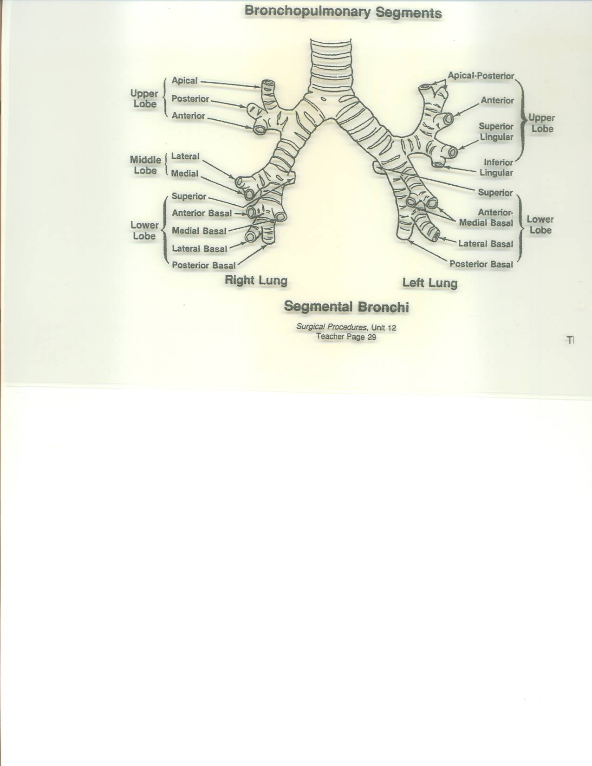

Slide 16
Tertiary Bronchi
Terminal points of tertiary bronchi
End at alveolar ducts, each of which is surrounded by alveoli
Alveoli encased in arteries and veins
Alveoli are where the actual gas exchange takes place (oxygen coming in and carbon dioxide going out)
Total alveoli surface area is actually as large as a tennis court (300 million)

Slide 17
Respiratory System Functions
1. Ventilation
Movement of gas in and out of lungs
Filter, moisten, and warm gases
Inspiration and Expiration

Slide 18
Respiratory System Functions
External Respiration
Movement of gases from lungs to blood and back to lungs
Exchange of gases takes place between alveoli and capillary
Both membranes are thin which allow for great amount of diffusion
Diffusion is movement from greater concentration to lower concentration
Alveoli O₂ level/pressure 105mm/Hg verses capillary O₂ pressure 40 mm/Hg
Alveoli CO₂ pressure 40mm/Hg and capillary CO ₂ pressure 45mm/Hg
So external respiration driven by law of diffusion

Slide 19
Respiratory System Functions
Internal Respiration
Movement of gases from blood to all other tissues and back
3% O₂ dissolved into plasma
97% O₂ picked up by Fe portion of hemoglobin (Hgb) molecule becomes oxyhemoglobin
O₂ released as gets to area or tissue in need and Hgb releases

Slide 20
Respiratory System Functions
Internal Respiration
Movement of gases from blood to all other tissues and back
5-7% CO₂ dissolved in plasma
23-25% CO₂ attaches to protein portion of Hgb becomes carbaminohemoglobin
70% used in buffer system to maintain acid base balance of body

Slide 21
Respiration
4 Functions of :
Provide oxygen to the body tissues and organs
Remove carbon dioxide waste
Maintain homeostasis (acid-base balance) through the oxygen and carbon dioxide exchange
Maintain heat exchange

Slide 22
Control of Respiratory System
Nervous System’s Respiratory Centers
Medulla Oblongata = subconscious
Pons = subconscious
Cerebrum voluntary/conscious =can temporarily over-ride medulla and pons

Slide 23
Regulation of Breathing
Receptors in PNS detecting CO₂ levels not O₂ levels
Chemical receptors in carotid artery and aorta are monitoring your pH blood levels
Lower pH (acidic)= ↑ breathing rate
Higher pH levels (alkaline) = ↓ breathing rate

Slide 24
The Thoracic Cavity
Sternum: xiphoid, body, and manubrium
Ribs: 12 ribs attached to thoracic vertebrae posteriorly
7 true ribs attached to the sternum by coastal cartilage
Next 3 false ribs indirectly are attached to the sternum by costal cartilage
Last 2 false or floating ribs, do not attach to the sternum at all only the thoracic vertebrae

Slide 25
Anatomy & Physiology of the Thoracic Cavity
Mediastinum
Middle of thoracic cavity
Contains esophagus, trachea, heart, and great vessels
Pericardial cavity is where heart actually located
Pleural Cavities
To left and right of mediastinum
Contain the lungs

Slide 26
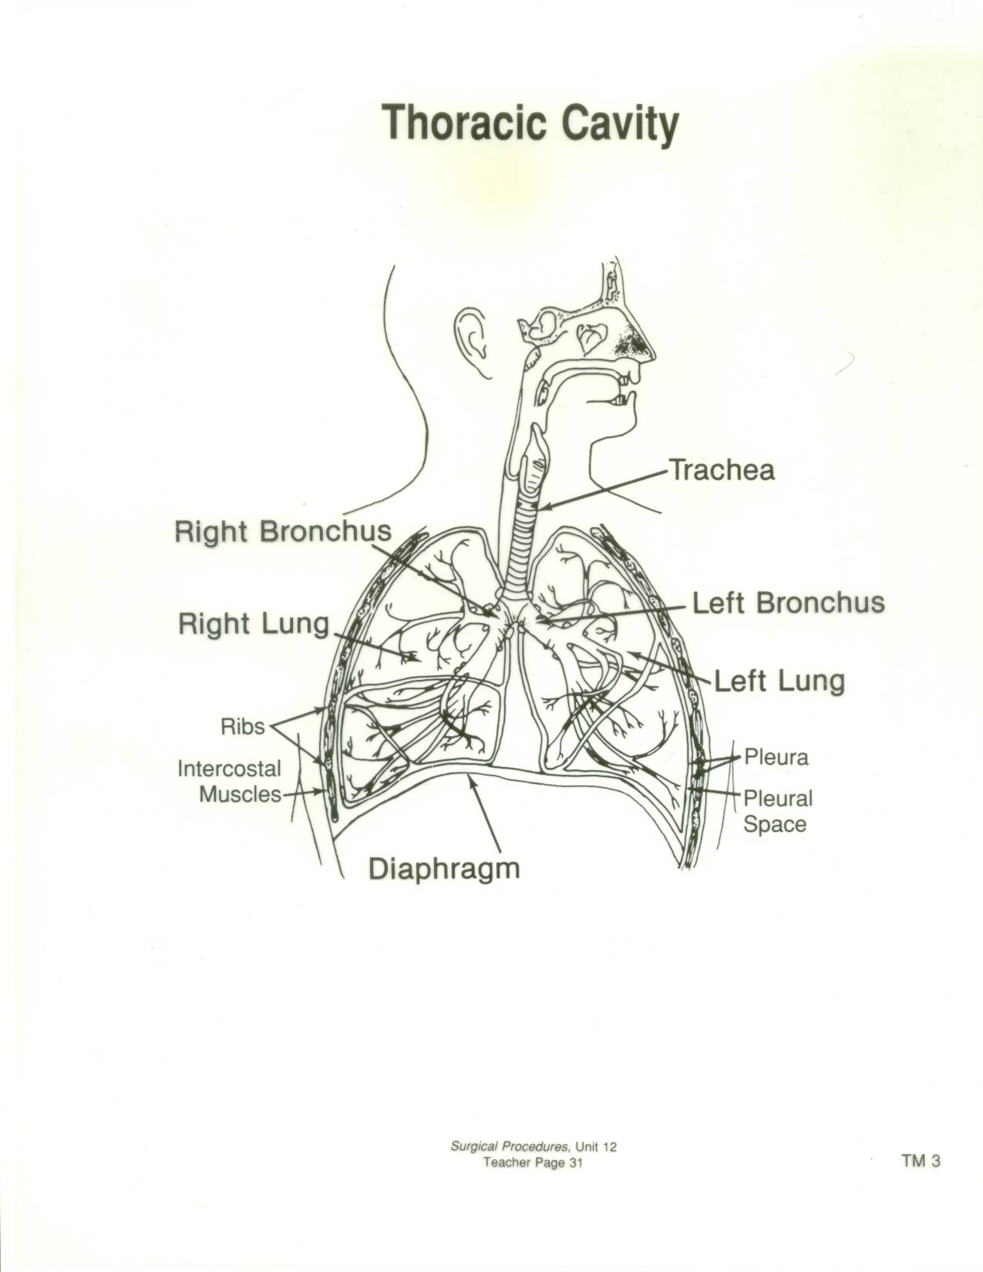

Slide 27
Lungs
Contained in the pleural cavity
Each surrounded by the parietal pleura, a serous membrane lining the chest wall and diaphragm
Potential space between parietal and visceral pleura is the pleural space or intrapleural space
Against the lungs themselves and against the parietal pleura is the visceral pleura, a thin membrane that covers each lung
Beneath the visceral pleura is lung tissue

Slide 28
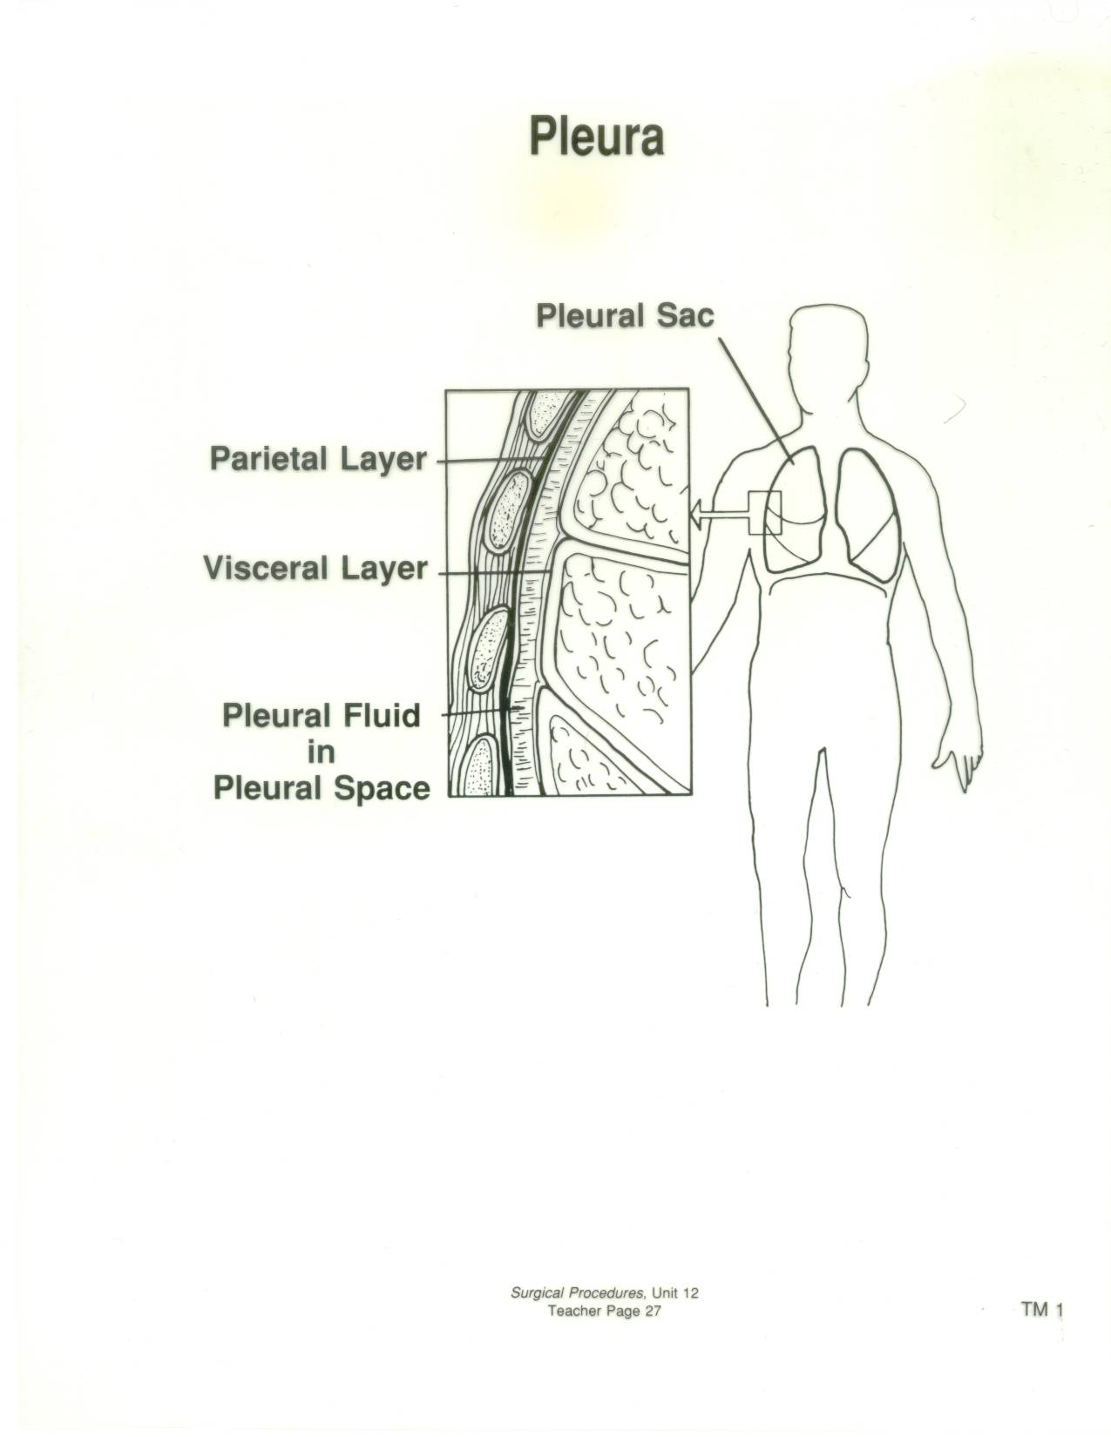

Slide 29
Lungs
Right Lung
Has three lobes (RUL, RML, RLL)
Shorter than left due to liver beneath it
Left Lung
Has two lobes (LUL and LLL)
Longer than right because the heart pushes left
*Apex of the lungs is above the clavicles and the base is resting on the diaphragm

Slide 30
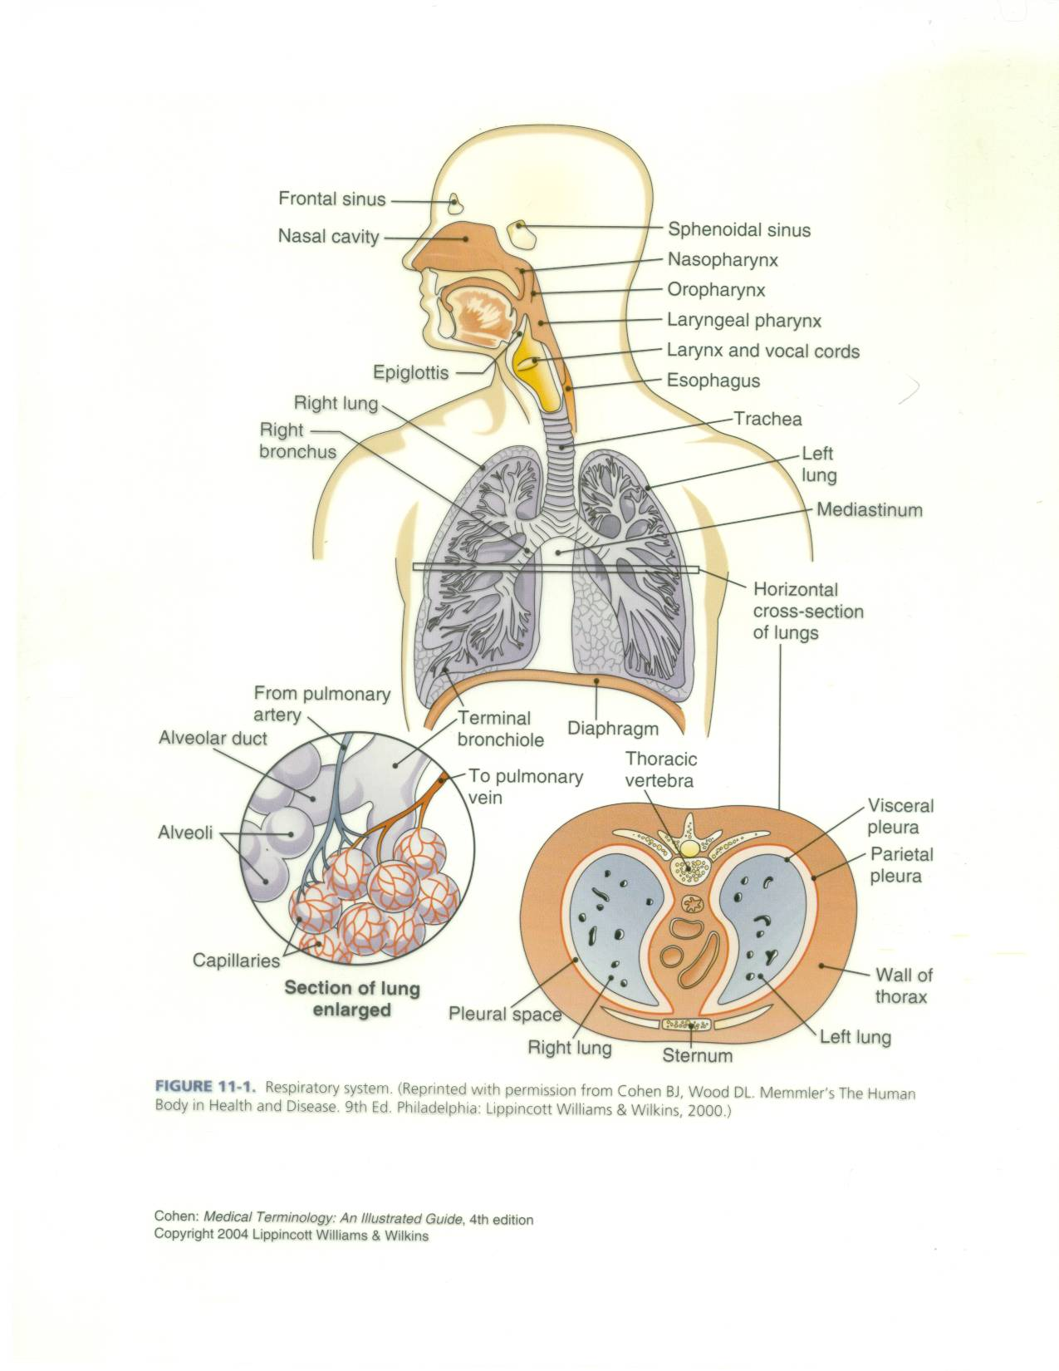

Slide 31
Respiration/Breathing
Inspiration
Passive result of skeletal muscle action
Diaphragm causes the thoracic cavity to increase in size as it descends (contracts)
Diaphragm is the 1˚ muscle responsible for inspiration
External intercostals play a part in inspiration by elevating the ribs
Volume of chest cavity increases and pressure decreases, so air moves in
Atmospheric pressure in chest cavity low, outside is high pressure negative pressure is established
Notes:
Diaphragm 1˚muscle responsible for inspiration

Slide 32
Respiration
Expiration
Passive
As volume decreases pressure increases and air is forced out
Lungs are never completely empty
Positive pressure causes air to come out
Muscles involved in expiration:
Internal intercostal muscles depress the ribs
External oblique depress lower ribs
Abdominus rectus muscles depress ribs and viscera

Slide 33
Boyle’s Law
Respiration is an inverse relationship between pressure and volume
Inspiration=V↑ P↓
Expiration = V↓ P↑

Slide 34
Pathology
Mediastinum
Children: neurogenic (resulting from nervous tissue) tumors
Adults: thymomas ( thymus gland tumor), lymphomas (originating from lymphatic system, can be malignant or benign), and cysts (may be solid or fluid filled)
40% asymptomatic
60% symptomatic (cough, dyspnea, chest pain)
Of 60% that are symptomatic, 60% of those will have a malignant lesion or tumor

Slide 35
Pathology
Lungs
Carcinoma=a new growth or malignant tumor
Lung cancer #1 cause of death r/t cancer
Tumors Divided into 4 Groups:
Small Cell Carcinoma or Oat Cell (malignant)
Large Cell Carcinoma (malignant)
Adenocarcinoma (malignant)
of bronchi = primarily smokers
of bronchioles = 50%smokers & 50%nonsmokers
Squamous Cell Carcinoma (benign) formed from epithelial or squamous cells which line mucous membranes)
90% malignant lung cancers r/t smoking

Slide 36
Pathology
All tumor types with the exception of small cell (oat cell), have a good prognosis with medical and or surgical intervention
Surgical Interventions include:
Wedge/Tumor Resection with margins
Lobectomy
Pneumonectomy
Medical Interventions include:
Chemotherapy
Radiation

Slide 37
Initial Diagnosis
Cytology of sputum sample
Will determine the type of cells that are present in the respiratory system
Will show presence of cancer cells but not where they actually came from in the lungs
Most preliminary of all tests
Chest X-ray must follow to narrow down location of tumor or mass

Slide 38
Initial Diagnosis
Chest X-ray
may be found on routine exam (asymptomatic)
may be ordered after presents with symptoms:
Cough
Bloody sputum (hemoptysis)
Dyspnea

Slide 39
Diagnosis
Cell type determines the course of treatment
Tumors are looked at in terms of “staging”
Staging means,” how developed is the tumor”?
Is it in the lymph nodes, has it metastasized to another area, or is it localized
Staging is accomplished by sending a tissue sample to pathology and having it analyzed for type
Tissue samples are obtained by biopsy
Tissue samples can be of lymph nodes or lung tumor, done with a biopsy needle or actual wedge resections of the lung
Biopsy can be done by laryngoscopy, bronchoscopy or mediastinoscopy

Slide 40
Specimens
Specimens must be handled appropriately
Mishandling could damage a sample causing it to not be analyzable
There are two types of tissue samples in the OR related to node or tissue:
Fresh frozen
Permanent

Slide 41
Specimens
Fresh Frozen
Identifies type of tumor
Determines margins, did you obtain the entire tumor
Will entail a waiting period in the OR until pathology has determined this
Depending on results may have the tumor in its entirety and close or not have it all and will require going in for more tissue
Frozen sent when tumor has not been previously identified by laryngoscopy, bronchoscopy, mediastinoscopy, or needle biopsy

Slide 42
Permanent
Must ID the type of tumor before it can be stained to determine staging
There are different stains required for different types of tumors
Would send a wedge or lobe for permanent if the tumor type had already been identified by a previous biopsy (from mediastinoscopy, bronchoscopy, or needle biopsy)

Slide 43
Specimens
Sometimes may hear send this for Fresh and the doctor will want cytology run
Cytology identifies an infectious process:
Fungal
Bacterial
AFB (acid fast bacillus) checks for TB

Slide 44
Other Diagnostic Tests for Review
CT scan or MRI
Shows location of tumor so that if a thoracotomy is done, the surgeon knows where to operate to excise the lesion

Slide 45
Anesthesia
Local with IV sedation for straight laryngoscopy or bronchoscopy
Mediastinoscopy, tracheotomy, thoracoscopy
General
Epidural catheter may be placed for post-op pain management (thoracoscopy)
May use local injection at wound site at closure to manage post-op pain

Slide 46
Medications
Sterile NS
Sterile water (presence of malignant tumors)
Antibiotic for irrigant
Surgicel, Gelfoam and Thrombin (available)
Avitene (available)
Available for possible open thoracotomy: Bone wax or focal-seal

Slide 47
Preoperative Patient Preparation
Chest X-ray, MRI, and or CT Scans should be in the OR before the patient arrives. They may accompany the patient. They should be displayed in the x-ray box for the surgeon.
Type & Cross should be done in the event that the patient experiences extreme blood loss and needs blood replacement during surgery
These procedures are risky in that large vessels are present in the thorax and mediastinum and could be accidentally injured

Slide 48
Positioning
Mediastinoscopy
Bronchoscopy
Laryngoscopy
Trachestomy
Antero-lateral thoracotomy incision (following + add rolled blanket or sandbag under operative side from scapula to buttocks)
Supine
Arms tucked or on armboards
Shoulder roll
Pillow under knees
Headrest (donut + towels)
Heel protectors
Safety strap

Slide 49
Laryngoscopes
L-shaped – intubation
Flexible – assist with intubation, diagnostic, biopsy
Rigid U-shaped – biopsy, foreign body removal, vocal cord procedures
Notes:
Microlaryngoscopy p.792-794 Alex.

Slide 50
Microlaryngoscopy
Laryngoscopy
Microscope (400mm focal length=40cm focal length)
Microlaryngeal instruments (22cm)
Laser attached to microscope
CO₂ single beam, more precise (used with helium-neon beam to provide red beam for proper aiming)
Vocal cord, tracheal, bronchial lesions
Nd: YAG Laser tracheal or bronchial lesions
Notes:
Focal length=distance from lens to working area=clear visualization

Slide 51
Supplies, Instrumentation, Equipment
Bronchoscopy
Flexible or rigid bronchoscope
ET tube adaptor
Biopsy forceps (flexible or rigid)
Light source
Light cable (fiberoptic)
Gown, gloves
Suction tip and tubing
Sponges
K-Y jelly or other water soluble lubricant
Basin with saline or water
May be a Bronch Cart available with first five listed supplies

Slide 52
Bronchoscopes
Flexible
Rigid (preferred for foreign body removal)
Longer than laryngoscopes
Adaptor required for oxygenation
Nd: YAG (prn)

Slide 53
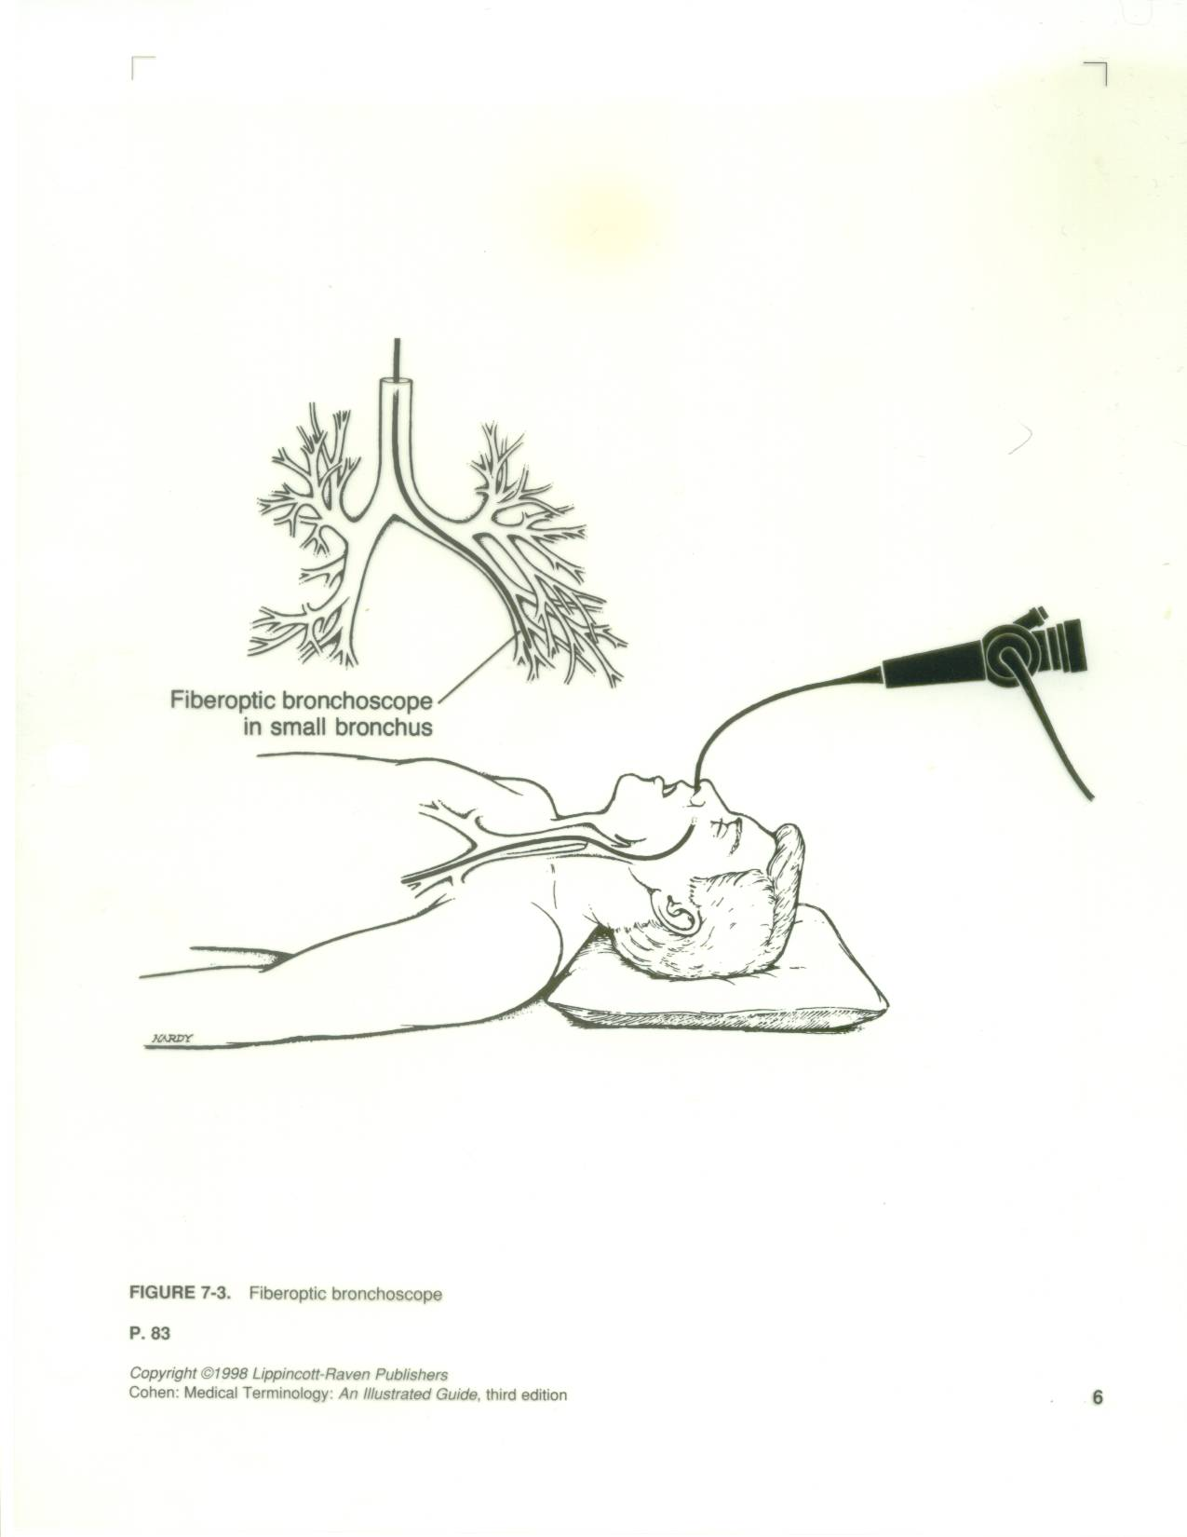

Slide 54
Procedure
Bronchoscopy (clean procedure)
Scope should be sterile (per institutional method)
Prepare scope (lubricate if surgeon preference attach light source)
Give surgeon adaptor for ET tube, pass bronchoscope
Pass biopsy forceps prn
Prepare to collect tissue samples on telfa (cut into small squares)
Identify with surgeon to communicate with circulator for proper labeling and containing so it can be sent to the lab correctly

Slide 55
For cytology washings
Attach sputum trap
Surgeon will irrigate through the port on the scope with a 10 to 30cc syringe filled with NS
Pass to nurse clearly identifying the source and type of cytology requested by the surgeon
Remove scope
Clean per institutional policy
See pg 1060 Alexander’s

Slide 56
Positioning
Mediastinoscopy
Supine
Pillow or donut under head
Arms tucked or on armboards
Pillow under knees
Shoulder roll optional (surgeon preference)
Heel protectors
Safety strap

Slide 57
Prepping and Draping
Mediastinoscopy:
Prep from incision site and out in a circle, usually prep upper chest and anterior shoulders
Towels x 4, drying towel, Ioban, pediatric laparotomy sheet or thyroid sheet

Slide 58
Supplies, Instrumentation, Equipment
Mediastinoscopy
Mediastinoscope
Light cord (fiberoptic)
Light source
Suction tip and tubing
Biopsy forceps
Grasping forceps
Clip applier
ECU with special bovie tip
Minor instrument tray
Raytex
Telfa
Biopsy needle
Towels
Pediatric lap sheet or a thyroid sheet

Slide 59
Procedure
Mediastinoscopy (sterile procedure)
Pass off bovie, suction tubing, light cord, & camera cord to circulator
Raytex up
Knife or scalpel to surgeon (incision made 2 cm above suprasternal notch)
Cautery (may use bovie or knife or finger to create opening in trachea)
Mediastinoscope (requires assembly when setting up: attach light cord, light carriers, camera)
*Practice light cord safety/attach to mediastinoscope ASAP Circulator should pay attention, but it is your responsibility too!

Slide 60
Procedure
Mediastinoscopy
Pass biopsy needle with syringe attached (10-30cc)
This is so the surgeon can aspirate before he pulls out a tissue sample
Checking for air or blood
Getting blood back, especially bright red blood indicates arterial blood
(Be prepared to open the sternum - need sternal saw available
Pass biopsy forceps (be prepared to collect specimen on a small piece of telfa)
Have several pieces of telfa available-may send several specimens
Make certain these go for frozen unless the surgeon tells you otherwise
You are getting a preliminary node and tissue analysis that may lead to medical or further surgical intervention

Slide 61
Procedure
Mediastinoscopy
Scope removed upon completion of biopsies
Wound closed with a 3-0 absorbable suture (Vicryl) on a tapered needle (SH)
Skin closed with 4-0 absorbable suture on a small cutting needle (PS-2)
Dressing applied (telfa, tegaderm)
Disassemble mediastinoscope handling carefully and clean per institutional policy
See pg 1064 Alexanders

Slide 62
Indications For Tracheotomy or Tracheostomy
Vocal cord paralysis
Neck surgery
Trauma
Prolonged intubation
Secretion management
Cannot intubate
Stridor due to tracheal blockage
Sleep apnea

Slide 63
Tracheotomy/Tracheostomy
Tracheotomy temporary opening into the trachea to facilitate breathing
Tracheostomy permanent opening of the trachea and creation of a tracheal stoma
Must place tracheal tube with either
Patient will be hooked up to a ventilator
Long term tracheostomy may eventually be able to ween off ventilator, but maintain stoma that will function as their nose did prior to surgery

Slide 64
Positioning
Thoracoscopy or Thoracotomy
For talc pleurodesis, decortication, wedge resection, lobectomy, pneumonectomy
Full postero-lateral position
Operative side up
Vacuum-bag/beanbag under draw-sheet (surgeon preference)
Axillary roll prevents brachial plexus damage
Down arm on armboard
Up arm on padded mayo or airplane sling device
Pillow under head
Pillows x 2 between knees (protects peroneal nerve) and feet
Foam pad under down leg
Safety strap and adhesive tape across pelvic girdle and shoulders for stabilization

Slide 65
CHEST TUBE INSERTION “Thoracostomy”
Review of Normal Lung Function
Negative intrathoracic pressure and elasticity are required
Requires intact pleural cavity and intact visceral pleura

Slide 66
Chest Tube Insertion “Thorocostomy”
Disruption of Normal Lung Function
1. PNEUMOTHORAX
Interference with the negative intrathoracic pressure
Air in the pleural space or visceral pleura causes partial lung collapse
The air takes up the space the lung needs to expand
Requires chest tube placement to re-establish negative pressure and intactness
Cause: trauma (blunt or penetrating), tear or perforation in the visceral lining
Tear may result from an emphysematous bleb or lung abscess

Slide 67
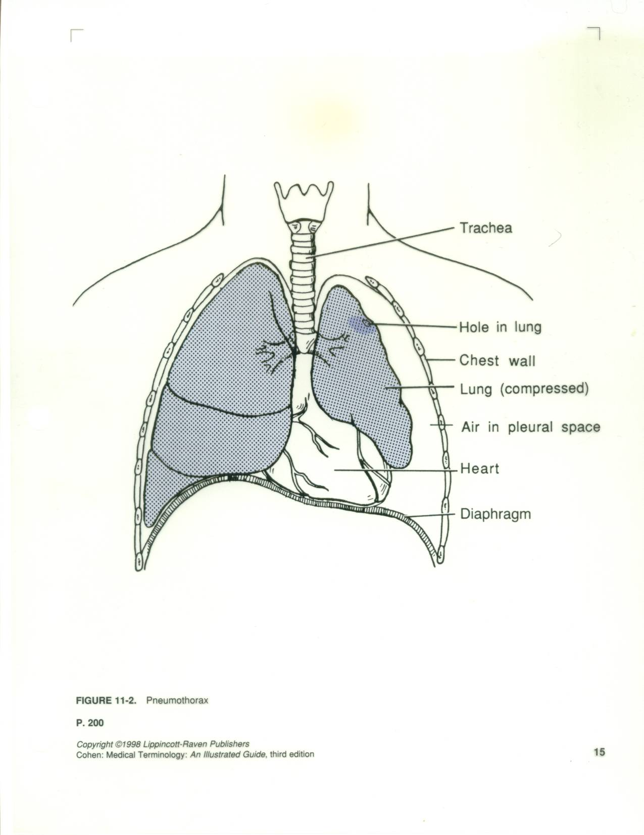

Slide 68
CHEST TUBE INSERTION “Thoracostomy”
Disruption of Normal Lung Function
2. Open Pneumothorax
Large penetrating wound
Cover wound with vaseline dressing
Insert chest tube
3. Tension Pneumothorax
Air coming out of bronchus into pleural space and can’t get back out
Requires decompression with a large needle and chest tube insertion
Urgent Intervention required due to potential shift that could affect the opposite lung and heart (death)

Slide 69
Chest Tube Insertion “Thoracostomy”
Disruption of Normal Lung Function
4. Hemothorax
Blood from small vessel rupture is leaking out into the pleural space
Causes: pneumonia
TB
malignancy

Slide 70
Chest Tube Insertion “Thoracostomy”
Prepping/Draping
Pre-existing chest wound /work around site and prep wound last (avoids further infection)
Non-pre-existing wound prep site of chest tube first and work around (remember prep axilla last if prepping that far out)
Towels x 4, laparotomy sheet, or universal sheet
In emergency may only use towels
In emergency may just pour anti-bacterial onto chest and GO

Slide 71
Chest Tube Insertion “Thoracostomy”
Procedure
Knife
Bovie
Long kelly or tonsil
Chest tube
Heavy Silk (#1) on a cutting needle (are free-eyed needles)
Cut chest tube to protrude about 4” attach to pleurevac with suction attached
Band connection or tape
Apply gauze dressing or drain sponge and tape

Slide 72
Chest Tube Insertion “Thoracostomy”
Chest Drainage System/Pleurevac
Provides way for blood, fluid, or air to drain from the mediastinal or pleural cavities re-establishing negative pressure
Drainage system work 3 ways:
positive expiratory pressure
suction
gravity or water seal

Slide 73
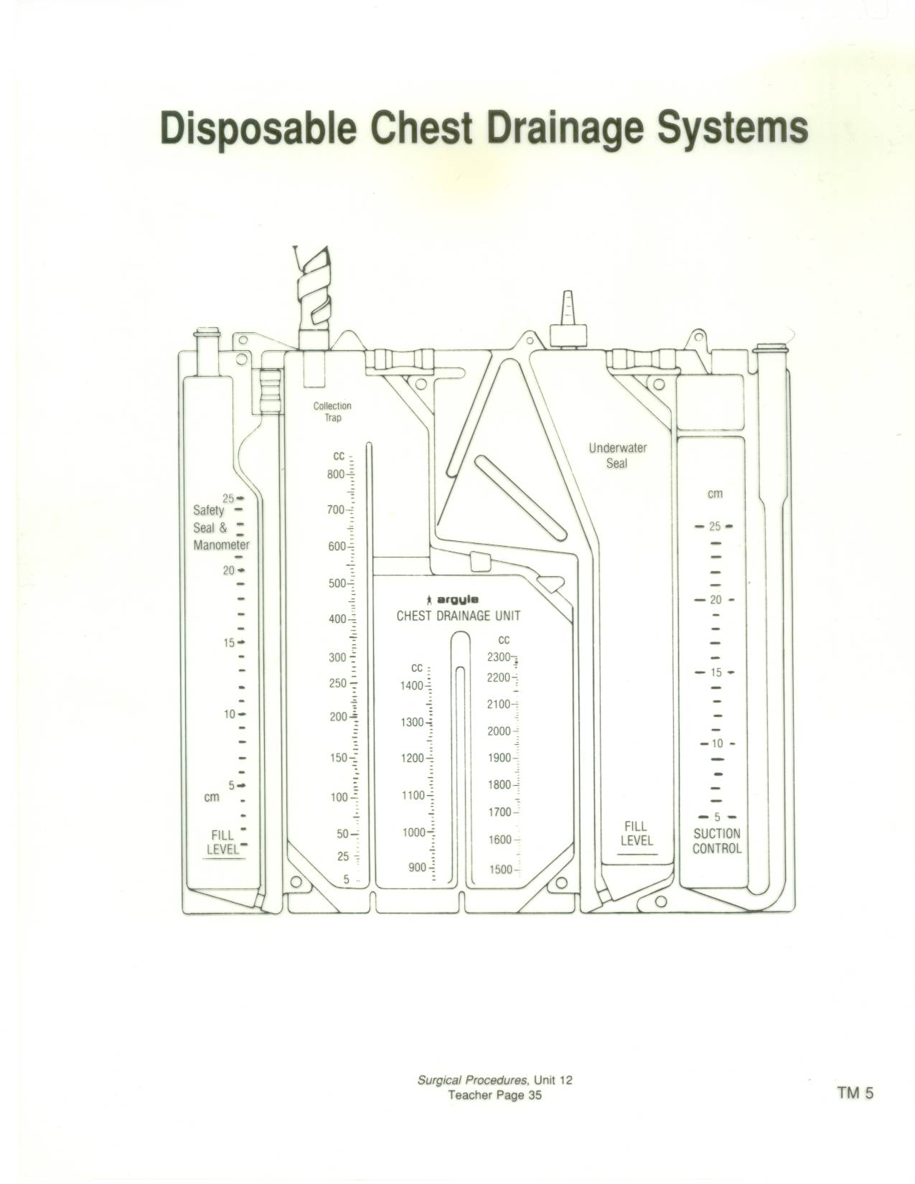

Slide 74
Chest Tube Insertion “Thoracostomy”
Keep drainage system or pleurevac below the patient’s body
Must be kept sterile
Are usually taken out in 3-7 days depending on the reason they were placed

Slide 75
Thoracoscopy
Visualization of the thoracic cavity by a thoracoscope
Used to obtain/evaluate biopsies, take wedge resections, and administer talc pleuredesis
*Talc Pleuredesis (tx. for spontaneous bleb rupture)
Consent will have most often have “thoracoscopy possible thoracotomy” in event larger incision is needed based on biopsy results and visibility
Will need to have instrumentation for a thoracotomy on field

Slide 76
Thoracoscopy
Supplies
Laparotomy sheet or universal sheets
Gowns, gloves
Minor or major basin set
Blades #10 and #15
Bovie
Chest tubes (surgeon preference) & Pleurevac
FRED or anti-fog
Scope warmer (place raytex in bottom to prevent scope damage/tell circulator it is in there)
Trocar
Insufflation tubing (available)
Warm saline on field and in scope warmer
Raytex
Bovie
Suction (sigmoid suction tip)
Closing suture (vicryl 2-0 CT-2 and 4-0 PS-2)
Endoscopic staplers (variety)
Dressing post final counts

Slide 77
Thoracoscopy
Instrumentation
0° or 30° scope
Camera
Light cord
Endoscopic instrument set (graspers, scissors, bovie, clip appliers)
CV Tray or Major Tray
Chest Tray
Pilling lung clamp tray available
Long instrument set available

Slide 78
Thoracoscopy
Equipment
ECU
Suction
Bair Hugger (lower body)
Light source/Camera box
Video monitor
Thorax cannot be insufflated
Double lumen ET tube allows for single lung ventilation and collapse of affected lung
Defibrillator (available)

Slide 79
Thoracoscopy
Prepping and Draping
Begin at incision site and work outward in a circular motion (axilla last)
Towels x 4 or 5
Drying towels
Ioban
Laparotomy sheet or universal drapes

Slide 80
Thoracoscopy
Procedure
Pass off bovie, suction, light cord, and camera cord
Knife
Bovie
Incisions x two or three
Kelly or metz to open intercostal space
Trocar (keep obturator available)
Scope
Trocar for manipulating device such as forceps, long pilling lung clamps
Endoscopic staplers as requested as well as reloads
Biopsy needle or culture swab as needed
Talc available if pleuradesis
Rough bovie pad cut and on a long sponge stick or pilling lung clamp

Slide 81
Thoracoscopy
Chest tubes (x 1 or 2) surgeon preference on size and type {come straight and right angled} Sizes #10F through 36F
Sew in chest tubes with #1 silk on a cutting needle
Close with 2-0 Vicryl taper CT-2 and 4-0 cutting PS-2
Dress per surgeon preference
Keep table sterile until all frozen results back and patient ready to transport (r/o thoracotomy)

Slide 82
*Decortication (removal of exudate or scarring)
Scarring interfering with normal respiration
Generally due to infectious process (ex. pneumonia)
Also called “membrane peel”
If extensive will have to open = “thoracotomy”

Slide 83
Post-operative Considerations
Connect chest tube immediately to prevent clot formation in the tube or pneumothorax
Make sure chest tube attached securely so it does not come undone

Slide 84
Possible Complications
Atelectasis
Pneumonia
Respiratory insufficiency
Pneumothorax
Hemorrhage
Pulmonary embolus
Mediastinal shift
Acute pulmonary edema
Infection

Slide 85
Prognosis
Depends on patient’s post-operative status and the pathological process
Malignancies that have not progressed into the lymph nodes (negative nodes) have good prognosis with tumor removal
May undergo chemotherapy or radiation post-operatively

Slide 86
Summary
Anatomy & Physiology
Pathology
Diagnosis
Anesthesia
Medications
Patient preparation
Positioning
Supplies, Instruments, Equipment
Prepping and Draping
Procedures: Laryngoscopy, Bronchoscopy, Mediastinoscopy, Tracheotomy, Thoracostomy & Thoracoscopy
Post-operative Considerations/Complications

